Slide 1
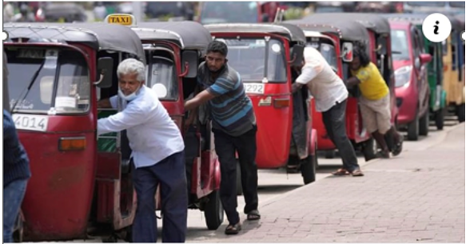
PACIFIC ISLANDS EMOBILITY WORKSHOP
Suva, Fiji: 28 – 30 November 2022
“SETTING THE SCENE”
Solomone Fifita, Manager, PCREEE

Slide 2
…. regional e-mobility policy document
……. regional e-mobility program to address existing barriers
…… promote SIDS-SIDS cooperation
Three Reports: Technical Background, Regional Policy & Regional Programme
https://www.pcreee.org/event/online-validation-regional-e-mobility-policy-and-program-pacific-islands

Slide 3
The regional e-mobility readiness programme
Objective: PICTs are best prepared for their respective sustainable mobility futures….
Output 1: Central Policy and Administration
Output 2: Standards and Guidelines
Output 3: Awareness and Promotion
Output 4: Demonstration and Upscale
Promotes SIDS-SIDS cooperation under the umbrella of the GN-SEC - https://www.gn-sec.net/
RE&EE For Sustainable Mobility in the PCREEE Business Plan & in the FESRIP too

Slide 4
2030 & 2050 Regional e-mobility targets
 | Proposed 2030 Regional E-Mobility Target | Proposed 2050 Regional E-Mobility Target
1. | 10 different models of manufacturer-supported, mainstream EVs are available in the marketplace. | Services provided by EVs are an integral and significant component of transport within the region and include single-person electrically assisted mobility options through to electric aircraft, trucks, buses and boats.
2. | Battery swapping for low-voltage mobility use is available on a commercial scale in the marketplace.
3. | There is good public awareness of EVs.
4. | 50% of all mainstream EVs are charged through devices that are managed-charging enabled. | 90% of all mainstream EVs are charged through devices that are managed-charging enabled.

Slide 5
4th PETMM Pacific Energy Officials Meeting: 5 – 7 July
Acknowledged the progress in the roll out of the regional e-mobility program by SPC/PCREEE in collaboration with various development partners including ADB, GGGI, NREL, UNIDO, PRIF, PPA, World Bank, and UNESCAP.
Supported the convening of an in-person meeting to discuss the coordination of the EV developments in the PICTs and the early adoption of EV policies, standards, and roadmaps at the national level to guide and facilitate the transformation in the energy and transport sectors.

Slide 6
THE WORKSHOP PROGRAMME – DAY 1 Theme: The potential role of e-mobility on the PICs’ energy security and climate ambitions
Session 1: Sustainable Mobility and the PICs Energy and Climate commitments
Global – COP, SDGs, etc
Regional – NDC Hub & Maritime Energy Officials meeting
Regional / Sub-regional – RMI, USP MCST
National

Slide 7
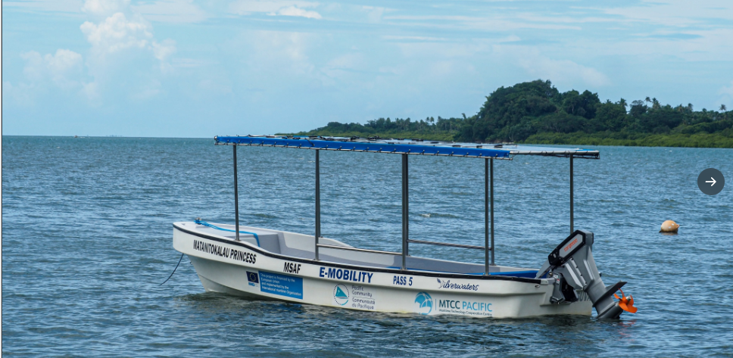
THE WORKSHOP PROGRAMME – DAY 1 Theme: The potential role of e-mobility on the PICs’ energy security and climate ambitions
Session 2: Framework for Regional Transport Services

Slide 8
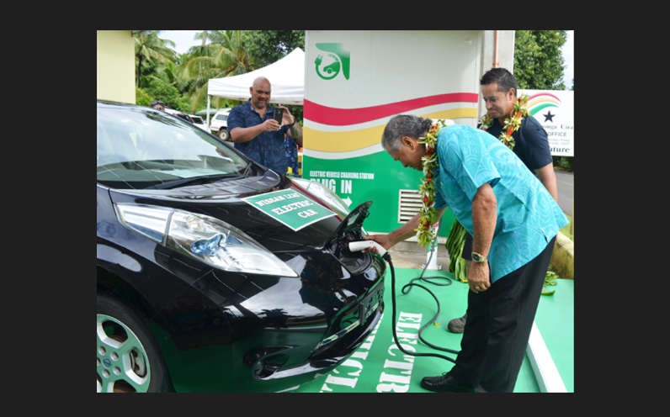
THE WORKSHOP PROGRAMME – DAY 1 Theme: The potential role of e-mobility on the PICs’ energy security and climate ambitions
Session 4: Perspectives and experiences on e-mobility
Power Utilities
Regulator
Transport
Energy Office
Investor
Development Partner
Industry??

Slide 9
THE WORKSHOP PROGRAMME – DAY 1 Theme: The potential role of e-mobility on the PICs’ energy security and climate ambitions
Session 3: Sharing experiences with emobility in SIDS and Beyond
Carribbean
Asia
Europe
NZ

Slide 10
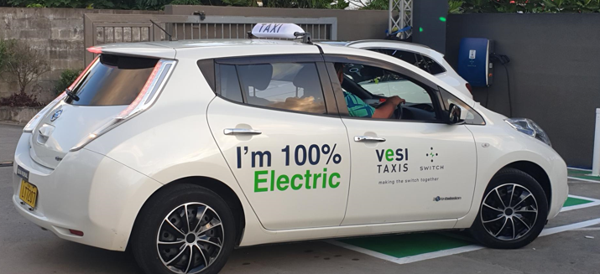
THE WORKSHOP PROGRAMME – DAY 2 Theme: Building back better stronger and better with e-mobility
Session 5 - Investing in e-mobility
Session 6 – E-mobility policy, roadmaps and frameworks
Session 7 – Draft e-mobility standards and guidelines

Slide 11
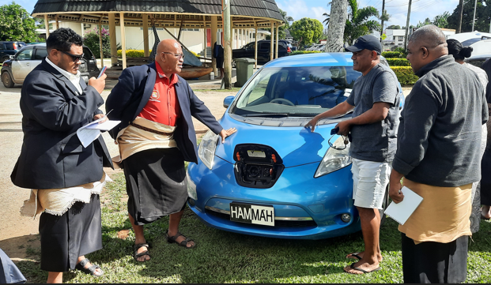
THE WORKSHOP PROGRAMME – DAY 3 Theme: Moving forward cooperatively and cohesively
Session 8 – A consultative and coordination mechanism for e-mobility
Session 9 – Key messages for the Energy and Transport Ministers Meeting
Session 10 – Site Visits

Slide 12
MALO ‘AUPITO

