Slide 1
Pacific Regional Capacity Building Energy Audit & Energy Management Country Presentation 27th Feb – 3rd Mar 2023
National Energy Office
Ministry of Environment
Republic of the Marshall Islands

Slide 2
Introduction
RMI consists of 29 atolls & 5 Islands
Land area of 181.43km²
Water area of ALOT
Pop. of apx. 45,000
Language: Marshallese & English (Official)
Parliamentary Republic

Slide 4
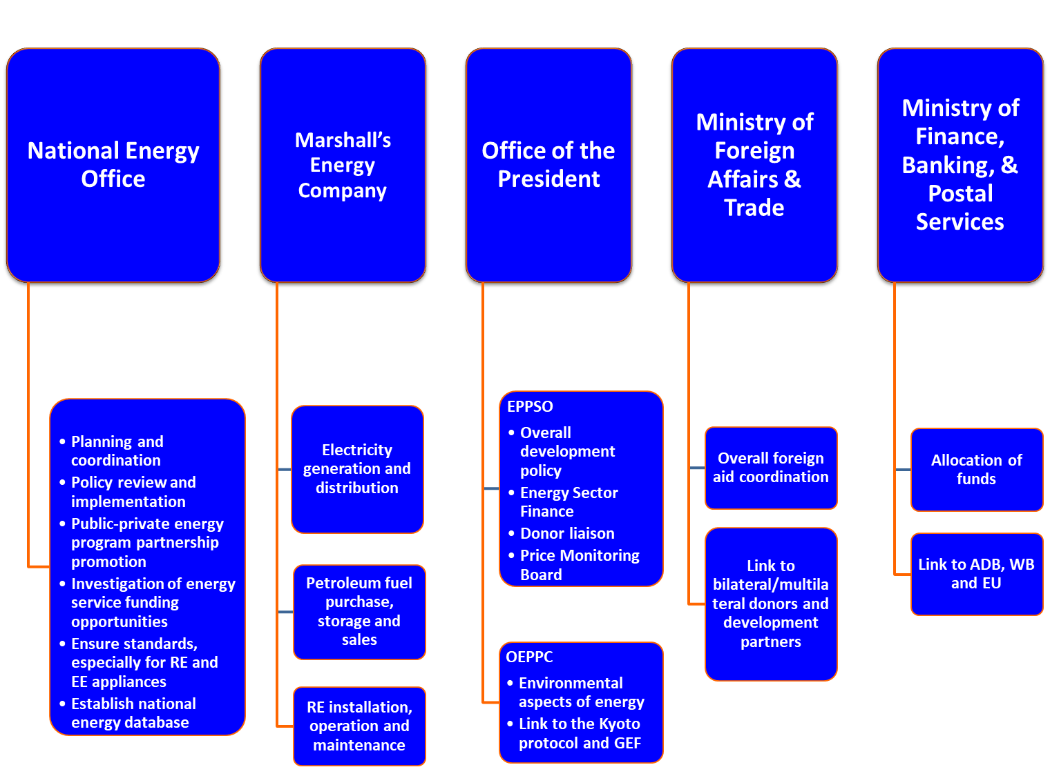

Slide 5
Policies / Legislations / Regulations on Energy Efficiency, Energy Conservation and Energy Management
National Energy Policy & Energy Action plan – overdue for revision and update
Nationally Determined Contributions
National Electricity Roadmap, 2018
National Energy Office Act, 2018
National Energy Act – in progress
National Building Code – in progress
Amended Import Duties Act, 2019
Notes:
National Energy Policy (2016) & Energy Action Plan
Nationally Determined Contributions, which the RMI had submitted their first NDCs in 2016 and SECOND NDCs in 2018.
The National Electricity Road map paves the way for RMI to reach their NDCs by focusing on the following pillars; Technology, Financing, and Human Resources.
In the Roadmap, it was recognized that the Energy Planning Division needed more bite to its bark, hence recommending that EPD become a bonafide office with some power in terms of creating policies and regulations and reforming them.
National Energy Bill provides the regulations for standardizing equipment and improving policies in terms of energy management and efficiencies.
National Building Code
Import duties act, tax exemption on energy-efficient products, with energy star label or equivalent. Also applies for electric cars.

Slide 6
Progress & Achievements for the Last 3 Years (on EE & EA Initiatives)
World Bank – SEDeP Project
Energy Efficiency
RE Investments
Efficiency improvements for utilities (retrofitting)
Technical Assistance & capacity building

Slide 7
Progress & Achievements for the Last 3 Years (on EE & EA Initiatives)
ROC Taiwan-RMI Solar Car Park – Majuro Hospital
68kW Solar System with battery – Off-grid
Reduce energy consumption from the grid

Slide 8
Progress & Achievements for the Last 3 Years (on EE & EA Initiatives)
GEF7 – Marshall Island’s Building EE Project
Enabling activities and policies for EE in RMI Buildings
Improvements in Govt. and public buildings in RMI
Monitoring and evaluation, and knowledge management

Slide 9
Progress & Achievements for the Last 3 Years (on EE & EA Initiatives)
ICDF – ROC Taiwan Development Financing
Provisions of funds through Marshall Island’s Development Bank
Energy Efficiency improvements
Solar PV Energy System

Slide 10
Progress & Achievements for the Last 3 Years (on EE & EA Initiatives)
Energy Audits – MICNGO’s Energy (EU-EDF11)
Marshall Island’s Council of Non-Governmental Organizations Project
Conducted energy audits
NGOs
Government
Schools
Utilities
Churches

Slide 11
Challenges & Opportunities Encountered
Challenges
Opportunities
Policies & regulations
Lack of capacity
Inflation
Community involvement
Financing
Develop policies & regulations
Building Capacity
Financing opportunities
Awareness on a community scale

Slide 12
Plans for 2023 – 2030 (Recommendations & Way forward)
Energy bill passed and endorsed
Petroleum Act
RMI building code passed and endorsed
Implement Electricity Roadmap
Implement the Human Resource strategy of the Roadmap
Look out for other funding opportunities

Slide 13
Koṃṃool tata! Thank you!
Website: Electricity Roadmap
www.rmienergyfuture.org

