Slide 1
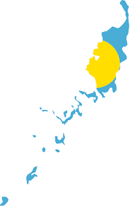
Pacific Regional Capacity Building Energy Audit & Energy Management (Palau)
Palau Energy & Water Administration
Ministry of Finance
Republic of Palau
27th Feb – 3rd Mar 2023

Slide 2
Introduction / Policies / Legislations / Regulations
Palau Energy and Water Administration (PEWA)
RPPL No. 11-18 (Approved March 2022)
Oversight electricity, water, and wastewater sectors
Key regulatory functions:
Review sector plans
Integrate RE and energy efficiency into mainstream energy policy
EE Regulations: Not available
PEWA is relatively young in terms of operations
Lack of sufficient data

Slide 3
Challenges & Opportunities Encountered
Challenges, PEWA
1. Organizational Challenges
2. Staff Capacity Challenges
Vacancies:
Water/Wastewater Engineer
Energy Engineer
Tariff Financial Expert
Opportunities Encountered
Extremely high dependence from imported fuels,
Energy sector collaboration:
Bi-lateral dialogues / agreements
External parties / countries / institutions expression of interests in developing Palau’s Energy Sector, with focus on renewable energy pathways.

Slide 4
Plans / Regulations 2023 - beyond
Determine Palau’s NDC status
Emissions reduction target of 22% in the energy sector
45% Renewable Energy (RE) share in electricity generation by 2025
35% Energy Efficiency (EE) targets by 2025
Address risk of climate change
Development of PEWA Regulations
-Energy sector
-Water sector

Slide 5
Recommendations & Way Forward
Capacity building efforts (TA) needed at all organization levels
-Energy Audit (including determining NDC status)
-Tariff Setting
Deploy business analytical tools to assist regulatory agency:
-Energy Management
-Energy Security at Utilities Level
Support on Renewable Energy Pathways

Slide 6
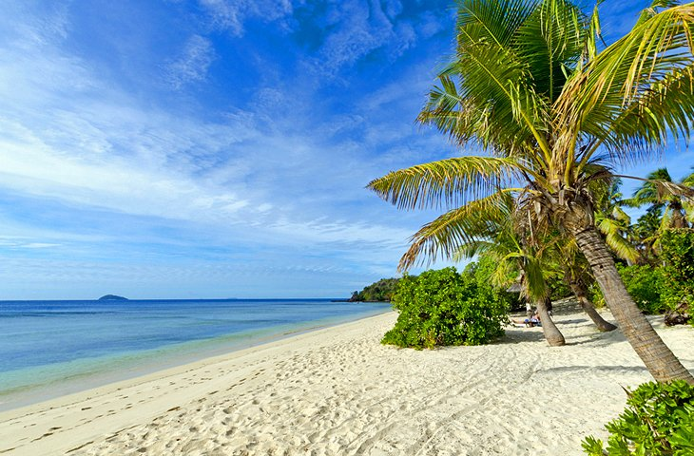
Vinaka!
Thank You!
Sulang!

