Slide 1
Electrician License/electrical contractors' requirement and business opportunities for Electrical contractors
Kiribati Energy Act 2022
Electricity Code of Practice

Slide 2
Content
Electrician License types
Electrical contractor registration
Electrician License requirement
Electrical contractor registration requirement
Electrical License & Registration Certificate
EPD license application assessment
Business opportunities for electrical contractors

Slide 3
Electrician License type
Electrician license A - This license allows the holder to work on any electrical installation (high voltage) involving the running, laying, fixing, or installation of wire. Low Voltage such as security system, fire alarms, and communication systems. The holder of the same license can also apply for wiring permit for residential, and commercial building.
The License A is appropriate for the following.
Government Electricians
SOE’s Electricians / industries
Private Business electricians / NGO’s
Electrical Contractors (will also apply for electrical contractor registration certificate & should not be a government civil servant)
Personal use – ( for private electrical installation only & can’t use in any electrical contractor work unless he/she have registered as an electrician contractor)

Slide 4
Electrician License type
2. Electrician License B (similar to Journeyman Electrician Licence) -This license allows the holder to work as an electrician under the supervision of an Electrician License A.
License B is appropriate for the following.
a. Government Electricians (new recruited electricians, junior electricians)
b. SOE’s Electricians (new recruited electricians, junior electricians)
c. Private Business electricians (assistance electricians)
d. Electrician working under the supervision of an Electrical contractors.
e. New graduate from KIT working in any electrical industry

Slide 5
Electrical Contractor Registration
Electrician Contractor Registration – The registration will allow the holder of license A type only to run an electrical contracting business and supervise other electricians.
The Electrician contractor registration is applicable for the following:
Must be a holder for a valid license “A”
Must have a list of licensed employees (License B type)
Must have a current Trade & Business License (Business registration with MTCIC)

Slide 6
Electrician License requirement
License A requirement
Minimum qualification – Electrical Trade Certificate two from recognise institution (regional & international institution)
Experience – minimum of 5 years working experience in the electrical filed (must provide supporting documents)
A copy of Birth Certificated is required
A copy of Medical Clearance is required

Slide 7
Electrician License requirement Cont…..
License B requirement
Minimum qualification – Electrical Trade Certificate from recognise institution
Experience – minimum of one years working experience in the electrical filed (must provide supporting documents)
A copy of Birth Certificated is required
A copy of Medical Clearance is required

Slide 8
Electrical contractor registration
Registration requirement
Provide a cover letter explaining to the Energy Planning Division (EPD) why you should be considered for an Electrical Contractor’s license
Must hold a valid license A type
Provide a list of licensed employees and their license number (license A or B)
Provide a copy of current trade & business license
Must provide two personal reference letters from an architect or general contractor that has a trade & business license.

Slide 9
MINISTRY OF INFRASTRUCTURE & SUSTAINABLE ENERGY BOTAKI IBUKIN MWAKURIAN KATEITEIAO KATEIMATOAN KORAKORA ELECTRICIAN LICINCE TYPE “A”
This licence entitles …………………………………………………………………….
of …………………………………to supervise or carry out electrical work subject to the provisions of the Energy Act 2022 and Electricity Regulations.
Date of Issue: ………………. Place of Issue: …………………..
License No: ………………… Expiry date: …………………….
…………………… ………………………..
Electrical contractor Energy Planning Division
(Signature) (Signature with official stamp)

Slide 10
MINISTRY OF INFRASTRUCTURE & SUSTAINABLE ENERGY BOTAKI IBUKIN MWAKURIAN KATEITEIAO KATEIMATOAN KORAKORA ELECTRICIAN LICINCE TYPE “B”
This licence entitles …………………………………………………………………….
of …………………………………to work carry out electrical work subject to the provisions of the Energy Act 2022 and Electricity Regulations.
Date of Issue: ………………. Place of Issue: …………………..
License No: ………………… Expiry date: …………………….
…………………… ………………………..
Electrical contractor Energy Planning Division
(Signature) (Signature with official stamp)

Slide 11
MINISTRY OF INFRASTRUCTURE & SUSTAINABLE ENERGY BOTAKI IBUKIN MWAKURIAN KATEITEIAO KATEIMATOAN KORAKORA ELECTRICAL CONTRACTOR
This Registration Certificate is issued to ….………………………………………….
Residing at ………………………………… an Electrical Contractor, under the terms and provisions of the Energy Act 2022 and Electricity Regulations.
Date of Issue: ………………. Place of Issue: …………………..
License No: ………………… Expiry date: …………………….
………………………… ............................................
Electrical contractor Energy Planning Division
(Signature) (Signature with official stamp)

Slide 12
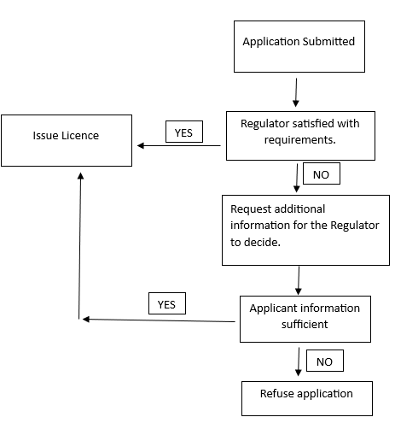
EPD license application assessment

Slide 13
Business opportunities for electrical contractors
Residential Electrical Services:
Offer Electrical services to homeowners, including electrical repairs, upgrades, installations, and wiring for new construction or remodeling projects.
Commercial and industrial Electrical Services:
Target commercial and industrial clients by providing electrical solutions for businesses, offices, factories, warehouses, and other commercial establishment.

Slide 14
Business opportunities for electrical contractors cont…..
Energy Efficiency Upgrades:
With the growing awareness of energy conservation, consider offering energy efficiency upgrades like LED lighting installation, air conditioning, or smart home integration.
Maintenance Contracts:
Establish ongoing maintenance contracts with clients, providing routine electrical inspection, testing, and maintenance services.

Slide 15
Business opportunities for electrical contractors Cont…..
Specialty services:
Consider specializing in niche areas such as home automation systems, home theater installations, and renewable energy installation.
Emergency Services:
Offer 24/7 emergency electrical services to quickly respond to electrical failure or accidents, which can be a lucrative business venture.

Slide 16
Kam Rabwa

