Slide 1


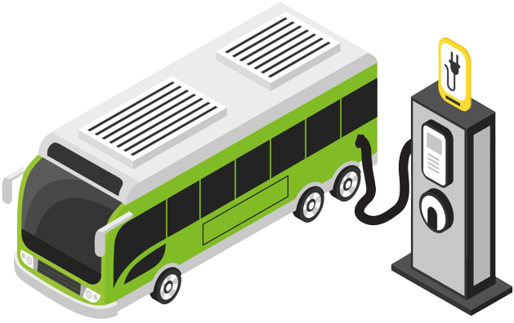
Electric Vehicle Integration in Fiji
-Accelerating E-mobility-
Razik Khan
Acting Mechanical Engineer – LTA Fiji
15th June 2023, Nuku’alofa, Tonga

Slide 2
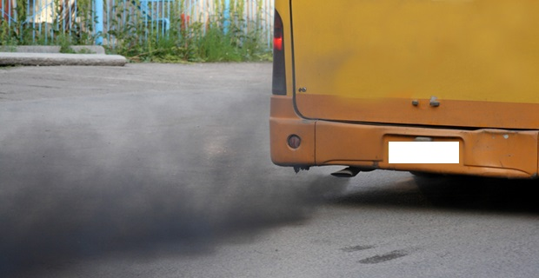

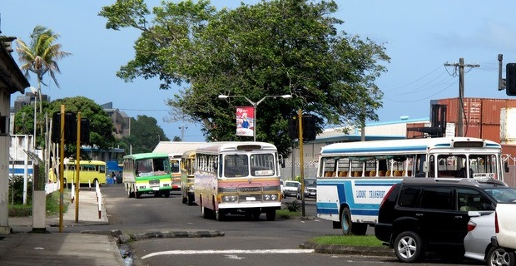

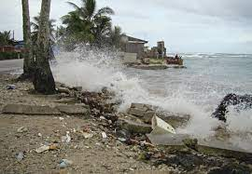
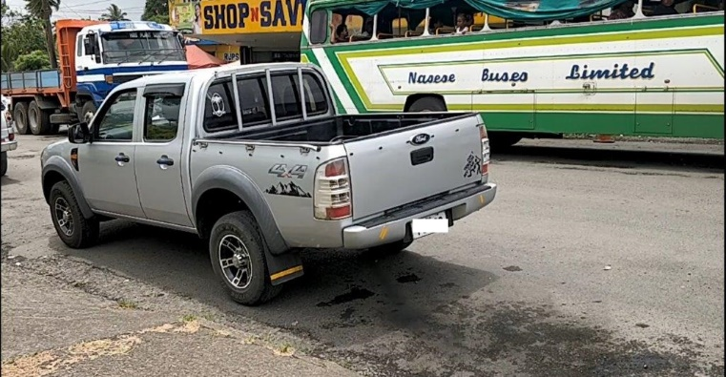
Overview
Fiji
Population
~900,000
~300 Islands
2 main Islands
69% below 40 years

Slide 3

Opportunities
Smaller bus routes → greater efficiency in EV operations
High % of younger population → Higher potential for change.
International benchmarking → lessons learnt
Government Incentives Available

Slide 4
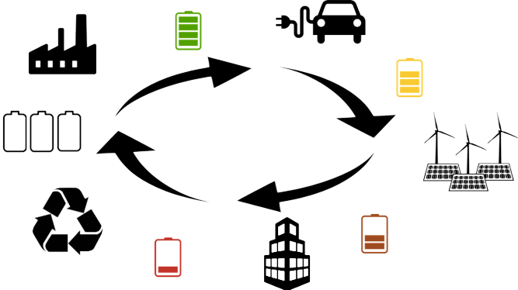
Technical Requirements
Charging Infrastructure
One of the key technical requirements for accelerating EV deployment in Fiji is the availability of charging infrastructure. We will need to invest in the installation of charging stations across the country to support the growing number of EVs on the roads. This will require significant investment in both hardware and software.
Battery Recycling
Another important technical requirement for EV deployment is the development of a battery recycling program. Batteries used in EVs contain valuable materials that can be reused, but they also contain toxic chemicals that need to be properly disposed of. Developing a battery recycling program will ensure that the materials are reused, and the toxic chemicals are safely disposed of.

Slide 5


Technical Requirements
Vehicle Standards
Fiji will need to establish vehicle standards for EVs to ensure that they meet safety and environmental requirements. This includes establishing regulations around the types of batteries used in EVs, the range of the vehicle, and the charging and discharging rates.
Government Incentives
The government can provide incentives to encourage consumers to purchase EVs. For example, the government can provide tax credits or rebates to people who purchase EVs, or it can offer subsidies to companies that invest in charging infrastructure.

Slide 6

Regulatory Framework
Vehicle Importation Regulations
Fiji will need to establish regulations around the importation of EVs to ensure that they meet safety and environmental requirements. Additionally, a long term plan on the phasing out of ICE vehicles import needs to be developed and adopted. A long term plan will ensure a smoother transition.
Charging Infrastructure Regulations
Fiji will need to establish regulations around the installation and operation of charging infrastructure to ensure that it is safe and reliable.
Battery Recycling Regulations
Fiji will need to establish regulations around the recycling of batteries to ensure that there is proper disposal of toxic chemicals and that the materials are reused.

Slide 7
Policies and Awareness
End of Life system for ICE Vehicles
To integrate EVs the first step would be to create a sustainable End of Life system for existing ICE vehicles. This will smoothen the shift towards e-mobility
Incentive Programs
The Government incentive programs need to be properly designed to ensure that they are effective and sustainable. Careful consideration will have to be given to the design of these programs to ensure that they are targeted to the right groups and that they align with the overall goals of reducing greenhouse gas emissions and transitioning to a more sustainable transportation system.
Public Awareness Campaigns
Public awareness campaigns will be required to educate the public about EVs and their benefits. These can help to dispel myths about EVs and promote their advantages, such as lower operating costs, reduced emissions, and a quieter and smoother ride.

Slide 8

Multi-Sector Collaboration
Multi-sector approach required – Energy, Transport, Customs, Standards, etc.
Alignment to Fijis climate commitments.
Energy sector alignment is high priority.
Clearly set requirements and regulatory framework to catalyze EV integration

Slide 9
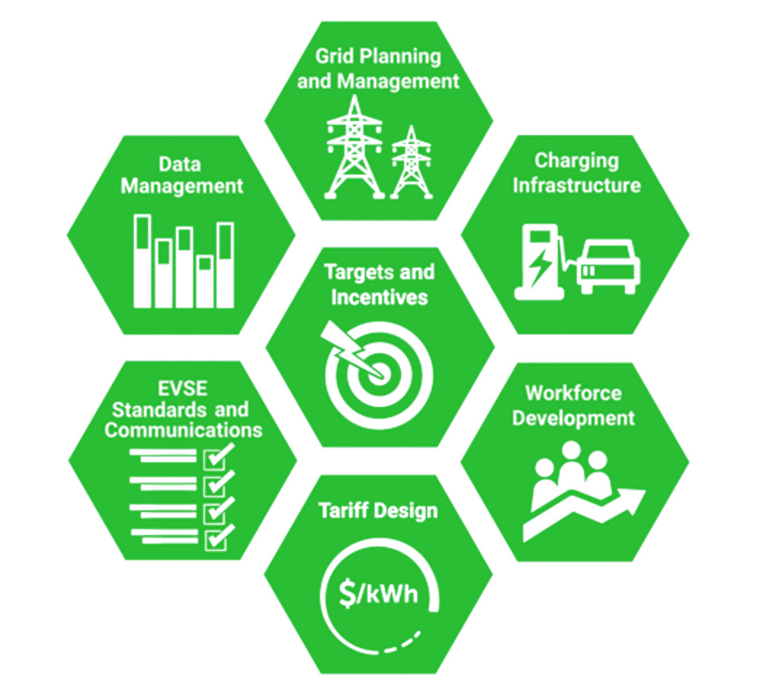

EV Deployment Enablers

Slide 10

Next Steps
In the short to medium term, some of the key areas that can be looked at are;
A compliance base end of life system for vehicles.
Electrification of Busses

Slide 11
A Compliance Based Vehicle End-of-Life System

Slide 12
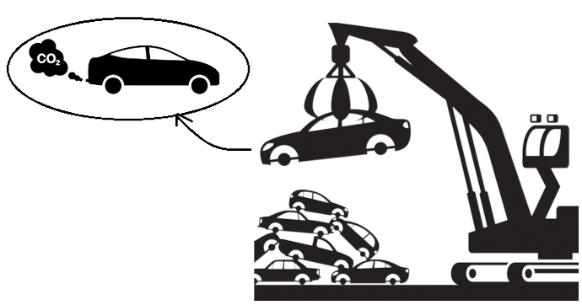
End-of-Life
Instead of having an age based vehicle end-of-life structure a compliance based end-of-life system looks more rewarding. This will ensure that vehicles in use are efficient and will also promote a shift towards cleaner, greener and more efficient vehicles.
Vehicle tailpipe emissions can be used as a pass/fail criteria during renewals, i.e. vehicles failing emission tests will be not be renewed.
This will lead to two things;
  Replacement of non-compliant vehicles.
  Guarantee better service and maintenance of all registered vehicles to comply to the required standards.

Slide 13

Emission Levy
Emission tiers can be developed as;
Tier 1 – most stringent emission standards. All vehicles falling in the tier can be exempt from paying an emission levy.
Tier 2 – slightly less stringent. Vehicles in this tier will be registered but will be required to pay a calculated emission levy based on vehicle usage to continue having the vehicle registered.
Tier 3 – least stringent. Vehicles in this tier will be registered but will be required to pay a higher calculated emission levy based on vehicle usage to continue having the vehicle registered.

Slide 14
Why Prioritize Electrification of Busses?

Slide 15
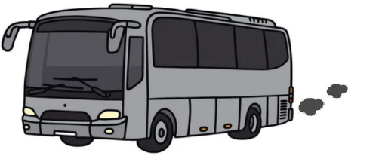
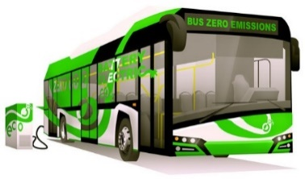

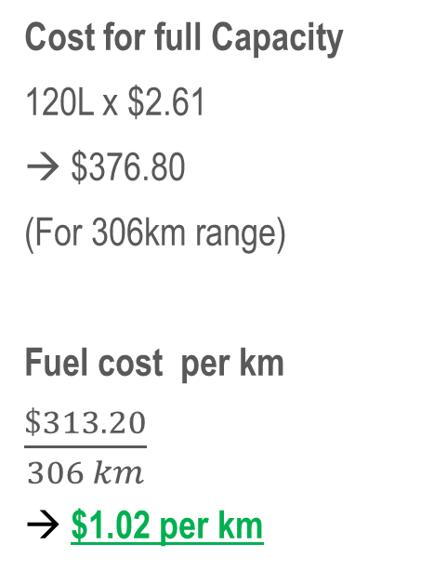
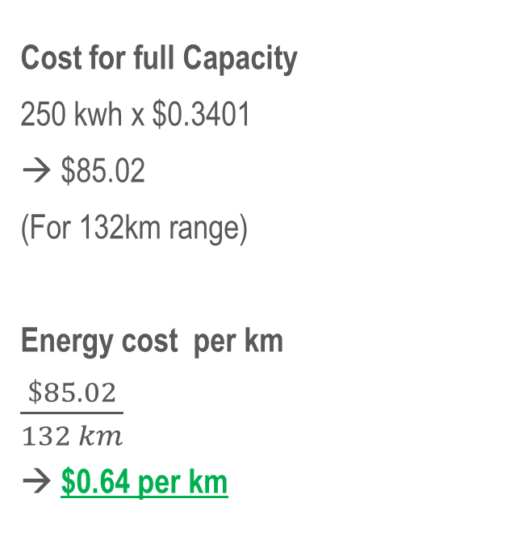
E-Buses vs
ICE Buses
($)
Cost for full Capacity
250 kwh x $0.3401
→ $85.02
(For 132km range)
Energy cost per km
$\frac{\$85.02}{132 km}$
→ $0.64 per km
Cost for full Capacity
120L x $2.61
→ $376.80
(For 306km range)
Fuel cost per km
$\frac{\$313.20}{306 km}$
→ $1.02 per km

Slide 16
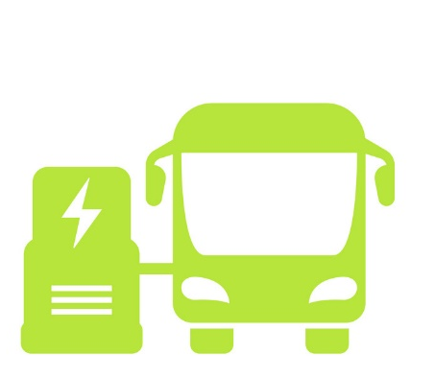

E-Bus vs
Private EVs
EV Type
Battery Capacity
Range
Passengers
Energy Consumption
Energy Consumption
Per passenger
60 kwh
118 kwh
320 km
240 km
5
24
0.19 kw/km
0.49 kw/km
0.04 kw/km/person
0.02 kw/km/person
Reference Model;
Nissan leaf
Reference Model;
Greenstar EV
*These calculations are based on best case scenario - most private cars run with only 1 or 2 occupants.

Slide 17
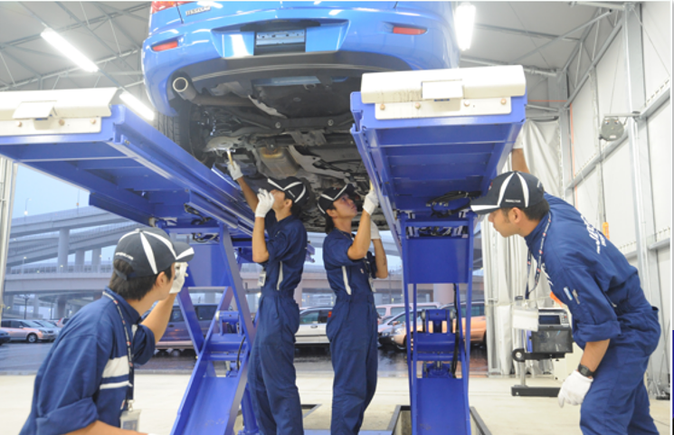
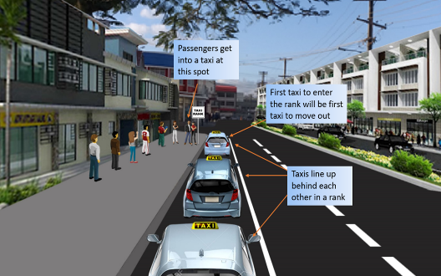
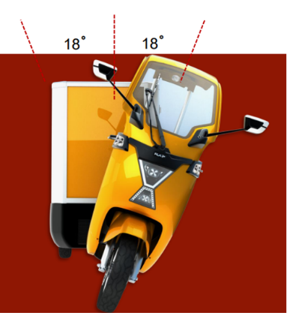
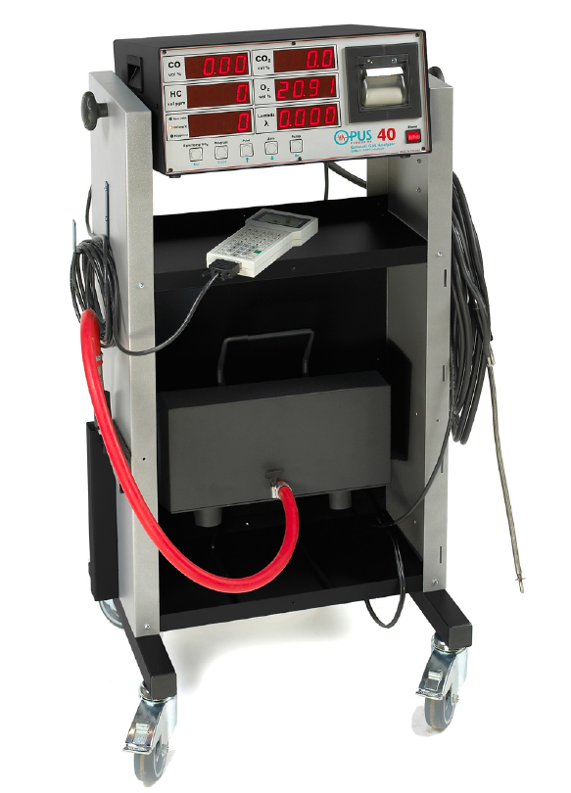
Projects Implemented
Pre-shipment vehicle inspections
  Inclusion of emission tests, hybrid vehicle battery testing, verification of emission standards
Open Taxi Ranking System
  Increasing efficiency of taxi operations and reducing frequency of empty runs
Technical Assistance and Data Provision
  Development of Fiji’s LEDS
  Development of Fiji’s NDC
  Development of Fiji’s NEP
Procurement of Emission Testers for Diesel/Petrol and LPG vehicle tailpipe emissions through grant funding
MOU with Universities for training development and R&D on EV projects.
Private Sector – 3 wheeler verification and approval for 10 units.

Slide 18
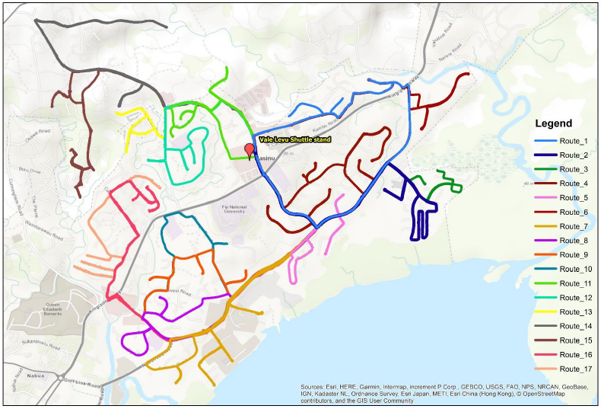

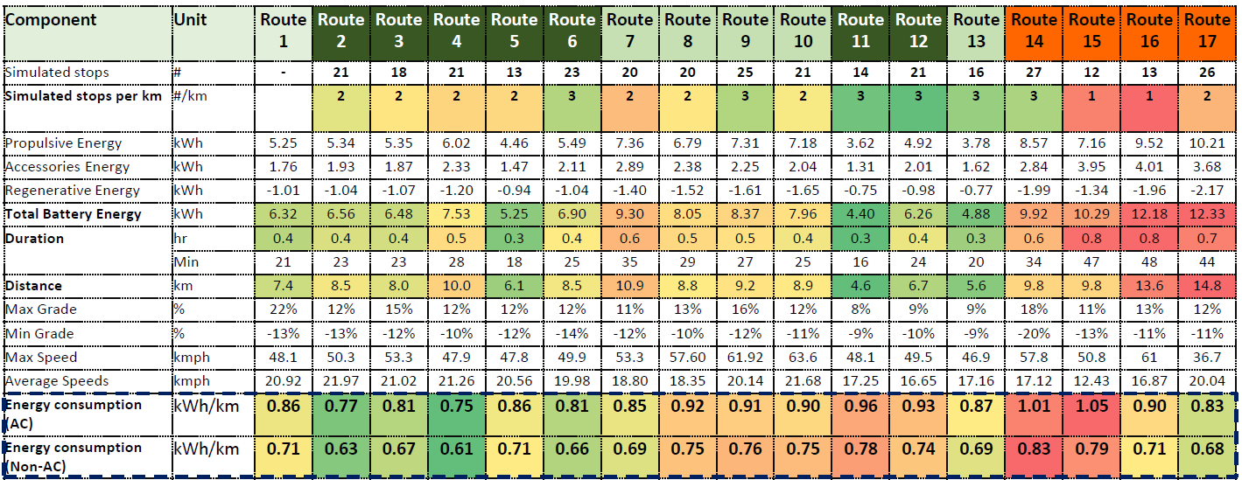
Bus Shuttle Project
A Pilot Project to aiming prove Electrical shuttle technologies
LTA Technical Support
  Route Selection and Mapping
  Route Data Collection
  Route Energy Analysis
  Technical Assistance in fleet planning
  Development of draft operating model and rules

Slide 19
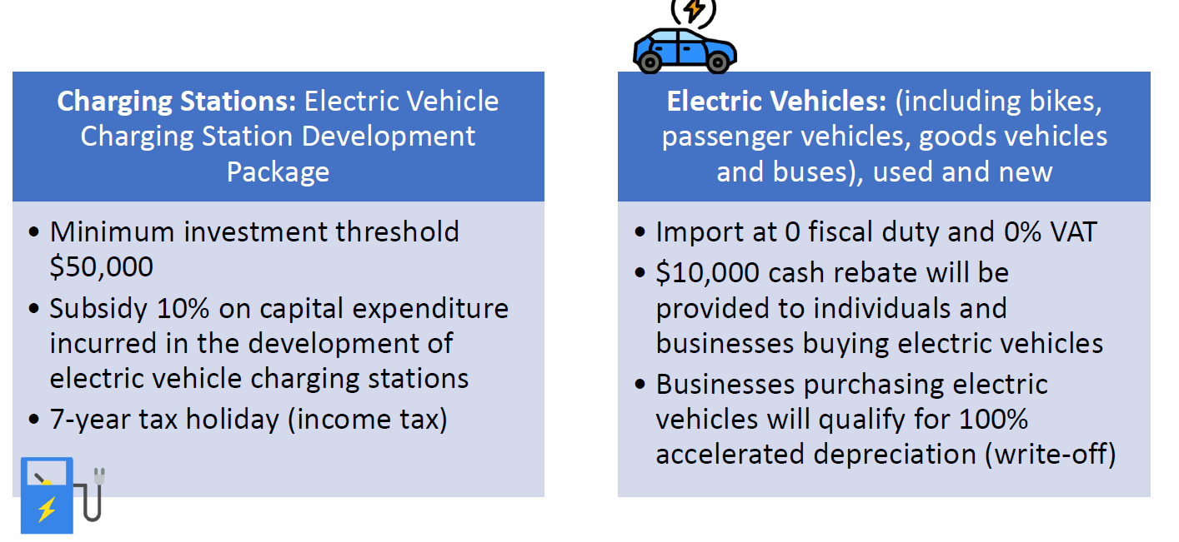
Available Incentives

Slide 20





