Slide 1

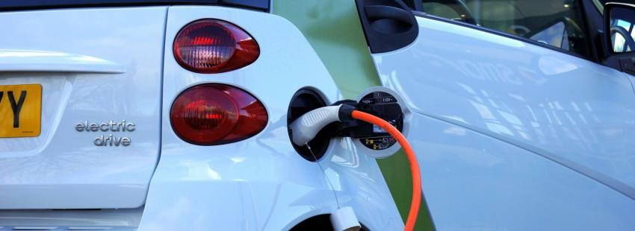
DRAFT
REGIONAL PROGRAM ON INTEGRATED E-MOBILITY AND RENEWABLE ENERGY POWER SYSTEMS
Solomone Fifita, Manager, PCREEE

Slide 2
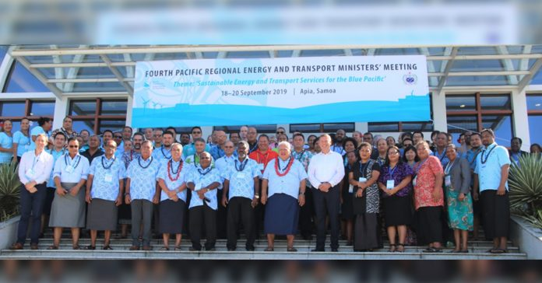
STRUCTURE
Introduction
Key Components of EVs
EVs and the Power Utilities
EVs and the PICs
PETMM Direction
The regional e-mobility programme
SIDS – SIDS Cooperation on EVs
Where to from here?
Q & A

Slide 3
INTRODUCTION TO EVs
E-mobility: Electric Mobility
EV: Electric Vehicles
International Electrotechnical Commission (IEC) definition of an EV - a vehicle propelled by an electric motor drawing current from a rechargeable storage battery or from other portable energy storage devices (rechargeable, using energy from a source off the vehicle such as a residential or public electric service)
Types of electric vehicles
battery electric vehicles - BEVs, which comprise a battery, an electric motor, and power electronics to make these operate
plug-in hybrid electric vehicles - PHEVs, which in addition to the same motor and battery system on a BEV, have an on-board petroleum-fuelled engine that can be used as well as, or instead of, the electric motor and battery to provide additional power and/or additional range.
EVs come in all shapes and sizes
passenger cars
buses
trucks
boats
motorised 2- and 3- wheelers
e-bikes & e-scooters.

Slide 4
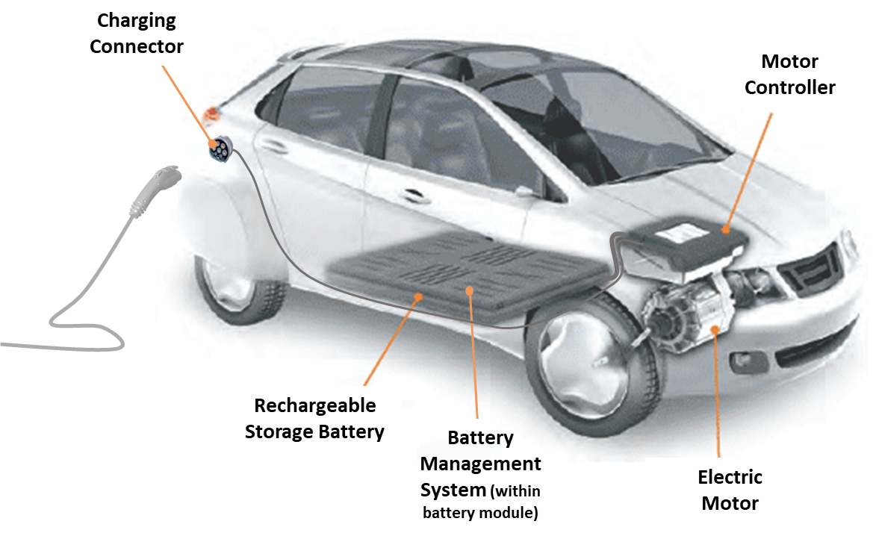
KEY COMPONENTS OF EVs
BATTERY
EV Batteries are DC while charging is from AC [converter]
Advance in EVs = Advances in technology / Batteries:
Nissan Leaf in 2010 ran at 110 km on one charge
  Latest model now have a range of 300 km or more.
PHEVs smaller battery capacity —commonly with an all-electric range of only 40-50km — but supplemented with a petroleum-fuelled engine
30% more efficient than comparable non-hybrid vehicles
Battery capacity of 24 kWh charging at a rate of 1.7kW would take about 14 hrs
Nowadays there are fast charging at 50kW and ultra rapid at 350kW
e-bikes and e-scooters are charged at as little as 2A from a supply of 230V AC – a fraction of the draw from an electric kettle (for comparison, a normal domestic socket outlet is rated at 10A).

Slide 5
KEY COMPONENT S OF EVs
BATTERY
The availability of advanced battery technologies has presented the market with many electric vehicle options, from electric push scooters to large trucks:
Larger-sized electric push-scooters
E-bikes
e-Two-wheelers
Motorised tricycles
electric passenger cars

Slide 6
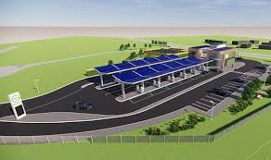
KEY COMPONENTS OF EVS
BATTERY
EV batteries are increasingly similar to RE batteries
When EV batteries are depleted beyond the point at which it can offer useful range, it will commonly be re-purposed as an electricity supply storage battery and enjoy a “second life” in this role

Slide 7
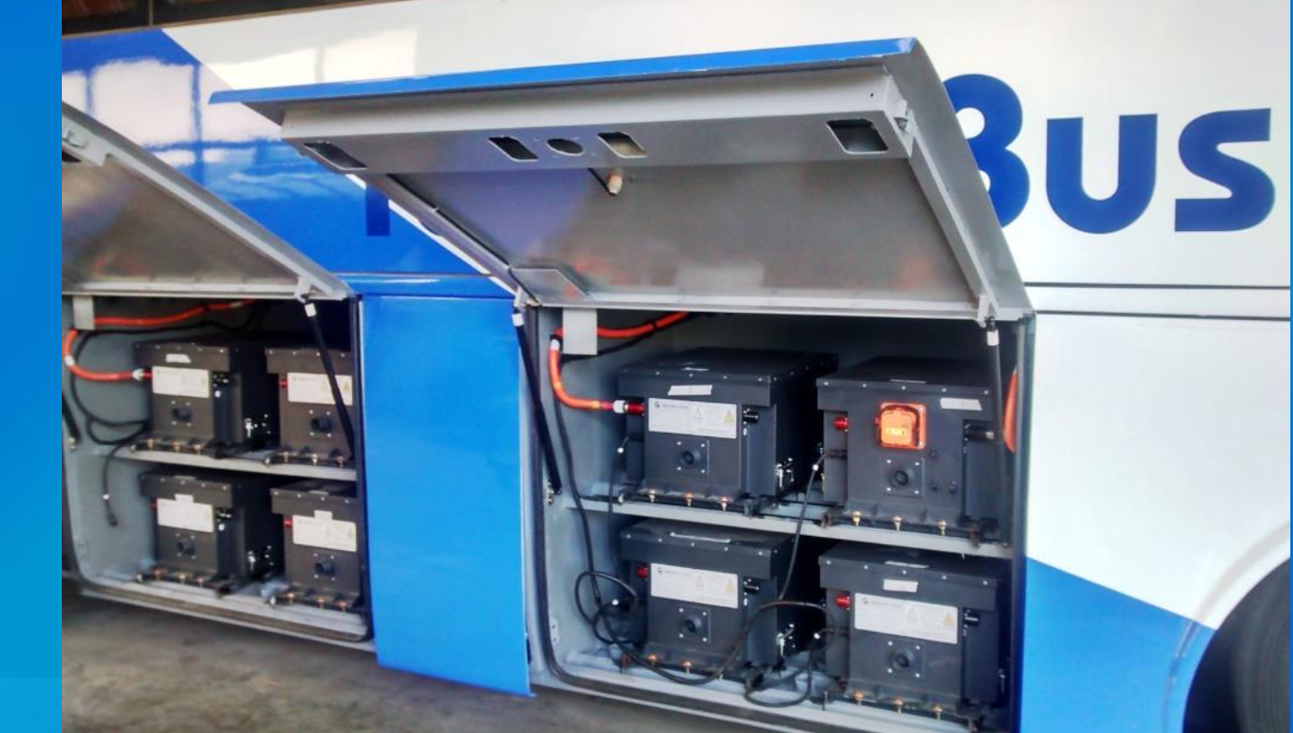
KEY COMPONENT S OF EVs
BATTERY
electric trucks
is still emerging
Electric bus
technology is more advanced than for trucks
due to the impetus provided by the Chinese market. The availability of ultra-fast charging means that individual buses can get away with smaller onboard batteries, which means
projects involving multiple buses / bus fleets are less expensive compared to projects involving small numbers of buses - costly on a per-bus basis
which means this technology would only be viable for the largest of cities of PoM, Suva, Honiara and Port Vila, etc.
any such project would need to be heavily subsidised in its early years.
marine vessels
does not appear financially attractive apart from small, slow-speed vessels operating in close, inshore waters
an opportunity to retrofit small fishing vessels with electric propulsion and to charge these using simple, low-voltage solar generation systems.
small vessels used to ferry tourists could also be electrified.

Slide 8
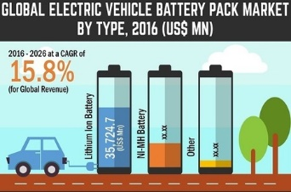
KEY COMPONENT S OF EVs
ELECTIRC MOTORS
electric motors can be more than 90% energy efficient, compared with combustion engines, which range from 10% - 30% energy efficient in typical automotive use
Diesel generators operate at 40% efficiency and above as compared to vehicular diesel motors
EVs basically transfer the load from the less efficient diesel-powered vehicle to the more efficient diesel power generator
More benefits if power system in largely RE-based and EVs are charged from a RE-based power source
Importance of working together with the Power Utility

Slide 9
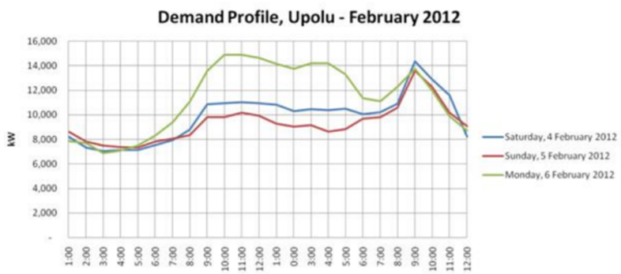
EVs AND THE POWER UTILITIES
Battery Charging
balancing the provision of peak capacity with the cost to do so.
“smart meters” or “Time of Use” metering can offer advantageous prices for charging at times that suit the demand profile

Slide 10
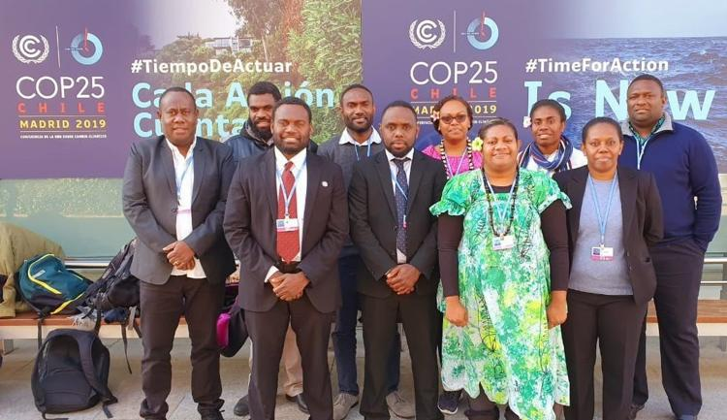
EVs AND THE PACIFIC ISLANDS
Heavy dependence of the region on fossil fuel
Major fossil fuel users / GHG emissions are electricity generation and transportation
Vanuatu INDC 2015
To approach 100% renewable energy in the electricity sub-sector contingent upon appropriate financial and technical support made available
NDC Reviews and Enhancement

Slide 11
CTCN Proposal - Feasibility Study for Low Emission Land Transport Sector in Vanuatu
Objective: To undertake a feasibility study and develop funding proposal for Low Emission Land Transport Sector in Vanuatu
Outcome: Empower the Government of Vanuatu to take evidence-based decisions on addressing energy efficiency in its land transport sector and to include energy efficiency in land transport in Vanuatu’s Energy Road Map and Nationally Determined Contributions.
Output 1: Development of implementation planning and communication documents
Output 2: Barriers to low carbon development in Vanuatu’s land transport sector and how best they can be removed are identified and analyzed
Output 3: A concept note on low carbon land transport sector programme for Vanuatu is developed and adopted
Output 4: Capacity Development on low carbon land transport

Slide 12
EVs AS THE NEW NORMAL
COVID 19 and uncertainties
Movement restrictions
Greener & Stronger
Rely more on local resources and expertise
Doing things virtually

Slide 13
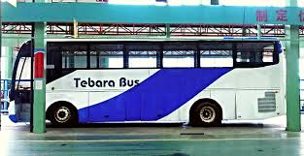
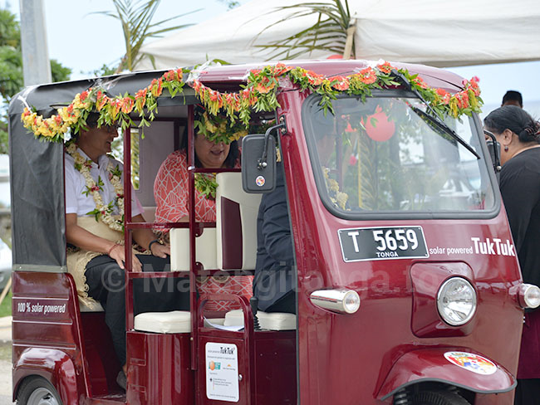
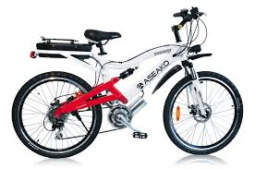

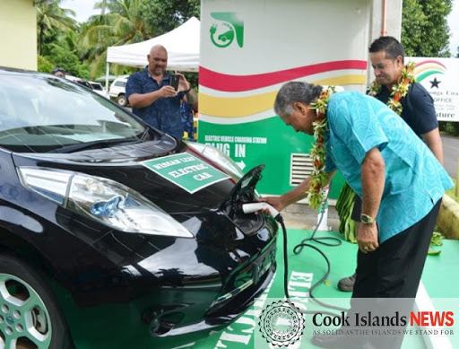
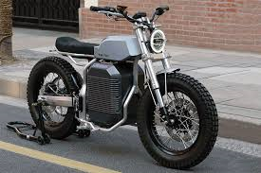
Rarotonga: 2014 – 2020 = >80 BEVs
2030 = about 400 / Second hand from Japan
About NZD 15,000 + FR8
Duty Free but pay GST / VAT

Slide 14

OTHER REGIONAL TRANSPORT PLAYERS
PIDF
USP & the Micronesia Centre for Sustainable Transport
SPC & MTCC

Slide 15
4th PETMM Direction
Request SPC/PCREEE, UNIDO and SIDS DOCK to develop a regional policy document outlining the short-term and long-term vision of PICTs with regard to integrated e-mobility and renewable energy power markets. It will propose regional e-mobility targets for the PICTs region by 2030 and 2050 and include a regional implementation framework with concrete priority actions.
Request SPC/PCREEE, UNIDO and SIDS DOCK to develop a regional e-mobility program. The program will address existing barriers by promoting regional interventions in the areas of (i) policy and regulation, (ii) knowledge management, (iii) qualification/certification, as well as (iv) the promotion of investment, entrepreneurship and innovation.
Request SPC/PCREEE, UNIDO and SIDS DOCK to promote SIDS-SIDS cooperation and exchange on integrated e-mobility and renewable energy power systems under the umbrella of the Global Network of Regional Sustainable Energy Centres (GN-SEC) - https://www.gn-sec.net/
Three Reports: Technical Background, Regional Policy & Regional Programme
https://www.pcreee.org/event/online-validation-regional-e-mobility-policy-and-program-pacific-islands

Slide 16
Diversity in the PICTs
Wealth - US$1500 for Kiribati to above $30,000 for Guam and Nouvelle-Calédonie
Urbanisation - below 20% for PNG above 90% for American Samoa
Road infrastructure
Vehicle fleet
Electricity market
Fuel market - tank-tainers”, drums, tank farms
Access to main market

Slide 17
What a Regional Program should do
Provide back-up support to national effort
Tuvalu’s Electric Motorcycles for pilot program under the Tuvalu Energy Sector Development Project
Consistent with, strengthen and improve
Package needs of multiple countries
Flexible, leave no one behind

Slide 18
Stages in the introduction and uptake of new technology
Availability of sufficiently matured technology for the market
Uptake by enthusiasts – rich and famous, Ministries & Boards
Uptake by earlier adopters
Normalisation of the technology
Mainstream (national scale take up)
Sector capability and capacity is required to run in parallel with the growth in order to provide he necessary supporting systems, including:
Maintaining safety
Maintenance
Charging
First response in case of accident

Slide 19
Barriers to E-mobility
EVs are new to PICTs and there are many barriers with associated with this “newness”” including:
  a lack of mandate to drive EV policy (opportunities in the revisions of NDCs and Energy Roadmaps);
  a lack of supporting institutional and regulatory framework
    LTAs deal mostly with vehicle registration while MoI/MoT deal with roads and bridges and Police deals with enforcing the traffic laws.
    In some countries, EVs do not fall into any of the vehicle categories, making it difficult to register them.
    Duty is based on engine size and no regards to the fuel type
  absence of standards is a safety hazards and could ruin the reputation of the technology
  a lack of charging infrastructure
  a lack of technical support capability and capacity
  a general lack of awareness of EVs (& market access).

Slide 20
The Regional e-mobility Program
Addresses existing barriers by promoting regional interventions in the areas of:
policy and regulation
knowledge management
qualification/certification
investment, entrepreneurship and innovation
promotes SIDS-SIDS cooperation under the umbrella of the GN-SEC - https://www.gn-sec.net/

Slide 21
The regional e-mobility programme
Objective: PICTs are best prepared for their respective sustainable mobility futures….
Output 1: Policy & Regulation / Central Policy and Administration
Output 2: Qualification & certification / Standards and Guidelines
Output 3: Knowledge Management / Awareness and Promotion
Output 4: investment, entrepreneurship and innovation / Demonstration and Upscale
RE&EE For Sustainable Mobility in the PCREEE Business Plan

Slide 22
2030 & 2050 Regional e-mobility targets
 | Proposed 2030 Regional E-Mobility Target | Proposed 2050 Regional E-Mobility Target
1. | Ten different models of manufacturer-supported, mainstream EVs are available in the marketplace. | Services provided by EVs are an integral and significant component of transport within the region and include single-person electrically assisted mobility options through to electric aircraft, trucks, buses and boats.
2. | Battery swapping for low-voltage mobility use is available on a commercial scale in the marketplace.
3. | There is good public awareness of EVs.
4. | 50% of all mainstream EVs are charged through devices that are managed-charging enabled. | 90% of all mainstream EVs are charged through devices that are managed-charging enabled.

Slide 23
Summary of Target Actions of the Regional EV Program
Central Policy and Administration
Develop high-level targets and mandates concerning EV uptake. Establish a staffed and funded Regional EV Hub with regional representatives responsible for coordinating national programs and collecting and sharing information and international links including those related to SIDS-SIDS cooperation. Support PICTs in developing and implementing national EV roadmaps. Identify tax levels or incentive packages to encourage the importation of desired EV goods. Establish partnerships in EVs. Develop a M & E system for national EV programmes. As appropriate, introduce/amend the regulatory frameworks for transport to include EVs. Maintain a watching brief on global EV-related developments.

Slide 24
Summary of Target Actions of the Regional EV Program
Standards & Guidelines
Develop and set minimum standards for EVs imports and for fitness testing. Ensure appropriate standards are in place for the retirement of EVs. Set guidelines for charging, including the specification of charging connectors. Develop criteria "EV-readiness“ in new construction and infrastructure. Develop guidelines for the use of V2H and on-site managed charging. Develop (at least voluntary) standards for low-voltage vehicles, the charging of them, and the use of "mobility batteries" for local power supply circuits. Develop and introduce accredited technical courses on EVs. Develop guidelines for e-mobility safety. Provide buyer and user guides on low-voltage e-mobility options.

Slide 25
Summary of Target Actions of the Regional EV Program
Awareness & Promotion
Undertake social marketing research. Develop and deliver an awareness, information and promotion campaign supporting the uptake of EVs. Develop, publish and promote guidelines on: EV purchase (micro-mobility through 4-wheelers); Charging (micro-mobility through 4-wheelers); Servicing and Support (micro-mobility through 4-wheelers). Collate and distribute global and PICT EV information. Ensure that first responders are aware of correct procedures.

Slide 26
Summary of Target Actions of the Regional EV Program
Demonstration & Upscale
Promote government leadership in purchasing of appropriate EVs. Consider supporting electric bus demonstrations. Consider supporting the demonstration of other non-passenger car EV projects if there is a good case for them. Consider methods to share heavy EV technical support capability across fleets and PICTs. Consider opportunities for the electrification of small marine vessels. Facilitate or co-invest in public charging infrastructure. Provide facilities in support of micro through large e-mobility options, beginning with facilities at public offices. Develop EV service industry and support local capability and capacity. (Support the introduction of Time of Use (TOU) electricity pricing). Conduct investment forums on EVs

Slide 27
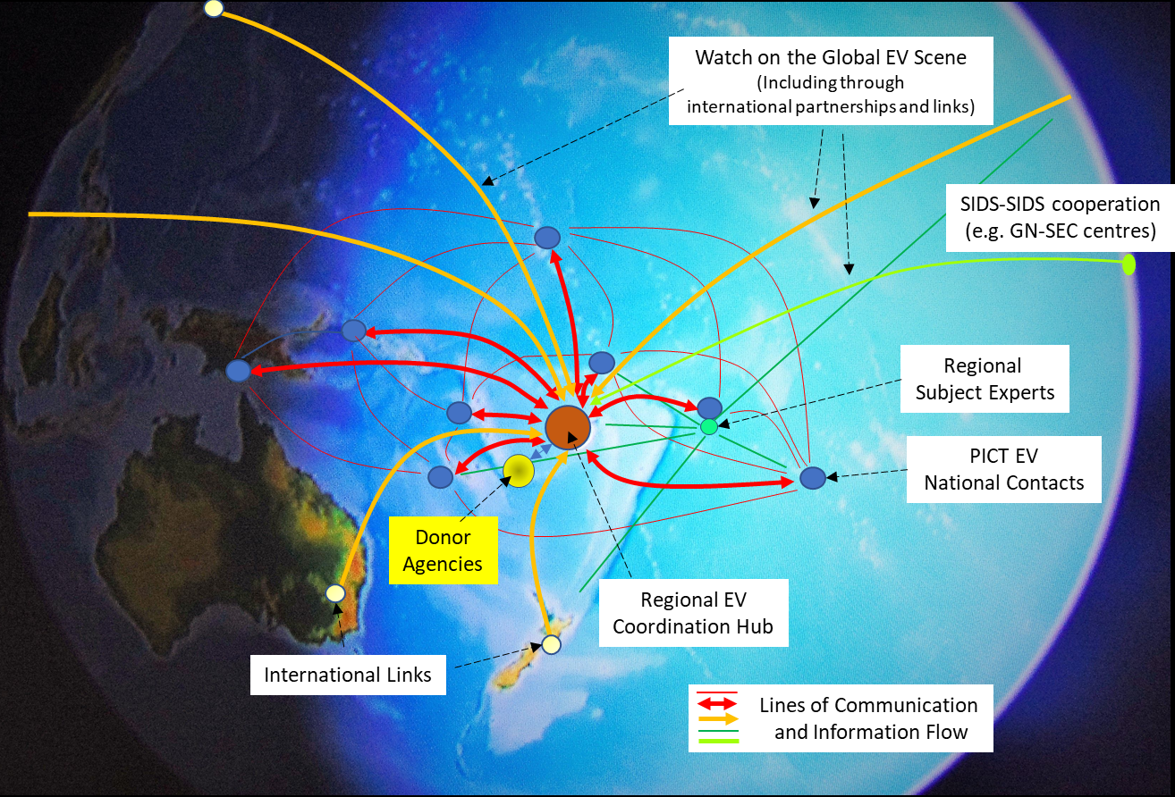
Proposed Management & Governance Structure

Slide 28
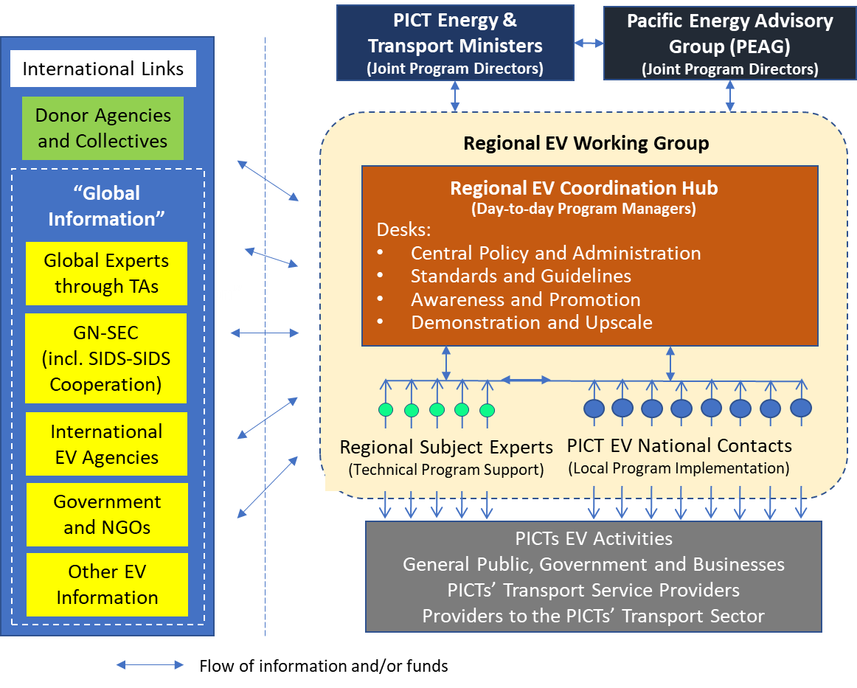
Proposed Management & Communication Structure
Options:
Regional EV Hub
FAESP coordination structure
PCREEE Steering Committee
CROP Transport Group [land, sea & air]
Multi-agencies transport group

Slide 29
Proposed Technical Assistance Projects in Support of the EV Program
Fund Type | Activity | Amount US$ | Year Deployed
TA1 | Oversee PICT development of EV roadmaps and EV mandates. | $ 30,000 | 1
TA2 | Provision of discussion document and guidelines on preferred specifications for EV-related goods and recommendations for tax/duty levels. | $ 15,000 | 1
TA3 | Provision of V2H and on-site managed charging guidelines. | $ 5,000 | 3
TA4 | Provision of low-voltage specification guidelines | $ 30,000 | 3
TA5 | Develop and provide generic courses on working with high-voltage EV systems. | $ 200,000 | 2,3
TA6 | Develop and provide generic courses on working with low-voltage EV and electricity supply systems. | $ 100,000 | 2,3
TA7 | Development of low-voltage awareness and promotion info ration. | $ 30,000 | 3
TA8 | Social marketing package, once per year (5 x $10,000) | $ 50,000 | 1,2,3,4,5
TA9 | Development of EV sector awareness and promotional campaign ($40k + 4 x $20k) | $ 130,000 | 1,2,3,4,5
TA10 | Provision of guidelines for public charging. | $ 20,000 | 2
Other | Contestable Fund Round 1 | $ 250,000 | 3
Other | Contestable Fund Round 2 | $ 250,000 | 4

Slide 30
Regional EV Program: Totals for the Staffing FTEs and Project Budget.

Slide 31





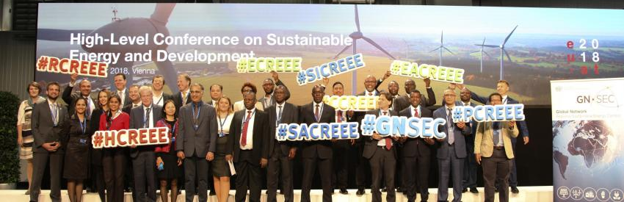

SIDS-SIDS cooperation on EV issues under GN-SEC and SIDS DOCK
Planning a webinar with CTCN on EVs in SIDS

Slide 32
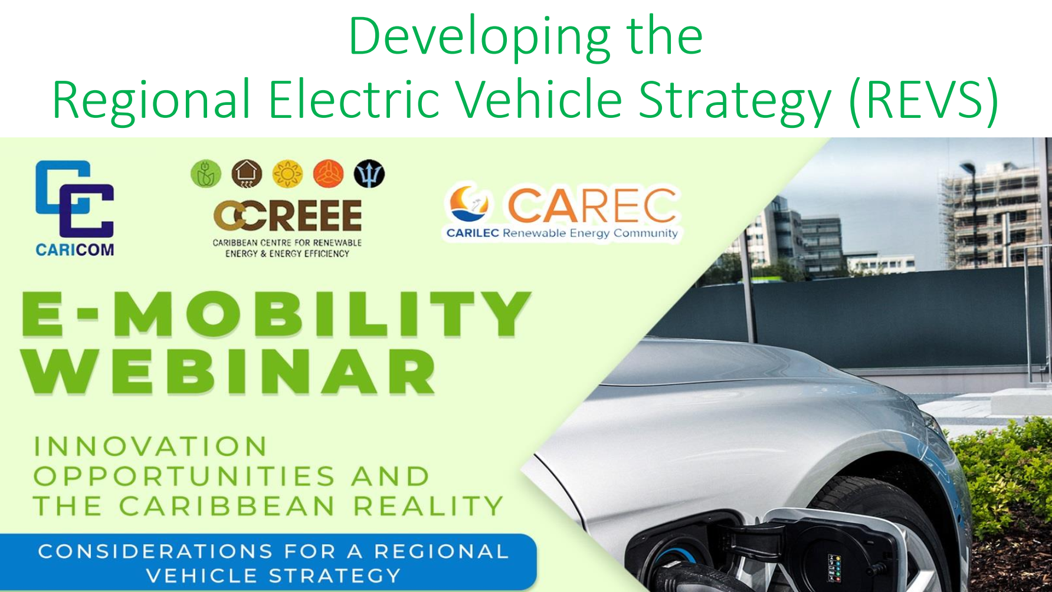

Slide 33

Where to from here?
This is the last national consultation
Identify demands for further national & regional consultations – MTCC & MCST
UNIDO, PCREEE and SIDS Dock will finalize the documents based on comments received and transform into a project document
Present to the 5 PCREEE SC Meeting on 18 Nov
As a courtesy to Pacific Energy and Transport Ministers, SPC will write to the Ministers informing them of the completion of the reports and the delivery of regional services based on the regional e-mobility policy and programme (approx. end of Nov)
SPC will publish the documents and make them available online
Meanwhile, SPC will include e-mobility in its resource mobilization effort, including a GCF Readiness proposal
SPC will also include e-mobility in its 2021 – 2023 budget preparations and donor consultations
SPC to ensure that the e-mobility is integrated with the new regional energy framework
Start delivering in 2021
Works on e-mobility will be reported to the 5th Energy and Transport Ministers meeting in Vanuatu in 2022

Slide 34
Q & A
Are there projects in the pipeline regarding e-mobility in Vanuatu?
How do you want the PCREEE and the regional e-mobility programme assisting Vanuatu?
Any comments on the 4 target areas and the proposed 2030 & 2050 targets
Any comments on the governance structure?
Any comments on the proposed budget?
Any comments on resource mobilisation for e-mobility in Vanuatu and the region?

Slide 35
MALO ‘AUPITO

