Slide 1
Training on Minimum Energy Performance Standards and Labelling (MEPSL)
13 – 15 March 2023
Kiribati
“Overview on the Kiribati Energy Act and MEPSL regulation”
Mr. Sosefo Tofu
Pacific Island Energy Professional
PCREEE

Slide 2
Kiribati Energy Act 2022
Passed by Parliament in December 2022 and recently assented by H.E President in Feb 2023
An act to provide for the legal framework of the Energy Sector and support the regulation of Industry Participants in Kiribati and for other Connected Purposes

Slide 3
Overview of Energy Act 2022
Part 1: Preliminary
Part 2: Administration of the Act
Part 3: Establishment of Energy Planning Division and its Function
Part 10: Energy Planning Division Oversight, inspection, performance, monitoring and Evaluation
Part 11: Disputes and Consumer Protection
Part 12: Disputes and Consumer Proteiction
Part 7: Renewable Energy and Energy Efficiency Projects and Generation Projects
Part 9: Petroleum Industry
Part 4: Energy Steering Committee
Part 8: Minimum Energy Performance Standard
Part 5: Electricity Supply Areas
Part 6: Electricity Tariffs and Prices for Services

Slide 4
MEPSL key components under the Energy Act 2022
EPLT Regulations
The Division must develop EPLT regulations prescribing the system, rules and standards required or convenient to be prescribed for the carrying out of or giving effect to this part
Registration and register of brand and model of electrical products
All brands and models of regulated electrical products (AC, Freezers and Lighting appliances] imported into Kiribati must be registered and comply with the required standards prescribed by the EPSL regulations

Slide 5
MEPSL Regulations 2018
It was drafted under the Consumer Protection Act 2001
Purpose: to establish the MEPS (approved standards) and Labelling for Electrical Appliances and Lighting.
The regulation applies to all regulated products
Imported or manufactured by supplies intending to distribute or sell the aforesaid products; and
Imported by government agencies/businesses users intending to use the products in their own buildings and operations
Import by any person for personal use.

Slide 6
Overview on the MEPSL regulation 2018
Part 1: Preliminary
Part 2: Powers of Regulator and Authorized Officers
Part 3: Importing and Retailing Regulated Products
Part 7: Breaches of Regulation
Part 4: Registration
Part 5: Testing
Part 6: Transitional provisions

Slide 7
MEPSL Regulations 2018 con’t
Regulated products are:
Refrigerators and freezers – effective from the date of commencement of the regulation
Air conditioners- to commence 6 months after the date of commencement of the regulation
Lambs – to commence 12 months after the date of commencement of the regulations

Slide 8
MEPSL Regulations 2018 con’t
Regulator has the power to:
appoint Authorised Officers;
prescribe and distribute forms for the application and granting of product registrations;
handle consumer complaints and execute any order issued by the court;
enter into bilateral arrangement with other agencies of the government, other governments or other third parties regarding cooperation on administering the act or exchanging information regarding Regulated Products
recover costs, related to any of the activities associated with this Regulation;
enter premises where regulated products are stored, used, sold or offered for sale (with or without the permission of the owner), to inspect and investigate whether the regulated products comply with this regulation.
inspect and examine Regulated Products in the possession of Customs and advise on whether they are compliant with this Regulation;
inspect Regulated Products at any location, whether offered for sale or installed for use in the premises;
take evidence in the form of photographs or physical samples;
(j) collect or require evidence that a product qualifies for the Transitional provisions in Part V1

Slide 9
MEPSL Regulations 2018 con’t
Regulator has the power to:
collect or require evidence that a specific brand and model of a regulated product meets the designated standards. The evidence must be submitted in the form specified by the Regulator, and a request can be made at any time – prior to import, at the time of import, or later;
require removal of any non-standard energy labels that may be present on products of a type listed in Schedule 1 or Schedule 2, if those products are displayed for sale.
require registration as a pre-condition for import, offer for sale or sale of regulated products;
maintain a register of specific models which meet the designated standards, in a form determined by the Regulator;
issue, withhold or cancel registrations, (on reasonable grounds, which must be disclosed to the applicant or registrant);
undertake public information activities related to the operation of the Regulation, including the publication of lists of registered products;
issue notices to comply with the Regulation;
confiscate any products that do not comply with the requirements for a Regulated Product.
order the destruction or re-export of confiscated products;
require Applicants and others to report the number of Regulated Products imported or sold in a given period;
inspect and Examine Regulated Products at the point of entry.
release Regulated Products if satisfied that they meet the Requirements of this Regulation;
hold any regulated products that do not meet, or are reasonably suspected not to meet, the requirements of this Regulation

Slide 10
MEPSL Regulations 2018 con’t
Categories of Registration of Product
Category A: The model you wish to register is already registered in Australia, New Zealand, Fiji or another PIC recognized under the PICs regulations. In this case, minimal info is required
Category B: The model to be registered is technically equivalent to a model that is already registered in Australia or New Zealand or a PIC other than the one in which the application is being made. In this case, slightly more information is required by regulator that Category A.
Category C: All other models. These products are not already registered in Australia or New Zealand or another PIC and as such the applicant is required to provide full technical details of the product in their registration application.

Slide 11
MEPSL Regulations 2018 con’t
Refusal and cancellation of Registration
The regulator may refuse or cancel registration of a product upon the following grounds
Applicant has not provided the required information
Product is no longer registered in any of the countries (Aust, NZ, Fiji and PICs that have already adopted MEPSL)
The regulator is not satisfied that the product complies with the relevant standards.
Regulator shall inform the applicant of the reasons for refusal within 7 days of the refusal or cancellation
When informing the applicant, the regulator shall allow 10 working days for the applicant to provide any additional info.
If the applicant won’t provides the additional information within the required period, the Regulator shall reconsider the refusal or cancellation.
If the applicant provides the additional information within the required period the Regulator shall hold the cancellation suspended until he/she has considered the information provided.

Slide 12
MEPSL Regulations 2018 con’t
Registration procedures
(1) A person making an application for registration of a regulated product shall apply for registration of the products under any of the relevant categories before the products
(2) A person making an application to import a product that is already listed on the register maintained by the Regulator, may apply to the Regulator before the items arrive in Kiribati
(3) Applicants shall obtain the relevant registration and/or import form from the Regulator. The completed form may be submitted in hard copy or in an electronic format specified by the Regulator.
(4) Every Applicant shall provide all the information required in the application form in full detail and truthfully.

Slide 13
MEPSL Regulations 2018 con’t
Breaches of Regulation
Offences
(1) Any person who fails to comply with the provisions of this Regulation commits an offence.
(2) A person commits an offence under this regulation when he:
fails to register a product;
fails to comply with all the registration requirements;
knowingly provides false information, to the Regulator or any Authorized Officer when performing his/her duties under this Regulation;
fails to display a correct energy label in accordance with Schedule 1 (if the person is a retailer);
fails to refuses or provide information as requested by the Regulator or any Authorised Officer; or
undertakes any conduct which contravenes any provision of this Regulation.

Slide 14
Fees
Penalties
Application for registration: | Payable by person intending to sell (retail or wholesale) or use in own business (not to sell) | Payable by person intending to use at home
Refrigerator or freezer, using Form A | AUD $60 per model registered | AUD $15 per model registered
Refrigerator or freezer, using Form BC | AUD $70 per model registered | AUD $20 per model registered
Air conditioner, using Form A | AUD $60 per model registered | AUD $15 per model registered
Air conditioner, using Form BC | AUD $70 per model registered | AUD $20 per model registered
Lighting product, using Form A | AUD $50 per model registered | AUD $5 per model registered
Lighting product, using Form BC | AUD $60 per model registered | AUD $10 per model registered
Offence | Payable by business or government agency | Payable by individual person
Importing a product without a valid registration certificate (first offence) – if product found to be compliant | AUD $15 per unit imported | No penalty (but offence recorded)
Importing a product without a valid registration certificate (repeat offence) – if product found to be compliant | AUD $40 per unit imported | AUD $20 per unit imported
Importing a product without a valid registration certificate (first offence) – if product found to be NON compliant | AUD $30 per unit imported | No penalty (but offence recorded)
Importing a product without a valid registration certificate (repeat offence) – if product found to be NON compliant | AUD $50 per unit imported | AUD $30 per unit imported
Offering a new product for sale without a required energy label (first offence) | AUD $15 per unlabelled product | No penalty (but offence recorded)
Offering a new product for sale without a required energy label (repeat offence) | AUD $15 per unlabelled product | AUD $5 per unlabelled product
Failing to comply with lawful instruction from Regulator or authorised officer | AUD $15 per offence | AUD $5 per offence

Slide 15
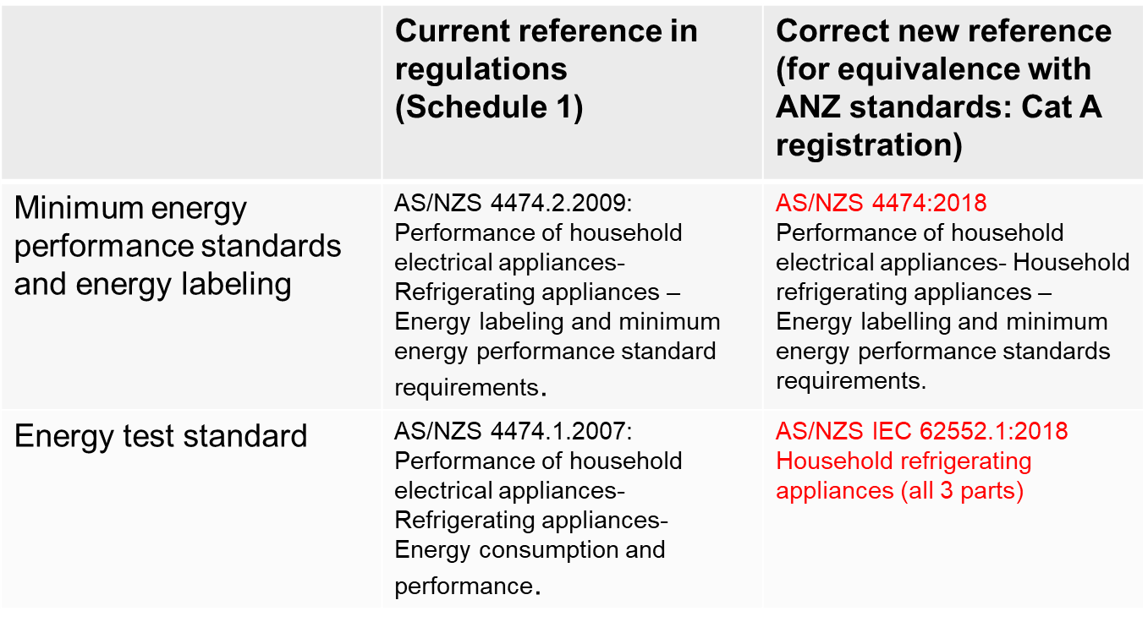
Recommendations and way forward
Need to amend the draft regulation and ensure its align with the recent Kiribati Energy Act 2022 [Last deliverable of PCREEE technical assistance to Kiribati under NDC hub – to be submitted by June 2023]
E.g. require an update to the standards in the draft regulation [from George Wilkenfield]

Slide 16
THANK YOU

