Slide 1
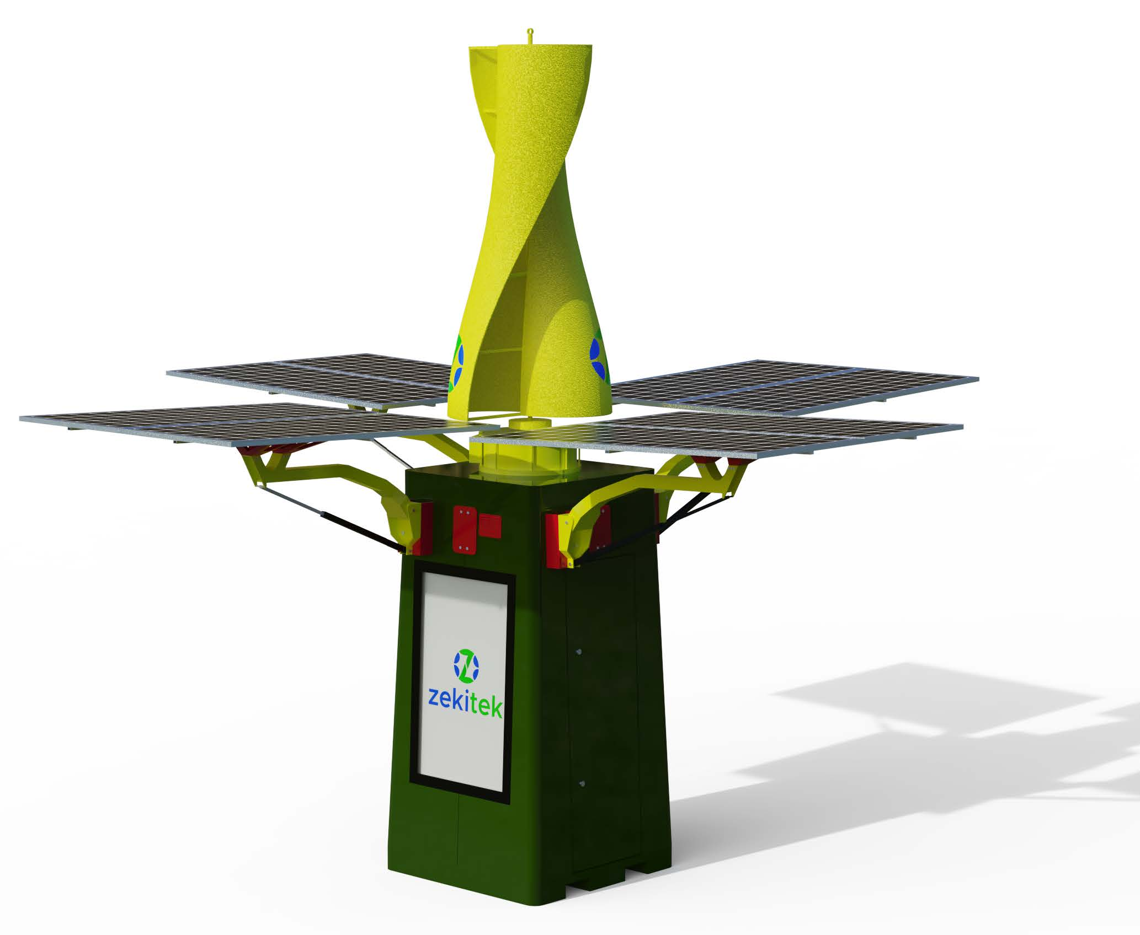
ZekiGen is a self-contained renewable energy generator with a
compact footprint. Our flagship product is ideal for off-grid, remote and public urban power generation and charging.
ZekiGen works 24 hours a day, generating and storing power through an inbuilt vertical wind turbine and solar panels. Power is stored in an integrated battery, so electricity can be accessed and used continuously.
Safe
Our products are safe for
people, animals and nature
Adaptable
ZekiGen works in
multi-faceted Wind directions.
Soundless
0dB measured within 2m
of the ZekiGen vane
Weather-proof
ZekiGen withstands rain,
snow, frost, heat,
humidity and highwinds
Durable
Designed to stand the
test of time, with a
robust battery system
Practical
Commnuities will
Enjoy charging
with ZekiGen
Video Link - https://youtu.be/5XJK6P3TnD4
zekitek l presentation of zekigen in Fiji

Slide 2
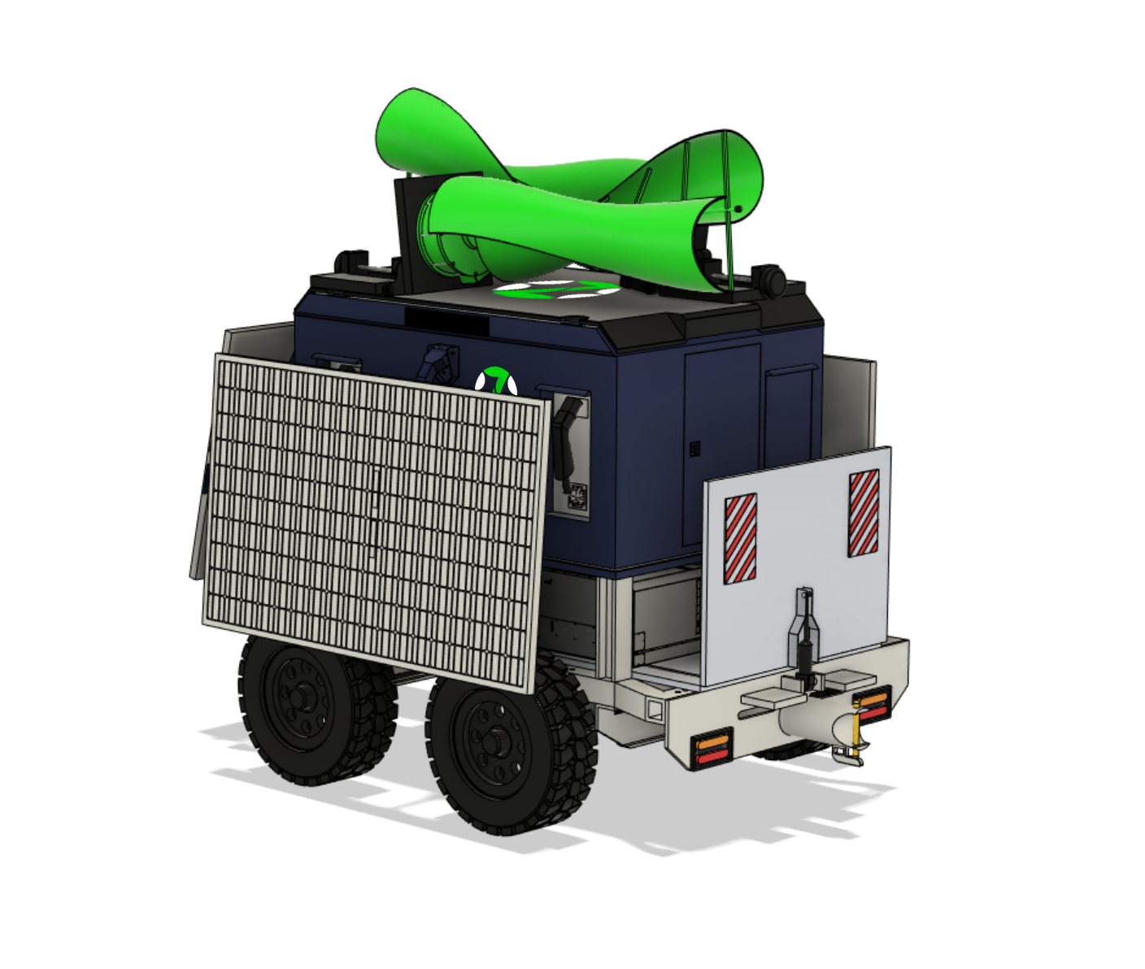
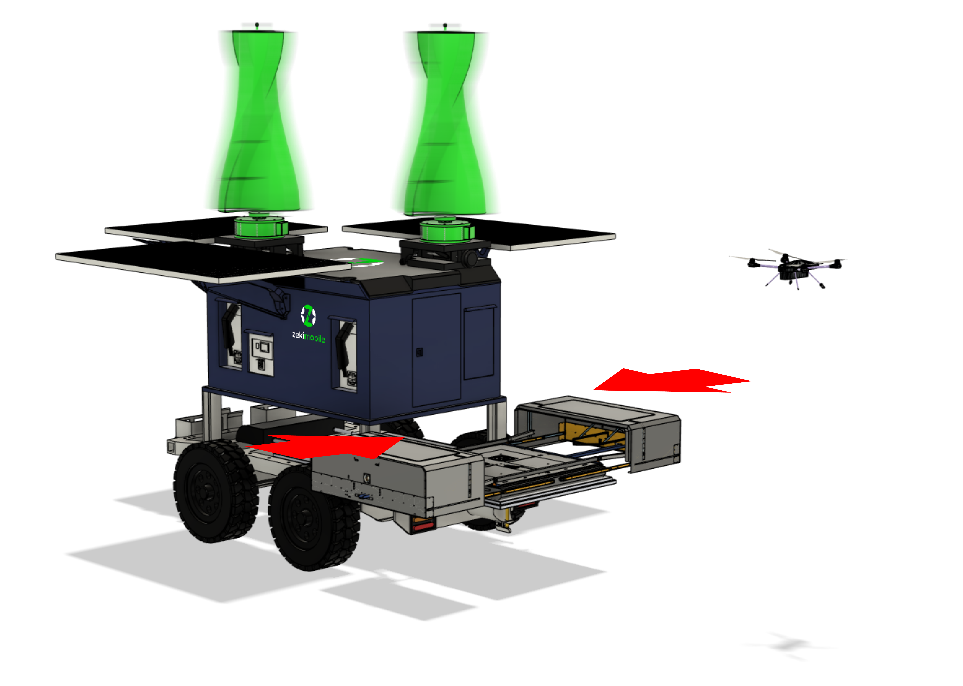
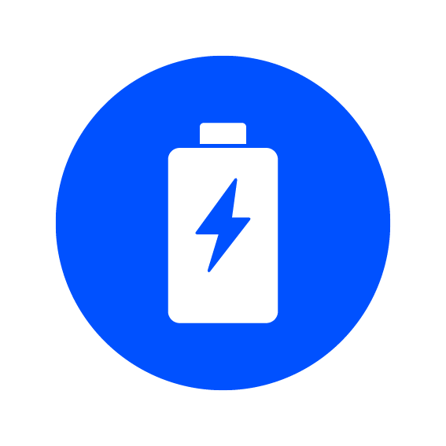
ZekiMobile is a trailer based mobile generator that uses both wind and solar to generate power, which is then stored in
its integrated battery.
Highly portable, the ZekiMobile generator is easily transported by towing with a vehicle. Ideal for remote
areas and communities where they operate completely self-sufficiently.
Deactivation
When it moves to where you want, every component folds down.
Highly portable & 100% green
power.
REMOTE
SUSTAINABLE
EFFICIENT
Safe
Our products are safe for
people, animals and nature
Location
Operation
Wind power
Solar power
Activation
When it activates, every component raises up and generates green
power.
Having autonomous drone system and EV charger.
Integrated battery
More coverage
Low cost
zekitek l presentation of zekimobile in Fiji

Slide 3
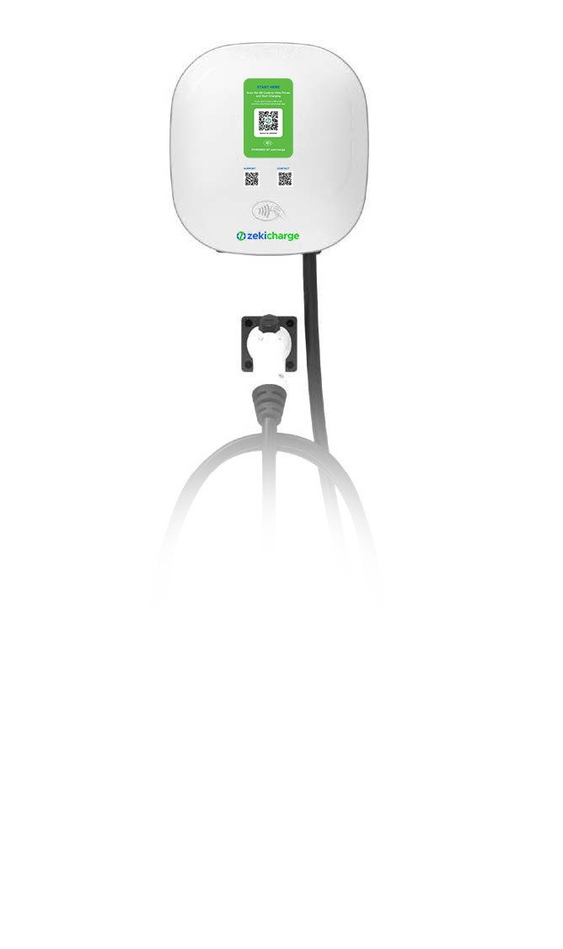
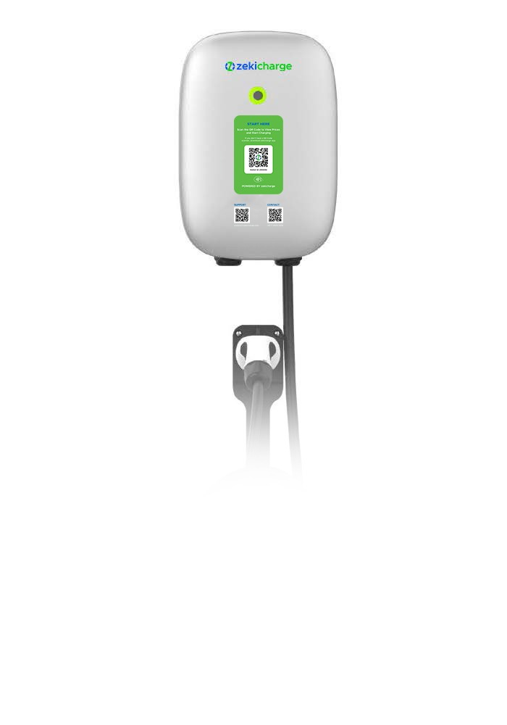
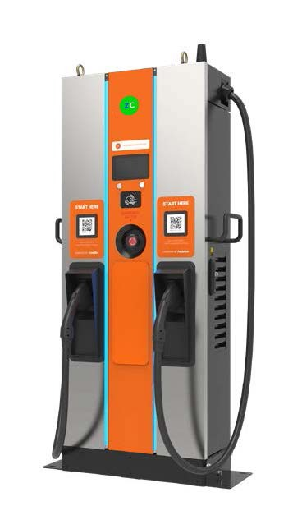
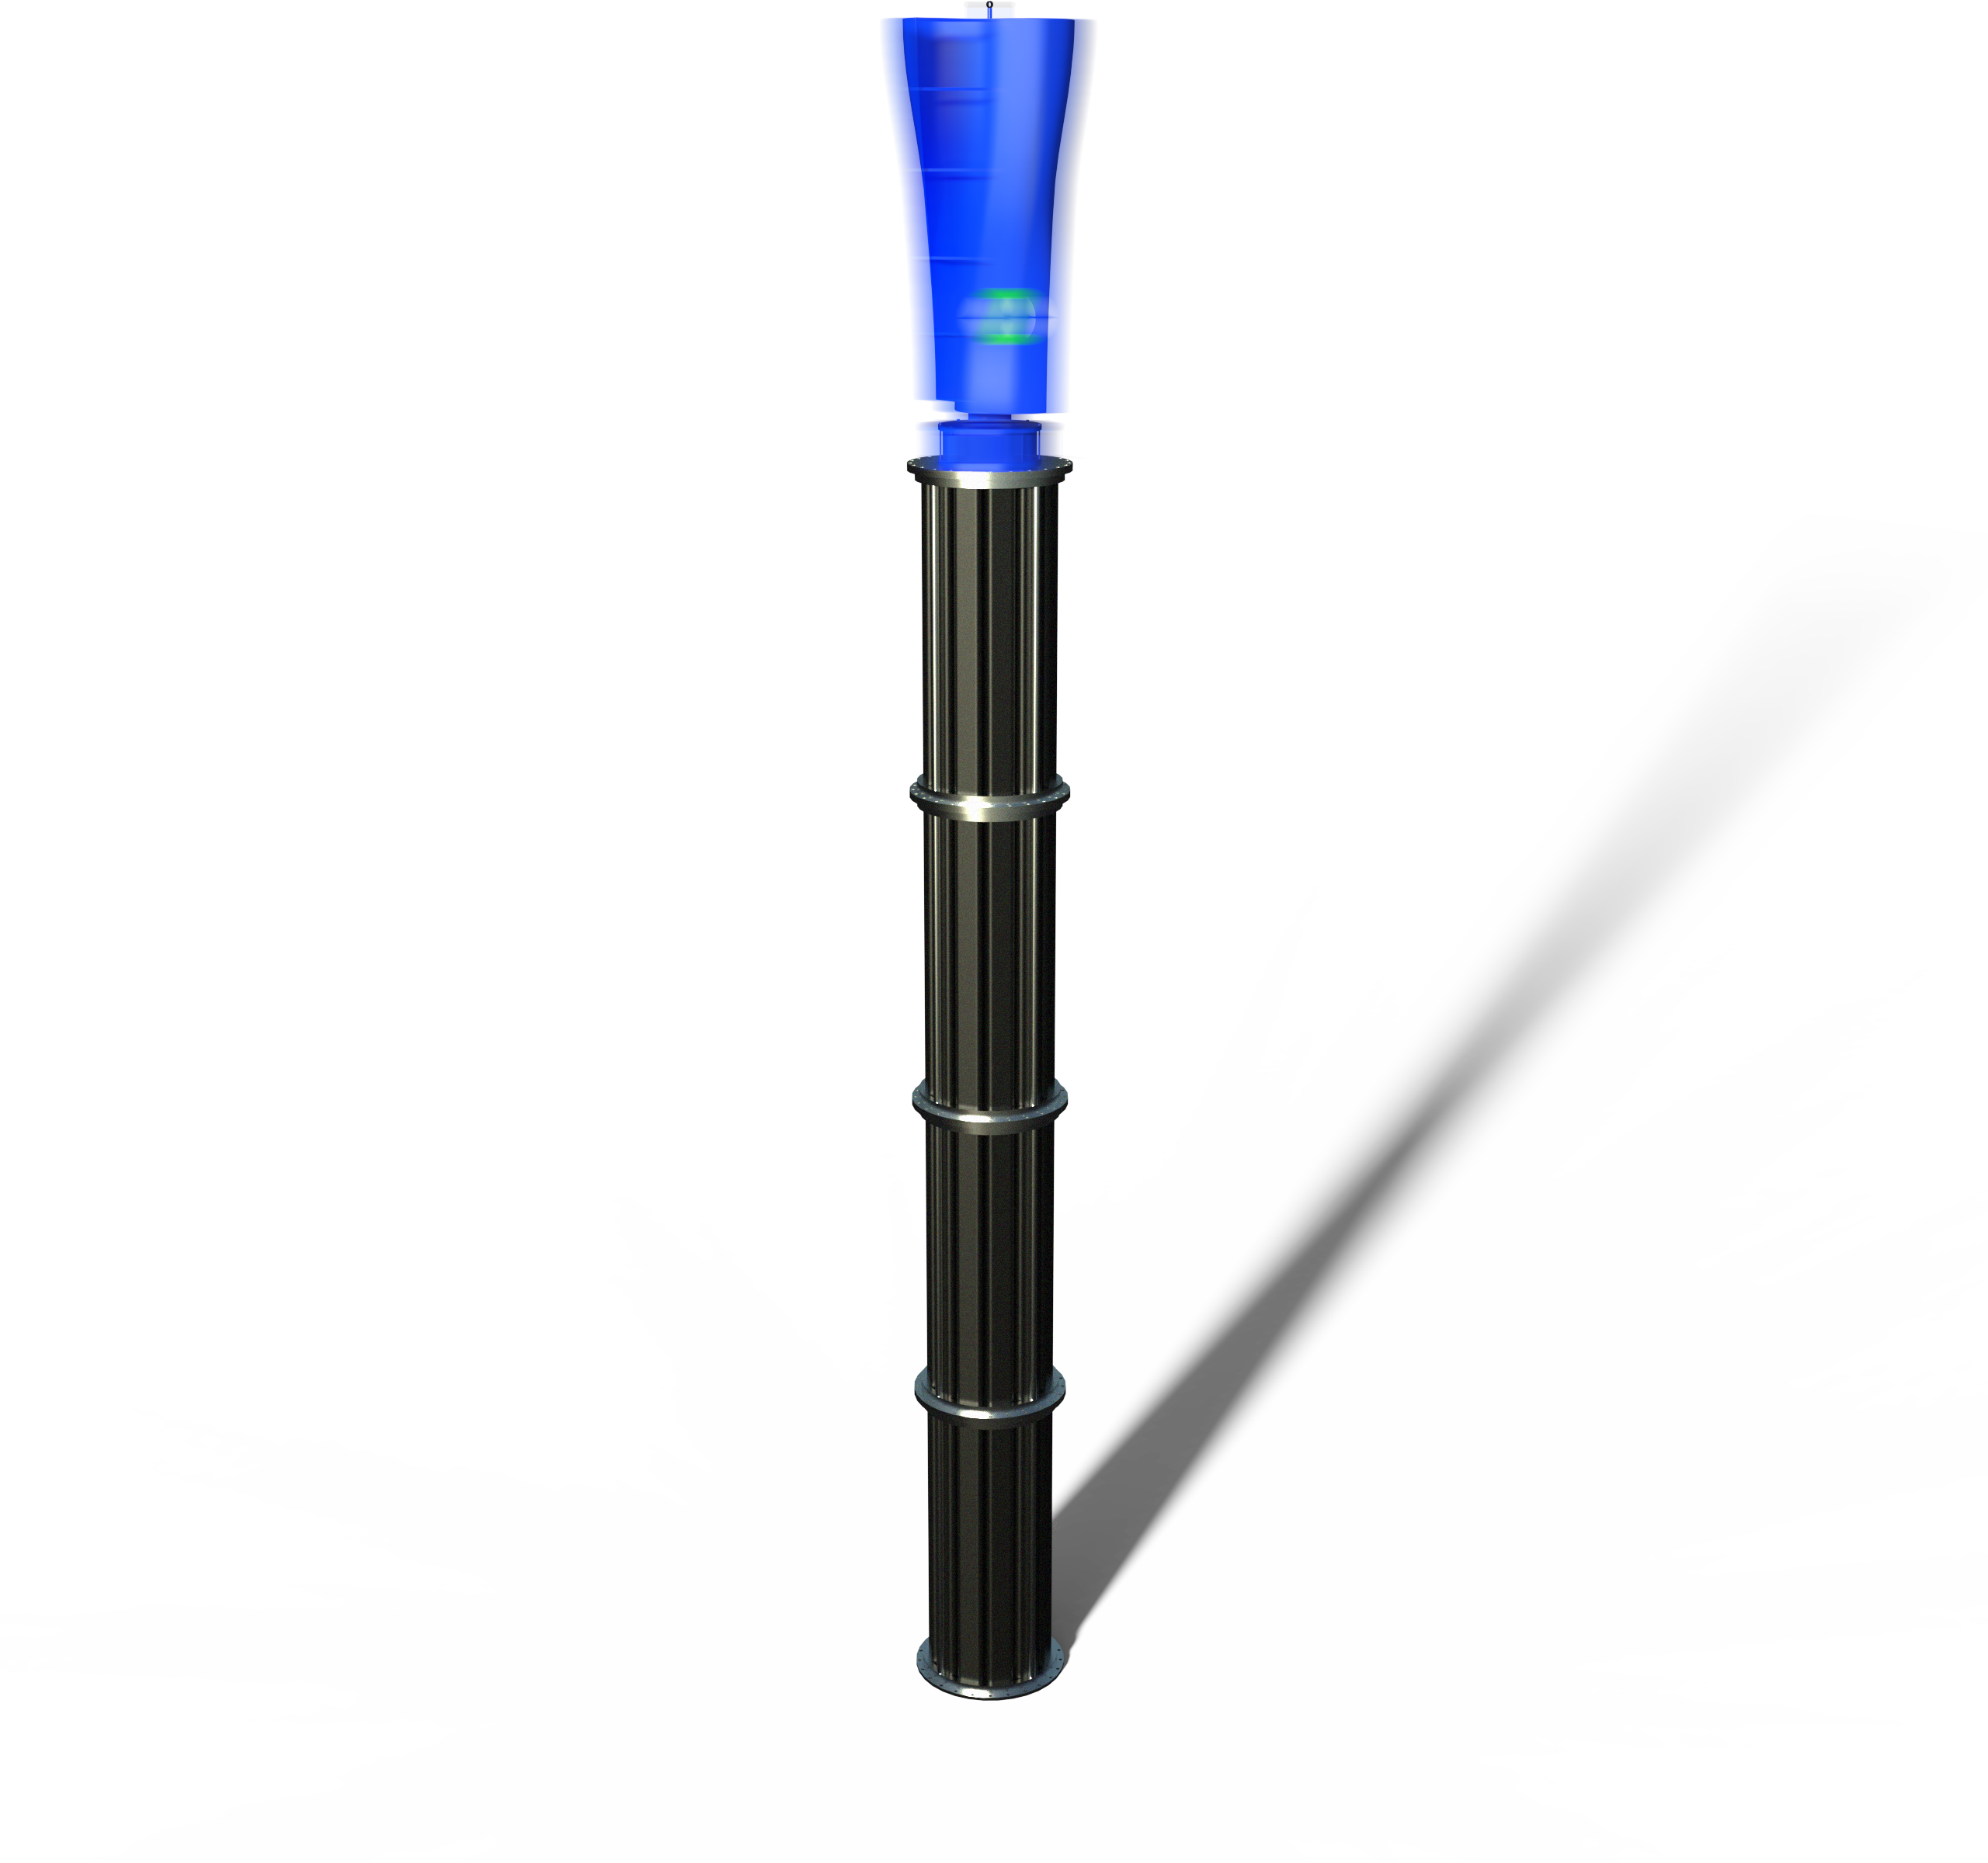
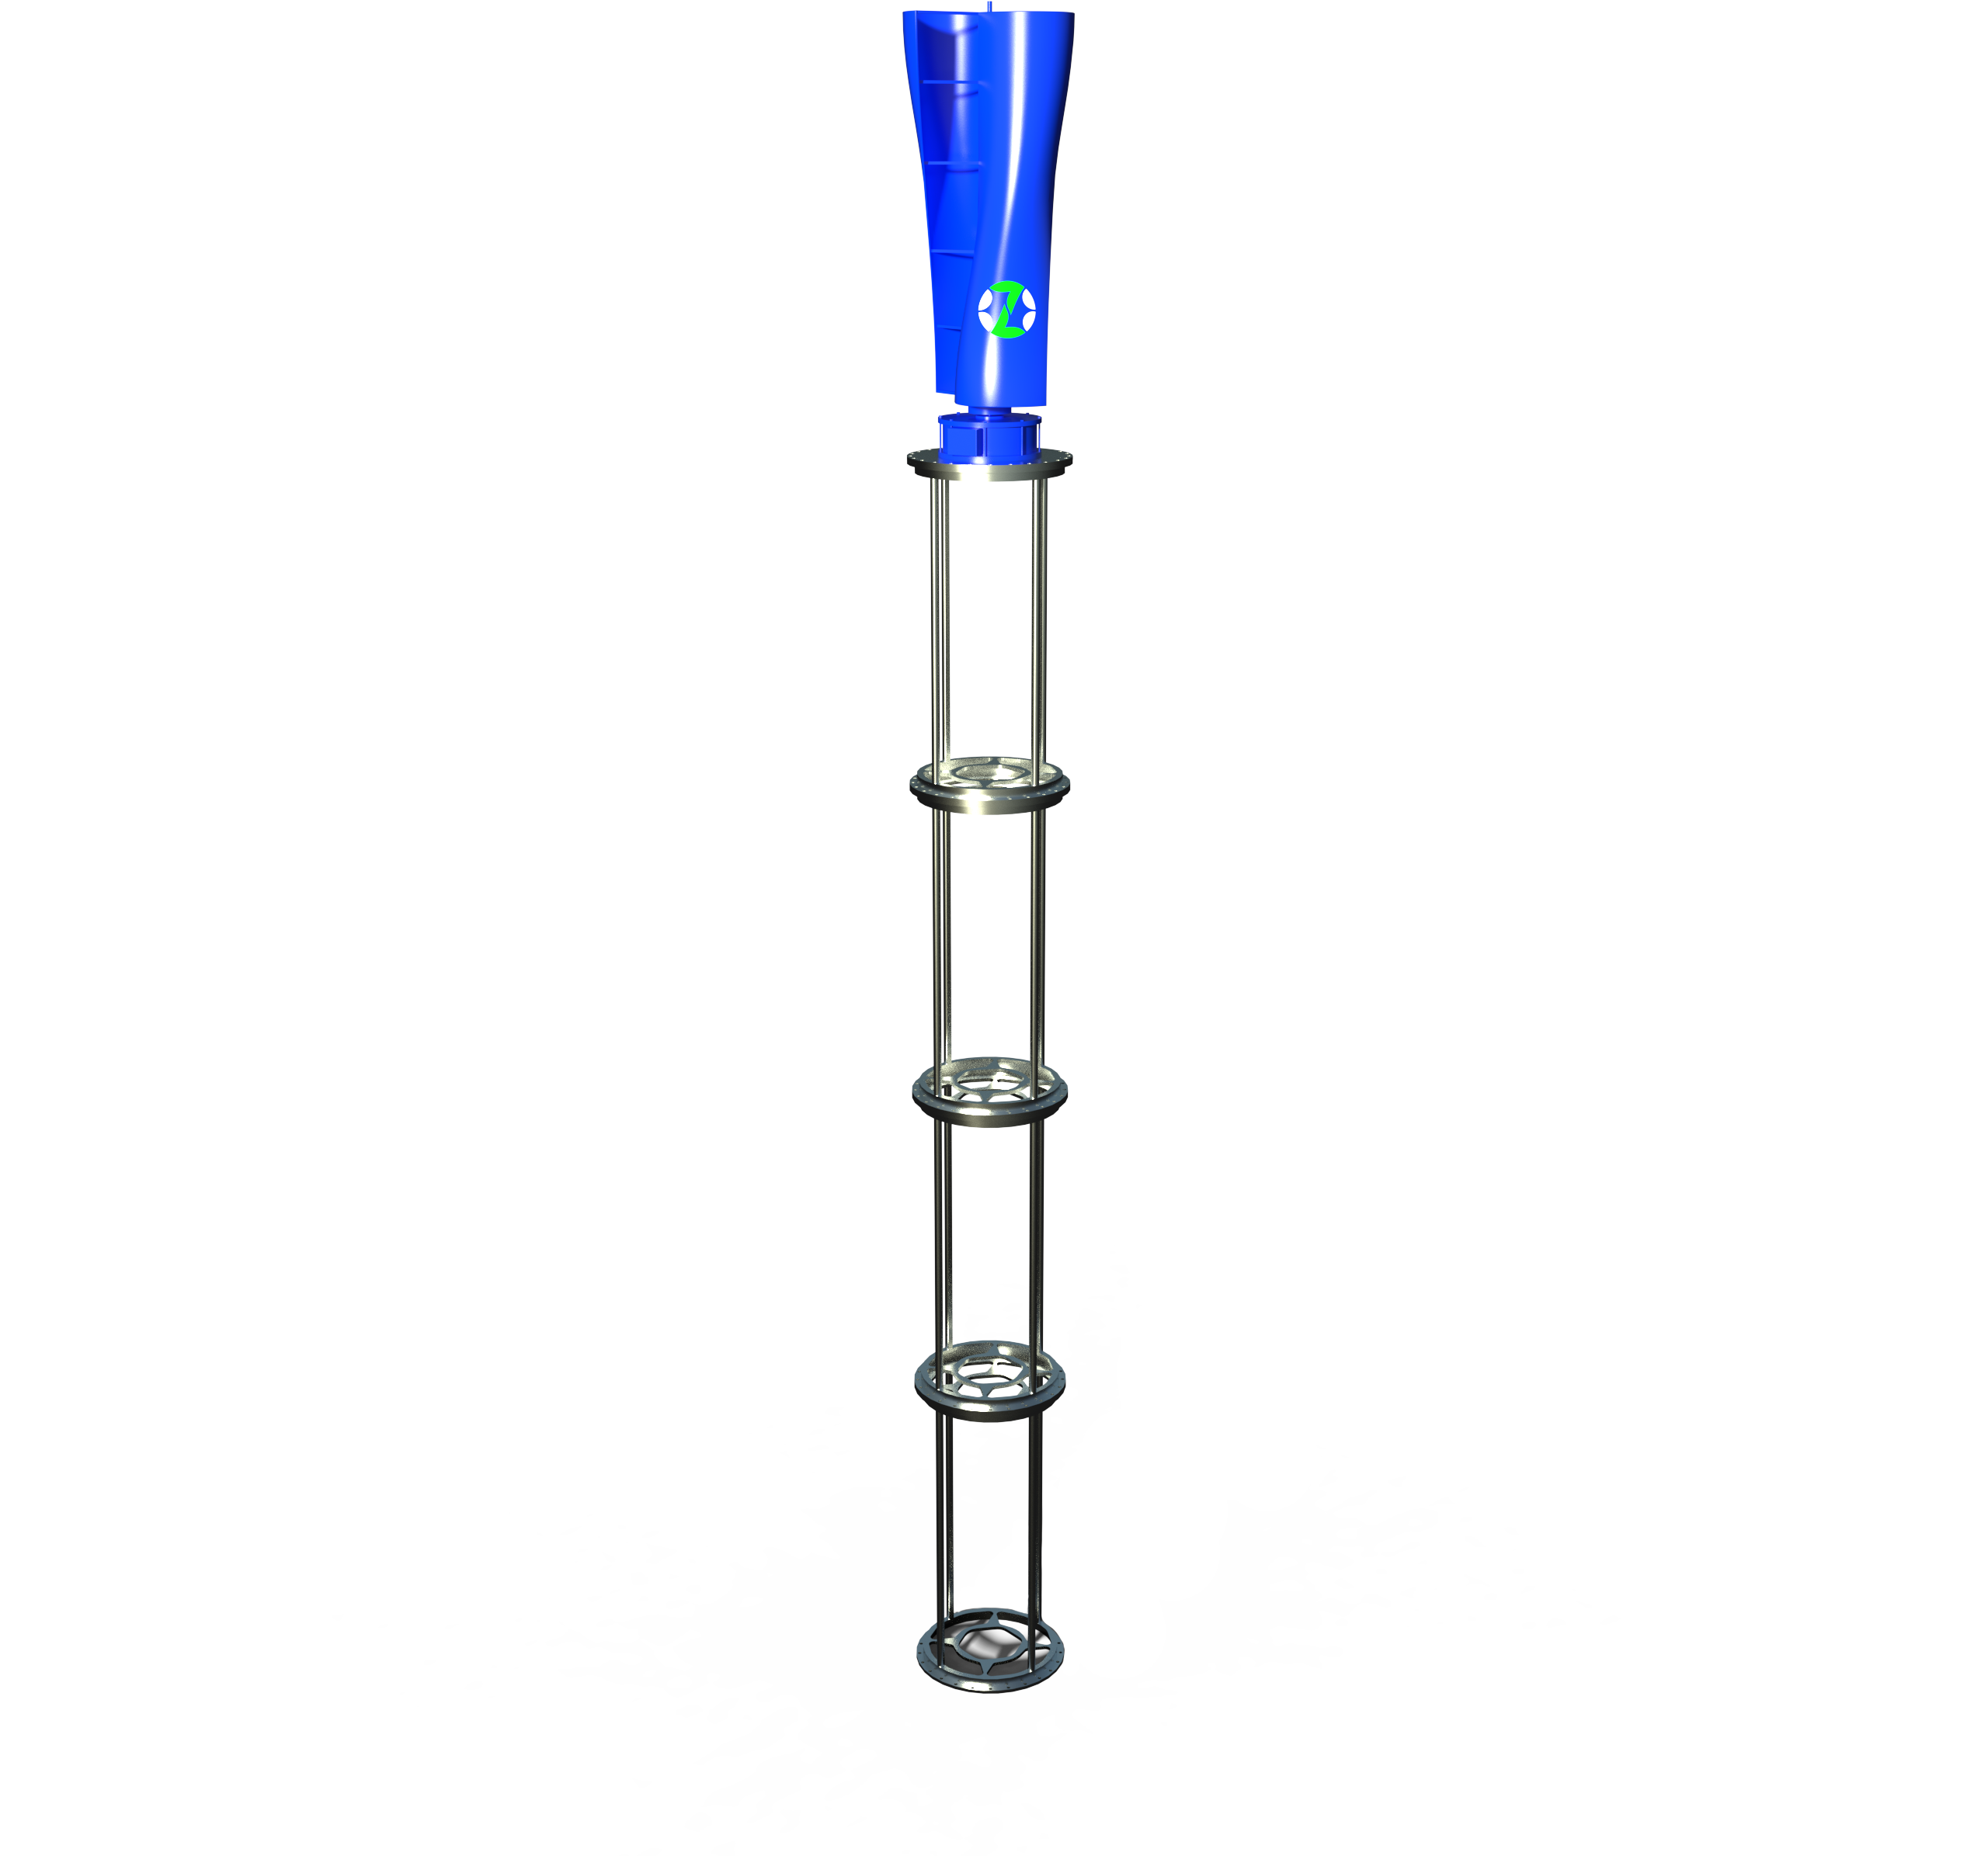
ZekiCharge EV OS
ZekiPost is likened to a futuristic light pole, is a power generation pole with an integrated ZekiTurbine (vertical wind turbine) on top, containing a ZekiBattery lithium battery storage system at its core.
ZekiCharge EV OS is a next-generation, cloud-centric operating system that runs your entire charging infrastructure. It is your intelligent operations manager, performing tasks at scale regardless of how many stations you manage.
The ZekiPost is the future of microgrids. The post has significant storage and demand
management capabilities and is able to receive and store power generated from local rooftop solar, enabling it to serve as infrastructure for grid operators.
A ZekiPost with frequency and voltage control can reduce peak distribution loading and support substations with minimal footprint. The ZekiPost can assist grid operators to manage peak demand and solve frequency issues, by creating a microgrid that enables excess energy tobe captured and traded.
22kw
7kw
60kw
ZekiCharge EV OS features
- Easiest to use
- Fully autonomous
- Add-on applications
- Customisable
- Zero cost for installation
- V2G (vehicle to grid)
- Peak-hour price adjustment
- Intelligent energy management
- Seamless funds transfers
- Automatic diagnostics
Video Link - https://youtu.be/5XJK6P3TnD4
Video link - https://youtu.be/FZxT91Q-jgs
zekitek l presentation of zekicharge in Fiji
zekitek l presentation of zekipost in Fiji

Slide 4
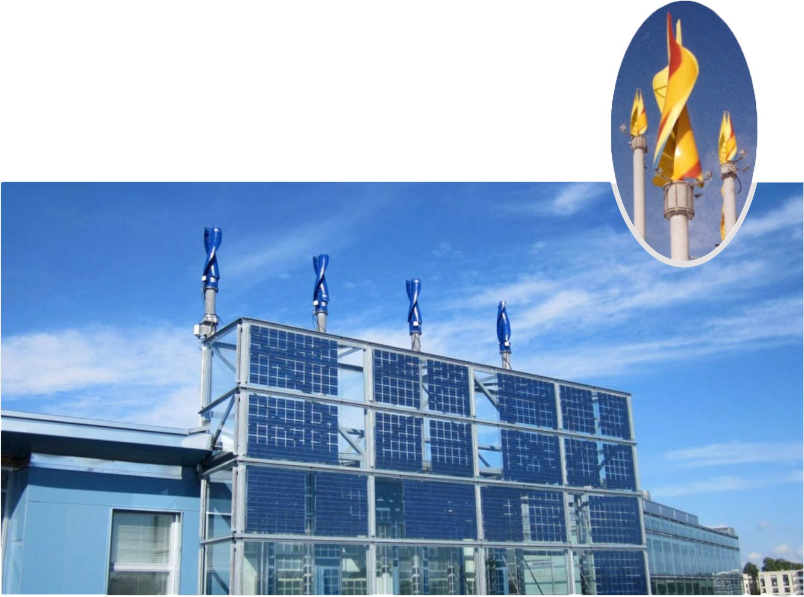
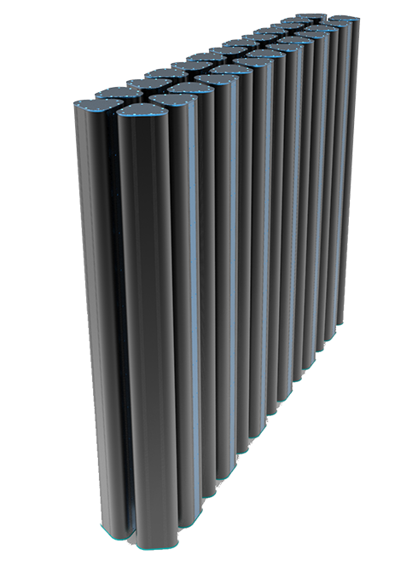
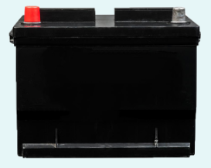
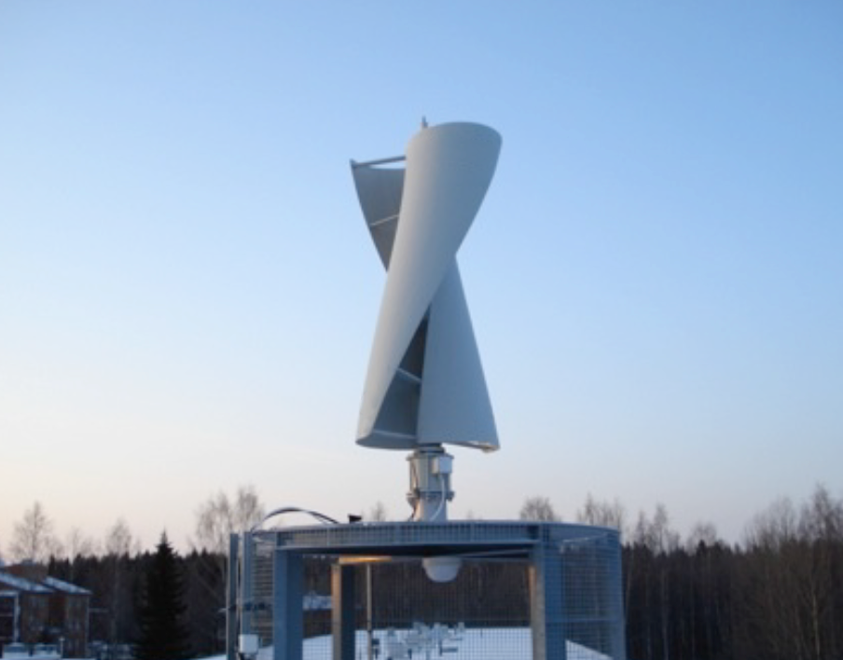
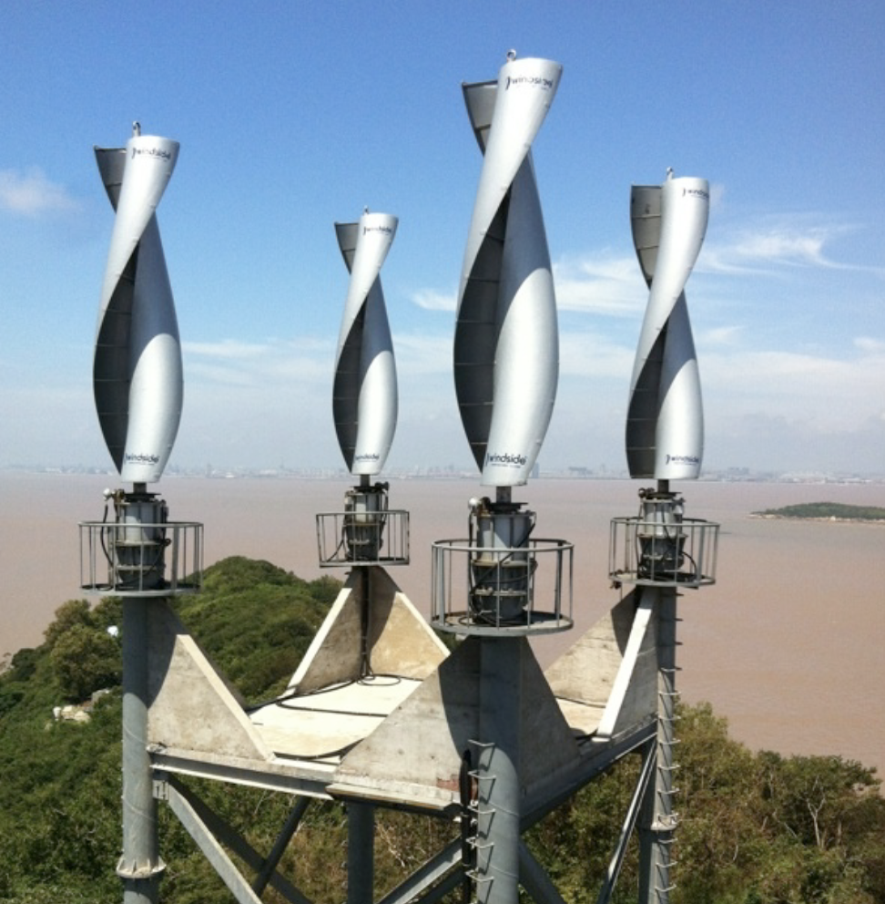
ZekiTurbines are compact vertical axis wind turbines with a small footprint enabling them to be installed in any location, including roadsides and rooftops.
A superior proprietary lithium-based battery system.
ZekiBatteries offer a market-leading life cycle of 22,000 cycles and almost 100% charge and discharge properties, produced using the world’s safest lithium technology.
ZekiBatteries can be used for both commercial and domestic purposes and are available
in two chemistries, LTO and LiFePO4.
LiFePO4 batteries can achieve over 4000 cycles @ 80% Depth of Discharge (DoD) at 25˚C temperatures.
ZekiTurbines can range in size from 1m to 10m in height and from 1m to 3m wide to suit all locations. They can be mounted with nuts and bolts at their base to any surface that is structurally sound.
ZekiTurbine excels in natural wind tunnels and motorways where passing vehicles contribute to generating power, and where needed the turbine can form a microgrid renewable energy generation system.
Video link - https://youtube.com/shorts/sqzQn-jL5Pg?feature=share
LTO Batteries
LiFePO4 Battery
Rooftops of commercial buildings
Mounted on poles
Remote areas
Benefits of ZekiBatteries
- Long life cycle – with warranty to match
- High density and lightweight
- High discharge current
- Maintenance free
- Fast charging
- Environmentally friendly
- Exceptional temp range of -20o to +60o
An urban solution to capturing the power of wind
- Small footprint
- Flexible
- Very effective in natural wind tunnel locations
- Generate 24/7, unlike solar
Video Link - https://youtu.be/5XJK6P3TnD4
zekitek l presentation of zekiturbine in Fiji
zekitek l presentation of zekibattery in Fiji

Slide 5
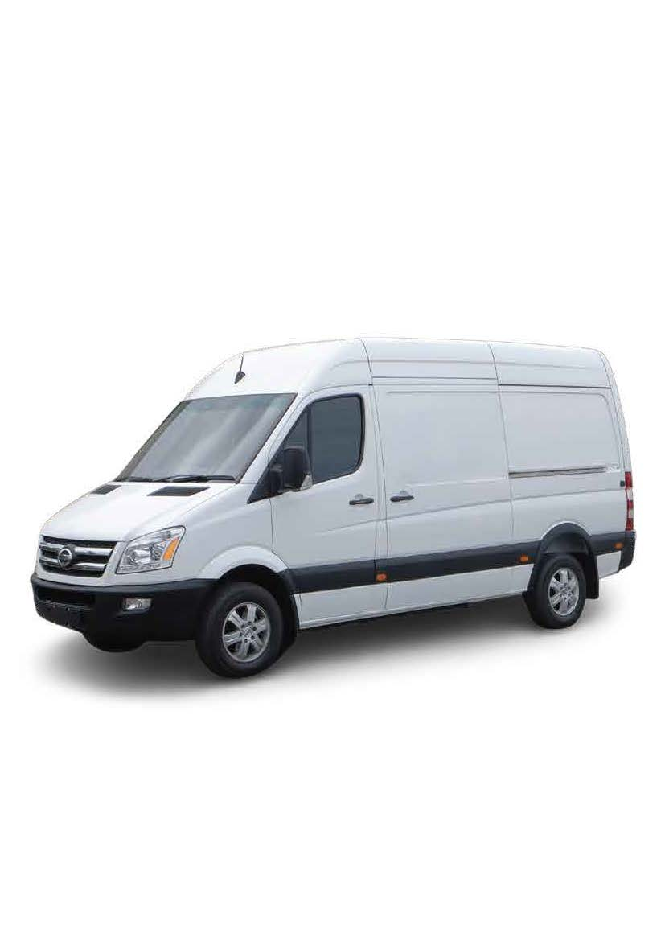
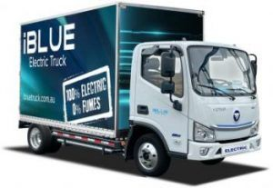
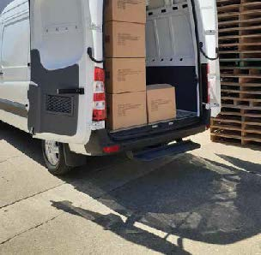
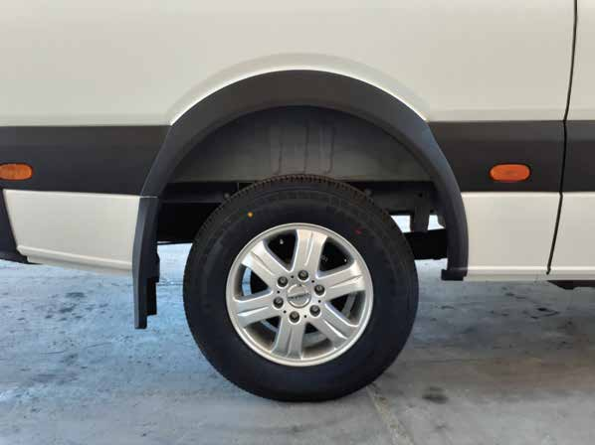
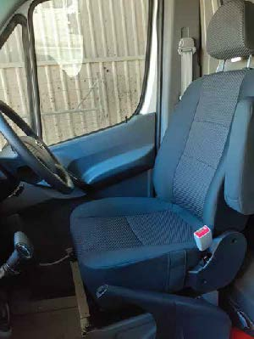
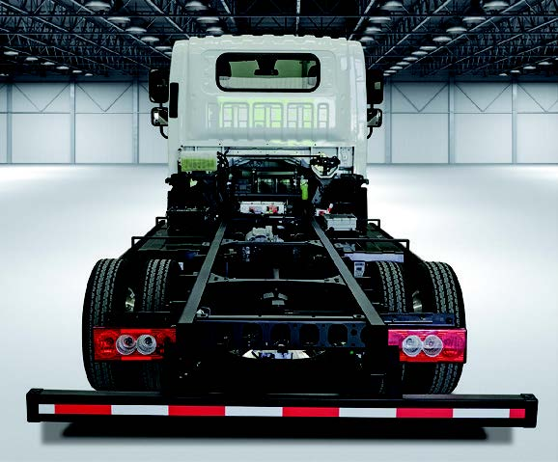
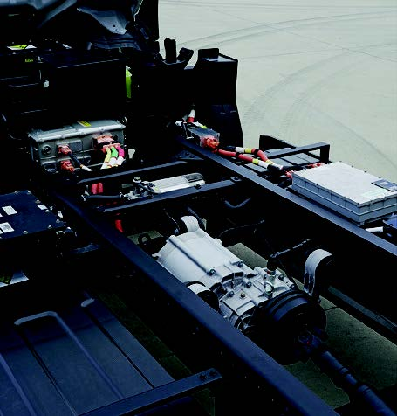
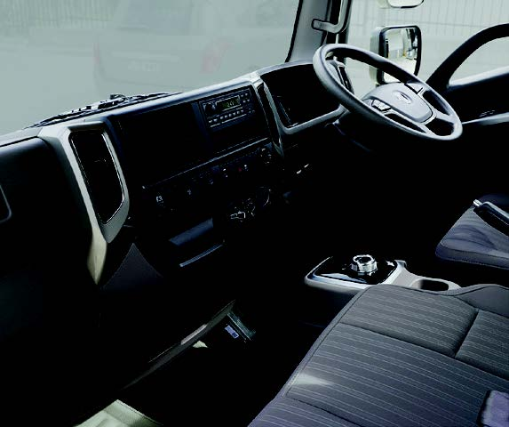
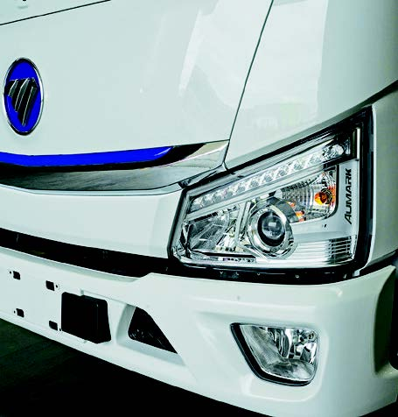
E-CREW (Electric Van & Bus)
i-BLUE (Electric Truck)
With a 12 seat capacity, the E-CREW minibus promises to provide a viable electric solution to operators looking for a cost-efficient solution to transport passengers within a defined radius. With Dual-zone air conditioning and a selection of interior trim options, the E-CREW will set a new standard of comfort and style.
The new iBLUE Electric Truck – Energy efficient for urban and intra-city service.
A cleaner transport solution, high performance, intelligent & advanced EV technology,
offering excellent features, a comfortable ride & Zero emissions.
Features of i-BLUE
Features of E-CREW
1. Dual Rear Doors opening to 270 Degrees and rear step allow for easy access when loading and unloading.
2. Standard 16” Alloy wheels with Full-Size Alloy spare wheel allowing for Tyre
rotation if desired.
3. The multi-function
instrument cluster
Provides clearly
structured, easy to
read data.
4. Height adjustable seat belts, Multi position drivers arm rest, cloth seats, Tilt adjustable steering wheel all make for a comfortable driving experience.
FEVD l presentation of E-CREW in Fiji
FEVD l presentation of I-BLUE in Fiji

