Slide 1
November 29, 2022 Inchul Hwang WB IEAE1
WB Study on PIC E-mobility Roadmap

Slide 2
Contents
1. Introduction 2. Impact of e-mobility on electricity systems 3. Economic viability of e-mobility
4. Policy recommendations

Slide 3
1. Introduction

Slide 4
Objective: develop a regional e-mobility policy roadmap for the PICs
The WB contracted ECA and TTA to develop a regional e-mobility policy roadmap for the PICs
Funded by the WB’s Korea Green Growth Trust Fund (KGGTF)
The focus of the roadmap is on assessing the feasibility of large-scale EV deployment in the PICs, with particular consideration given to high levels of VRE in the electricity systems
The roadmap aims to provide concrete policy recommendations and technical guidelines to support the PICs in promoting a transition to sustainable, decarbonised transport
Tasks: The current status of e-mobility, grid impact assessment, cost-benefit analysis, barriers to e-mobility uptake, policy recommendations and technical guidelines/standards for EV charging and maintenance

Slide 5
Status: E-mobility uptake remains low, but there is considerable potential
Potential e-mobility uptake in the PICs
Vehicle ownership in the PICs is low and the distances travelled tend to be short, which has led to low e-mobility uptake at the moment
However, short distances mean that virtually all trips can be conducted with less than a single charge. And fuel is expensive
Potential uptake varies a lot by EV type, based on how mature the technologies are and their suitability for users in each PIC
Overall, electric cars, motorbikes, and vans have the most potential in the short to medium-term future
Electric cars
High, particularly for taxis and high-use customers
Electric motorbikes
High, in countries where motorbikes are already used
Electric vans and trucks
High for delivery vans and transport, low for trucks
Electric buses
Low unless heavily subsidised
Electric boats
Low
Micro e-mobility
Moderate to high, with only small barriers to entry

Slide 6
Prospect: The expected uptake is uncertain, but will likely not exceed 10% by 2030
Electric cars
Estimates suggest that globally at least 10% of cars will be EVs by the end of the decade
Exact uptake rates are difficult to estimate given uncertainties about future technology costs and policies
Uptake is generally expected to be slower in low and middle-income countries due to a reliance on second-hand vehicles and lower incomes
ECA/TTA estimates that the share of electric cars in the PICs will be 6-19% of all cars in 2030, based on 20%-60% EV share in new vehicle sales. Actual uptake is likely to be at the lower end of this range
Electric motorbikes
Uptake could be high in countries already using two-wheelers, as low-cost models enter the market
Electric vans
Uptake of electric vans likely limited to small goods transport and public transport
Potential electric car uptake in PICs

Slide 7
Four groups and sample countries
Grouping of PICs
There is significant diversity across the 11 PICs
To ensure the analysis and recommendations reflect this diversity, while also being informed by detailed analysis, the PICs are grouped into four categories and select one country from each to analyse
Sample countries analysed in grid impact and economic viability assessments: Fiji, Solomon Islands, Marshall Islands, Tuvalu
Category | Countries | Key (relative) characteristics | Likely main types of e-mobility
Large markets | Fiji Samoa | Large (in size and population) Wealthy High vehicle ownership Cheap electricity | Electric cars (private, taxis) Electric vans (taxis, commercial)
Intermediate markets | Vanuatu Solomon Islands Tonga | Large (in size and population) Less wealthy Low vehicle ownership | Electric cars (taxis) Electric vans (commercial)
Small islands | Kiribati FSM Marshall Islands Palau | Small (short distances) Low vehicle ownership | Electric cars (taxis) Electric motorcycles
Very small islands | Nauru Tuvalu | Very small (short distances) Very small markets | Electric motorcycles and electric scooters

Slide 8
2. Impact of e-mobility on electricity systems

Slide 9
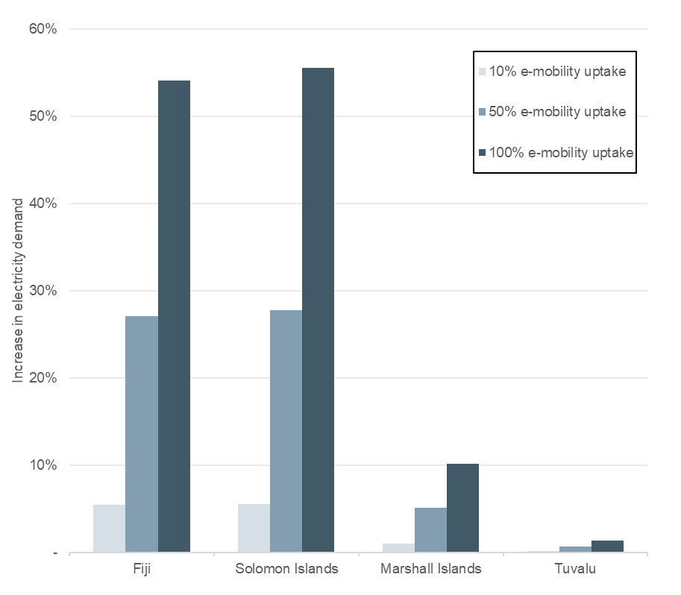
The impact of EVs on electricity demand will vary by country, based on car ownership & electricity demand
Expected impacts of EV uptake on electricity demand in the PICs are expected to vary, as shown in the analysis of four countries
Fiji impacts are relatively high (5% increase in demand for 10% EV uptake) due to higher car ownership and average distances travelled daily (~30km/car/day)
Percentage impacts in Solomon Islands are also high (6% demand, 10% EV uptake) due to low existing electricity demand per customer, which counteracts its low car ownership
Impacts on the Marshall Islands and Tuvalu are very low because car ownership is low (for example Tuvalu has only 65 registered cars)
As a general rule for the large and intermediate markets, every 1% uptake in e-mobility will lead to an approximate 0.5% increase in electricity demand
Increase in total electricity demand
due to e-mobility uptake

Slide 10
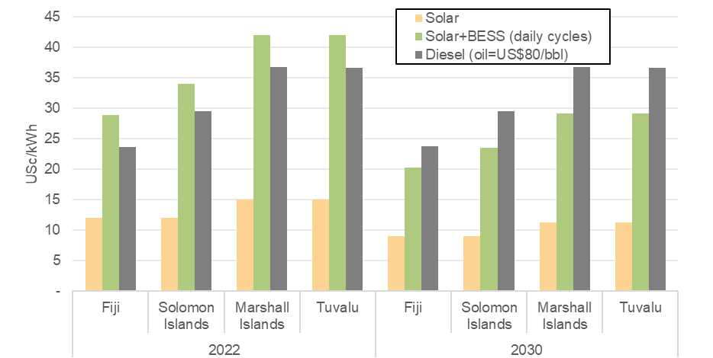
Solar + BESS and daytime charging will be the most efficient way to meet EV demand
A combination solar+BESS is currently more expensive than solar+diesel generation (although not by much at current fuel prices)
Massive investment needed for solar + BESS and network upgrades will be a challenge, but it is expected to change by 2030 as the cost of solar and BESS capacity continues to fall
It will be much cheaper to supply EV demand during sunshine hours than non-sunshine hours, by a factor of more than two in some cases
This is true even after accounting for the fact that network costs are mostly incurred during weekday business hours
Because most PICs currently typically face peak demand during the middle of the day, driven by commercial air-conditioning
Assumed levelised costs of
different generation types
2030 marginal cost of supplying
EV demand efficiently (US$/kWh)
 | Fiji | Solomon Islands | Marshall Islands | Tuvalu
Peak + sunshine hours (weekday, daytime) | 0.17 | 0.19 | 0.26 | 0.21
Peak + non-sunshine hours (weekday early evening) | 0.30 | 0.19 | 0.54 | 0.43
Off-peak + sunshine hours (weekend daytime) | 0.11 | 0.13 | 0.18 | 0.15
Off-peak + non-sunshine hours (nighttime) | 0.25 | 0.13 | 0.46 | 0.38

Slide 11
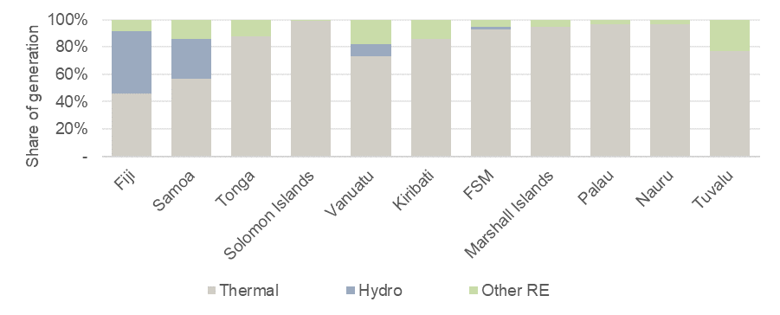
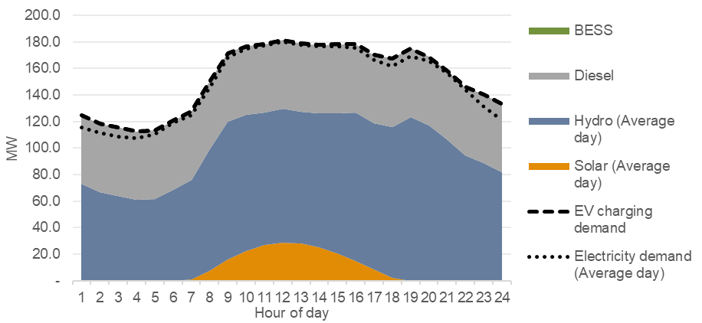
Much more solar is needed to improve EV business
Most Pacific electricity systems have high solar potential but have underbuilt solar and therefore rely on diesel-fired generation
Diesel generation (which is expensive and has high emissions) is currently the marginal generator in most countries, so is used to supply any new EV charging demand
This limits the viability of EVs, as it leads to high charging costs and limited environmental benefits
Fiji and Samoa are well placed to displace diesel through a combination of solar and hydro, but only if they invest more heavily in solar than planned
Other PICs will need to add a lot of solar and BESS to regularly push diesel off the margin. Network upgrades might be pursued at the same time.
Current generation mix in PICs
2030 electricity supply curve
in Fiji after adding 50MW solar

Slide 12
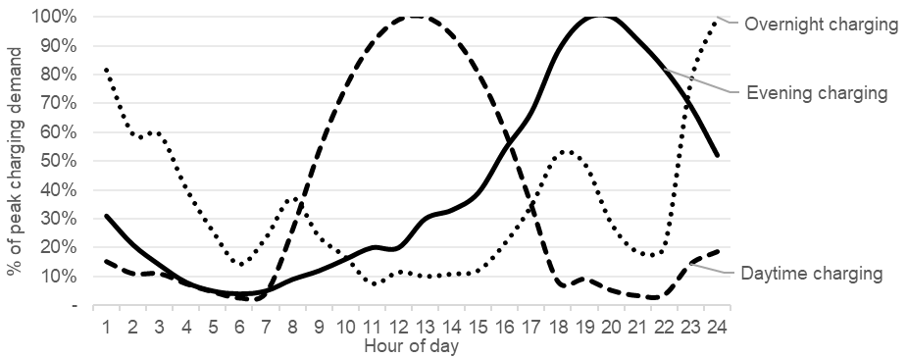
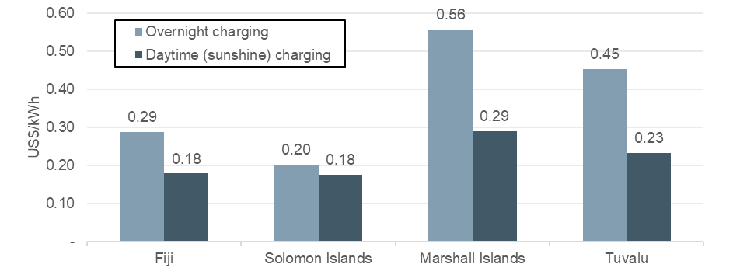
The more daytime charging, the cheaper the cost of supplying EVs
Without incentives encouraging otherwise, residential consumers will likely prefer to charge at home, typically through trickle charging from a standard electrical outlet
This would lead to a predominance of overnight charging, which would ease demands on generation and network capacity in the short-term
But would be sub-optimal once the utilities invest more heavily in solar generation
If EV demand is met with solar+BESS demand (instead of hydro), then overnight EV charging will be around 50% more expensive than daytime charging
Daytime charging can be encouraged through time-of-use (TOU) tariffs and by installing public charging facilities
Possible EV charging demand curves
2030 marginal costs of supplying EV demand

Slide 13
3. Economic viability of e-mobility

Slide 14
Net benefits calculated under low, medium, high use cases
Once governments know what is beneficial to society, they can implement policies that aligning societal benefits with individual financial incentives (eg. through tax breaks to reflect environmental benefits)
The viability of EVs is calculated by comparing EV and ICE costs:
Upfront costs for vehicles and charging infrastructure
Fuelling/charging costs
Maintenance costs
Environmental costs from vehicles and electricity generation
Net benefits are calculated under three distinct scenarios. Low, medium, and high-use cases for each EV Type (eg. taxis = high-use e-cars) are evaluated
To reflect that some vehicles are used more than others, which will impact how much lower operating costs offset higher upfront costs
Overview of scenarios and assumptions considered in cost-benefit analysis
Business-as-usual 2022
Based on status quo
No further policy interventions beyond status quo
Business-as-usual 2030
Conservative assumptions reduction in EV upfront costs
Only 20% of daytime EV charging supplied by solar. Use of diesel outside of sunshine hours
Mostly overnight EV charging
Favourable 2030
Higher future cost reductions in EV upfront costs
100% of daytime EV charging supplied by solar, thanks to increase RE investment. And 80% use of BESS (charged by solar) outside of sunshine hours
More daytime EV charging, thanks to TOU tariffs and provision of public charging facilities

Slide 15
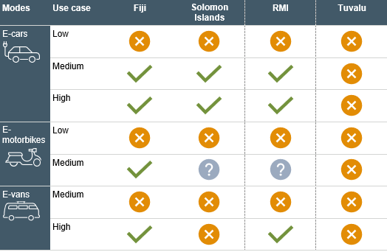
EVs will become viable if countries increase solar generation and encourage daytime charging
Despite forecast significant reductions in their upfront costs, e-cars, e-motorbikes, and e-vans are all unlikely to be viable by 2030 if countries do not make significant investments in solar generation
If the PICs successfully increase solar penetration, then EVs will be viable, except for when the usage is low
This also depends on countries implementing incentives to encourage daytime charging (to benefit from cheap and clean solar energy)
The higher benefits in the medium and high use cases (ie. commuters and taxis), suggests policies should focus on encouraging EV uptake among these groups
In Tuvalu and other very small islands, EVs are unlikely to become viable in the short to medium term
The short distances travelled do not allow the high upfront costs of EVs to be recouped through lower operating costs
Viability of EVs under certain use cases under the Favourable 2030 scenario

Slide 16
4. Policy recommendations

Slide 17
Barriers to e-mobility uptake in the PICs
While there is variation between countries, the barriers shown in bold are generally the most impactful
Not all of these can be easily mitigated, in particularly those relating to commercial viability. But as demand grows, private sector will bring more cheaper second-hand EVs to market
The reliance on diesel-fired electricity generation will take time to mitigate, but is critical. Decarbonisation of transport and electricity must happen in tandem
Policy-makers should give all barriers some attention, because many are inter-dependent
Unfortunately, smaller PICs will generally have a lower ability to act mitigate barriers
Key barriers to e-mobility uptake in the PICs
Transport and electricity infrastructure
A | Lack of electricity charging infrastructure
B | Dependency on diesel-fired electricity production and resulting high tariffs
C | Lack of technical support and adequate maintenance services for EVs
D | Limited environmental benefits given reliance on diesel generation for electricity
E | Electricity grid has limited capacity for electricity charging infrastructure
Commercial viability
F | Price gap between the upfront cost of EVs and ICE, with demand in the PICs very sensitive to price
G | Small trip distances limits operating cost savings
H | Reliance on second-hand vehicles and the limited second-hand EV market
I | Limited financing options for investment in infrastructure and EV fleets
J | Limited fiscal capability to subsidise EV uptake
Governance and policy
K | No clear e-mobility strategy or roadmap
L | Limited coordinated efforts between the Pacific Island Countries
Regulation and standards
M | Absence of regulations and standards relating to EVs
Communication and awareness
N | Limited experience and training with EVs
O | Limited understanding of quality standards of EVs and associated products

Slide 18
Recommendations – Transport/electricity infrastructure
# | Policy recommendation | Potential impact | Fiscal affordability | Ease of implementation | Overall priority
1 | Develop public electric charging infrastructure | High | Medium | Medium | High
2 | Support the development of in-house EV charging facilities | Medium | Medium | Medium | Medium
3 | Roll-out electricity smart meters | High | Low | Medium | High
4 | Require charging facilities in new buildings | Low-Medium | High | High | Medium
5 | Expand RE and BESS capacity | High | Low | Low | High
6 | Introduce electricity time-of-use tariffs | High | Medium | Medium | High
7 | Foster development of private PV facilities to charge EVs | Medium | High | Medium | Medium
8 | Conduct impact assessments of EV uptake on distribution grids | Medium | Medium | Medium | Medium
9 | Offer special EV access | Low-medium | Medium | High | Low
Many of these are interrelated and are focused on enabling daytime EV charging using cheap solar generation
Some are contingent on others and should not necessarily be implemented immediately. For example introducing time-of-use tariffs requires roll-out of smart meters and should not be implemented until RE capacity has been expanded

Slide 19
Recommendations – Commercial viability
# | Policy recommendation | Potential impact | Fiscal affordability | Ease of implementation | Overall priority
10 | Provide purchase incentives, such as subsidies or tax breaks | High | Low | Medium | High
11 | Offer targeted financial incentives for private companies to establish EV fleets | Medium-High | Medium | Medium | Medium
These are focused on reducing the upfront cost differential between electric and ICE vehicles and fairly reflecting the environmental benefits of EVs
Policy makers should hold off introducing large purchase incentives until their national electricity system can charge EVs from renewable sources

Slide 20
Recommendations – Governance and policy
# | Policy recommendation | Potential impact | Fiscal affordability | Ease of implementation | Overall priority
12 | Create a regional e-mobility council | Medium | High | High | High
13 | Develop a regional e-mobility strategy | Medium | Medium | High | High
14 | Develop national e-mobility strategies | Medium | High | High | High
15 | Monitor progress made on e-mobility | Low | High | High | Medium
16 | Coordinate planning across public administrations | Low | High | Medium | Medium
This roadmap provides a starting point for regional and national e-mobility strategies
Such strategies should be developed by local stakeholders to ensure that they have ownership over the policy

Slide 21
Recommendations – Regulations and standards
# | Policy recommendation | Potential impact | Fiscal affordability | Ease of implementation | Overall priority
17 | Establish regulatory instruments for EVs | Medium | High | Low-medium | Medium
18 | Develop technical guidelines for EV charging | Low-medium | High | High | Medium
19 | Establish minimum standards for EVs and charging equipment | Low-medium | High | High | High
20 | Develop public procurement procedures for EV products | Low-medium | High | High | Medium
Technical annexes to the report, which can be used as a starting point for national guidelines and standards, include:
Technical guidelines for EV charging stations
Minimum standards for EV charging equipment
Guidelines for EV maintenance procedures

Slide 22
Recommendations – Communication and awareness
# | Policy recommendation | Potential impact | Fiscal affordability | Ease of implementation | Overall priority
21 | Develop an e-mobility communication strategy | Medium | High | Medium | High
22 | Engage with stakeholders | Medium | High | Medium | Low
23 | Launch EV pilot projects | Medium | Medium | Medium | Medium
24 | Switch public vehicle fleets to e-mobility | Medium | Low | Short term | Low
25 | Provide training and information on e-mobility | Medium | High | Medium | Medium
26 | Mainstream gender aspects in EV policy | Low | High | Medium | Medium
An e-mobility communication strategy will be a key step in the implementation of regional and national e-mobility strategies

Slide 23
THANK YOU!

