Slide 1


Introducing electric mobility to Fiji and the wider Pacific

Slide 2

Low Emission
Pathways
Land Transport = 20% of global emissions
Higher in SIDS. PSVs are among the largest contributors, after heavy transport.
Switching to alternative fuel a priority of Low Emissions Development Strategy and an the NDCs.

Slide 3
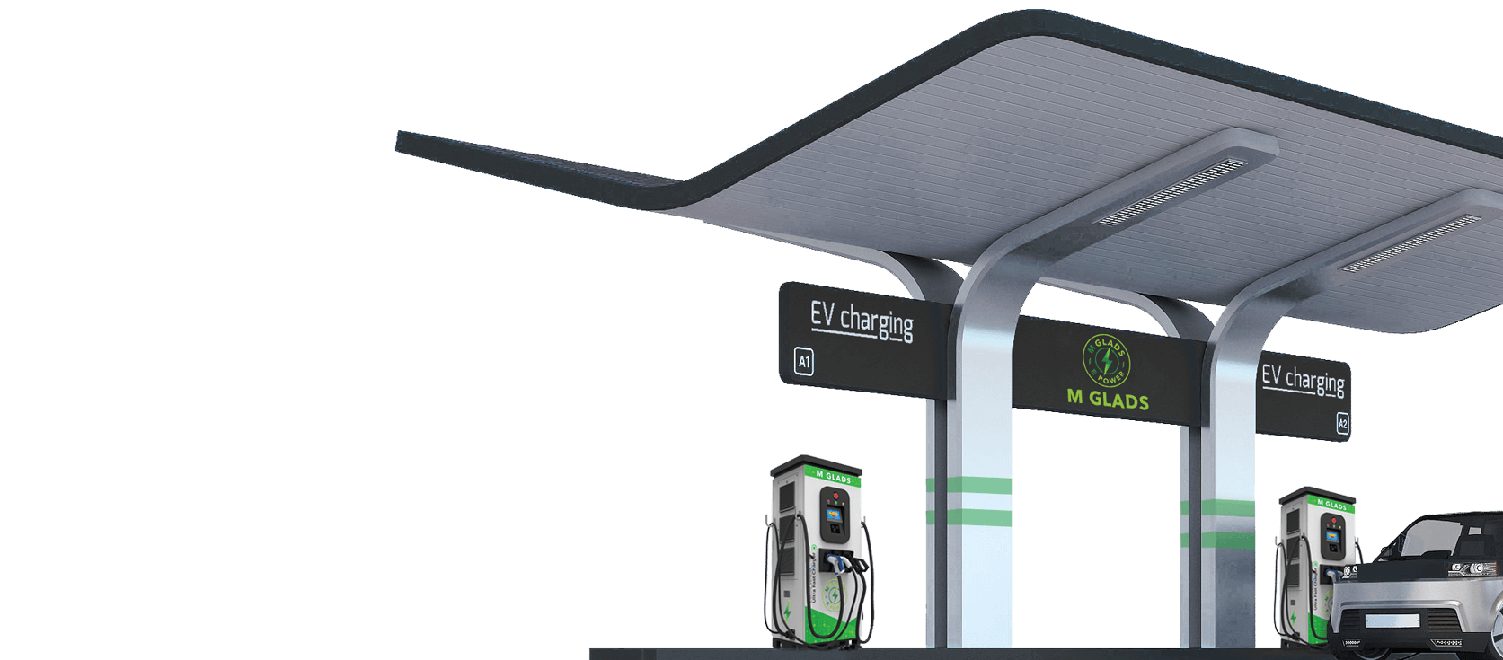
Do EVs make sense in the Pacific?
Prices are falling
New EVs within 15% of petrol equivalent, used EVs are among the cheapest options.
Range is increasing
200km+ range is the new standard
Fast chargers are more affordable
Low running costs benefit high mileage users.
Savings from E-Minibus estimated at $0.25/km
Results in daily savings of $50-$112 depending on route.

Slide 4
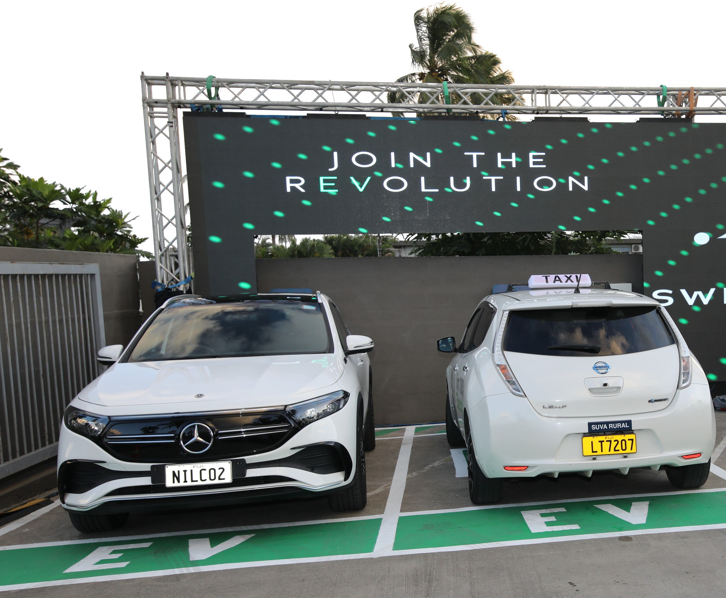
Chicken or Egg?
Despite the seemingly ideal circumstances, EV adoption has been negligible in the Pacific.
Switch aims to identify areas in which e-mobility can make the biggest cost and emissions difference and deploy solutions that work from day one.

Slide 5
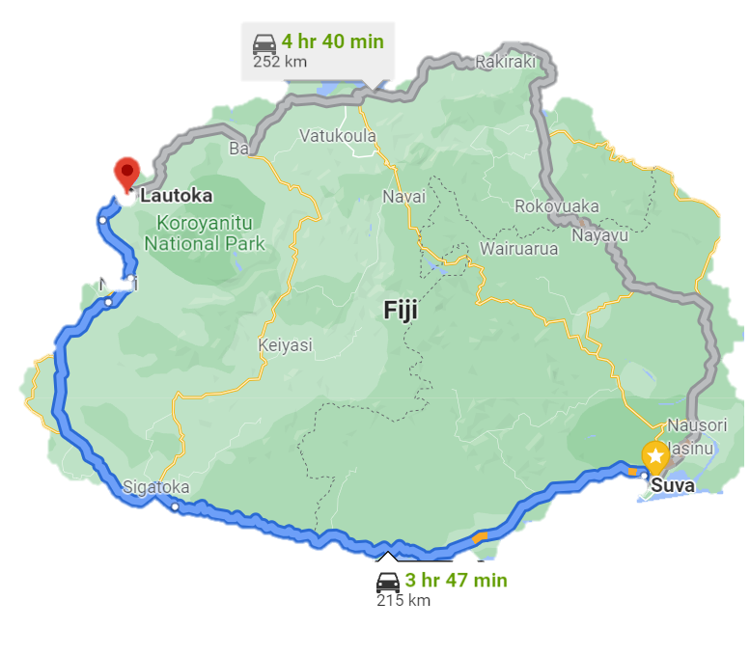
Green Mobility Hubs
Combining solar, EV charging and EVs
Offset emissions while creating transformer capacity for charging
Eliminate costly upgrades to the grid
Financially viable and delivering savings from day one

Slide 6
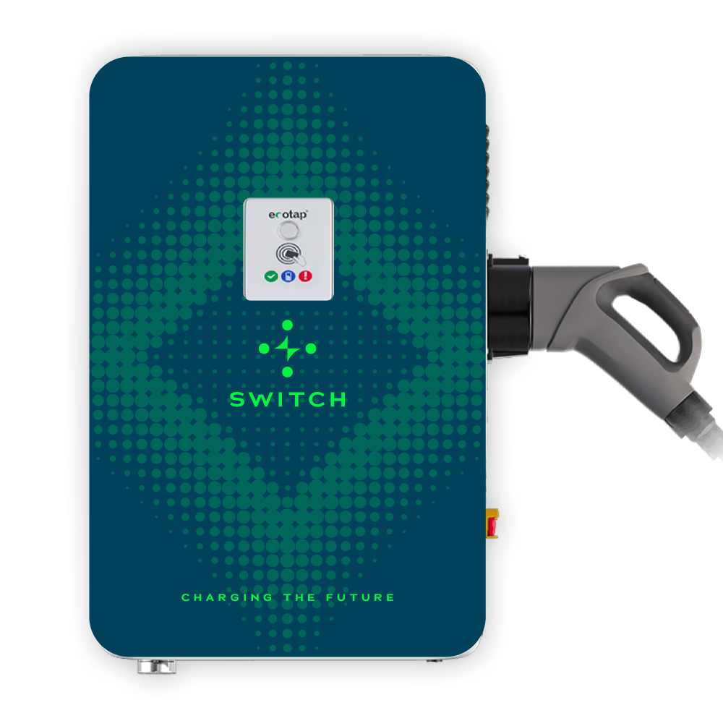
Positive Charge:
Focus on PSVs
Reduced running costs – Improved revenue
Eliminate fare inflation – stable tariff
New operating model: more runs with quicker journeys.
15/40 tonnes of CO2e reduced per taxi/minivan.

Slide 7

Enable the Energy Transition
Adoption of solar changes power dynamics
TOU tariffs are new to the region, no way of changing demand pattern
Our system allows utilities to trial new approaches in advance
Seeking partnerships with utilities in the region

Slide 8


