Slide 1
presentation
UPDATE ON MEPSL ENFORCEMENT IN VANUATU

Slide 2
UPDATE ON THE EE ACT AND REGULATIONS
EE Act was passed by the parliament on 9th December 2016;
Gazetted by State Law on 29th March 2017;
Regulation was signed by the Minister of Climate Change and Energy on 29 September 2017;
Gazetted by State Law on 3rd October 2017(commencement date);
Applies to business and personal importers who have placed firm orders after the commencement date;
Registration of regulated products is in good progress.
REGULATED PRODUCTS (and commencement date/year)
Fridges and Refrigerators(2017);
Air Conditions(2017);
Lightings(2017)
- Incandescent Lamps;
- Linear Fluorescent Lamps
- Compact Fluorescent Lamps
-Fluorescent Lamp Ballast
Televisions(2023);
Clothes Washers(2023).

Slide 3
PAD REGISTRATION UPDATE IN VANUATU
In April 2019, all applications and registrations were submitted, assessed and issued through the PAD;
The regulator(DoE) created usernames and passwords for the major importers(especially retailers);
All login details were distributed to respective users to allow them to register their products and apply for new registration certificates;
Assessments and approvals were processed by the regulator(DoE);
In April 2021, Vanuatu worked in collaboration with the department of Trades to launched the Vanuatu Electronic Single Window(VesW) system;
Once the VesW was officially launched, the PAD and the AS/NZ registration database were integrated into the VesW for product verification purposes.

Slide 4
ROLE OF DoE DURING AND AFTER REGISTRATION
Ensure that applicants have access to the VeSW online registration through the singlewindow.gov.vu link;
Ensure that all relevant information, including required documentation are provided during application submissions;
Ensure that an application is assessed and processed (accepted, approved and paid) accordingly in the system;
Ensure that, prior to importation, the importer must obtain a valid registration certificate;
Conduct Surveillance checks, especially in the retail shops or at the border to ensure only energy efficient products are imported into the country (monitoring compliance in the field);
Issue penalties for non compliant or prohibited imports;
Seize non-compliant products that do not meet the requirements;
Conduct awareness on the EE Act and regulations;
Conduct annual refresher trainings to customs border control officers.

Slide 5
PROCEEDURES TO APPLY FOR REGISTRATION CERTIFICATE IN THE VesW.
Importer must provide their product details to their respective customs brokers/agents. Product must comply with AS/NZ standard requirements;
Customs agents/brokers apply on behalf of the applicant/client;
DoE assess the application and verify the product specifications accordingly;
If the product details are ok, the application is accepted and forwarded to the regulator for approval;
If a product detail does not meet the requirements, the applicant is requested to provide supporting documents such as an AS/NZ test report to support the application;
Once the product documents are assessed and verified, the regulator approves the application;
After an approval, the registration fee is paid and the customs agent or DoE officers print the certificate and present it to customs officers during inspection and clearance.

Slide 6
FLOWCHART FOR VesW REGISTRATION

Slide 7
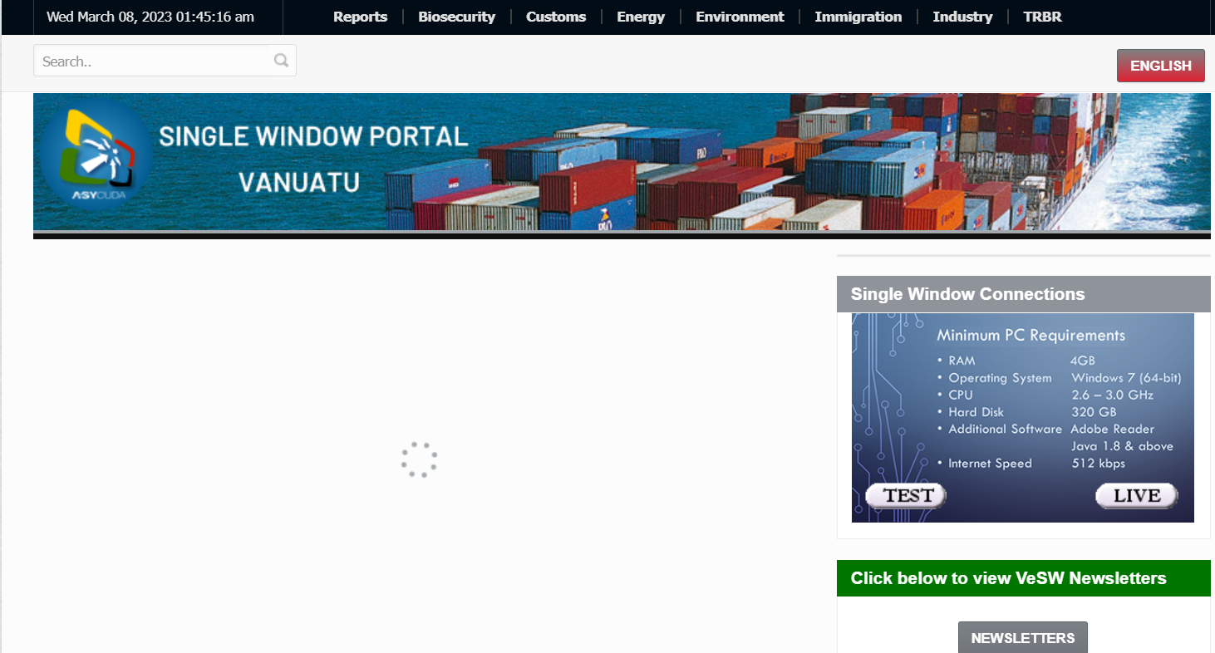
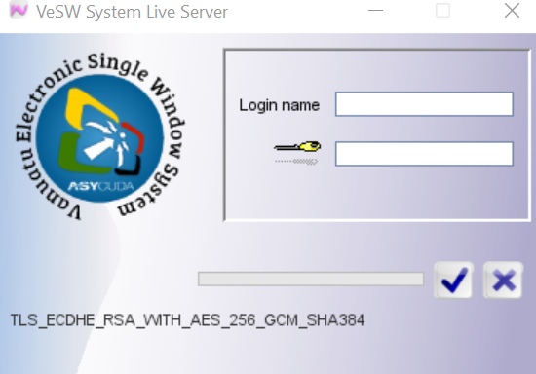
HOMEPAGE - VANUATU ELECTRONIC SINGLE WINDOW SYSTEM(VeSW)

Slide 8
ENERGY MODULE

Slide 9
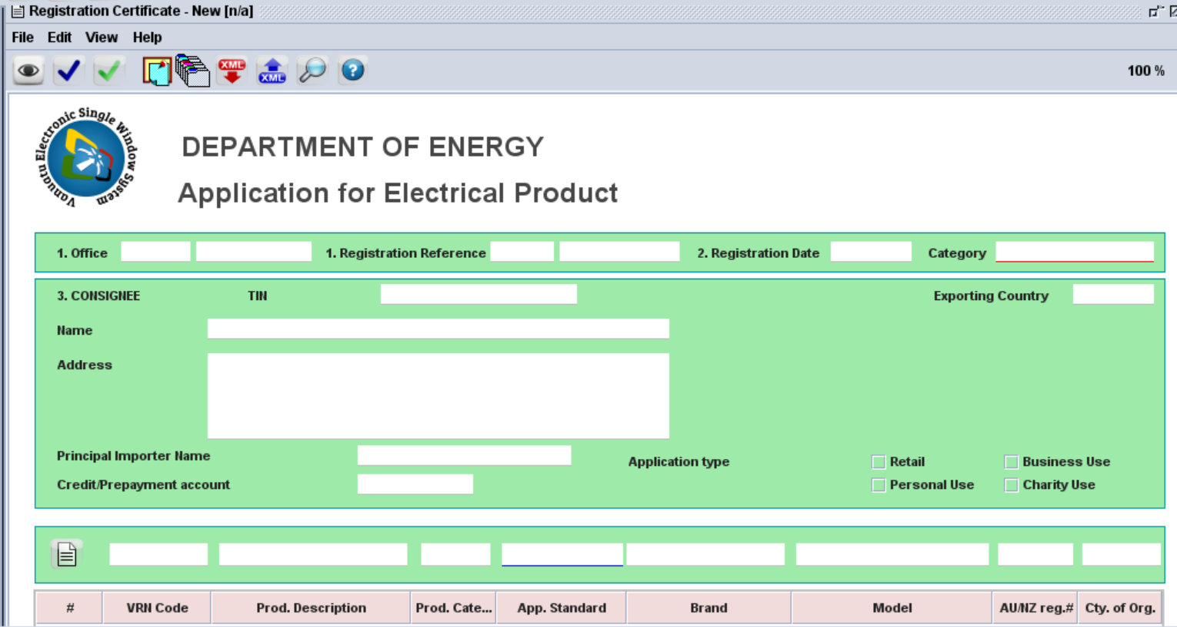
APPLICATION FORM
AS/NZ Database
PAD

Slide 10
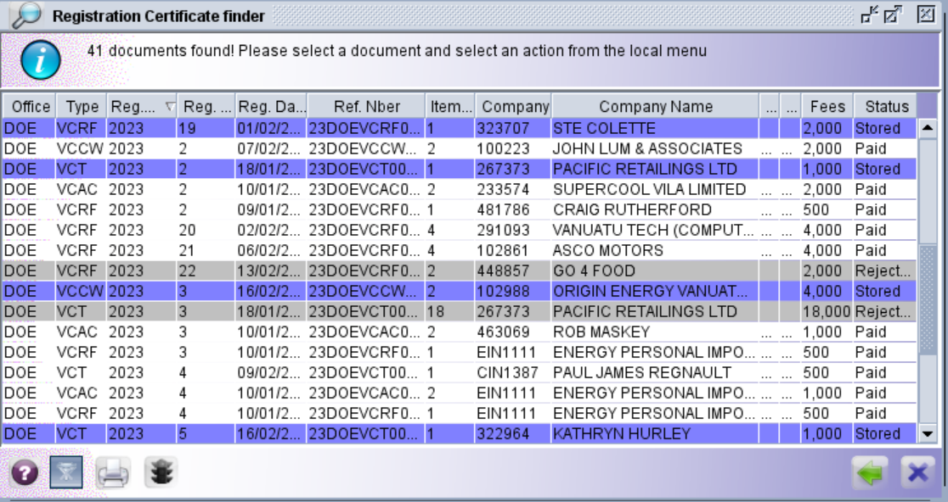
SAMPLE LIST OF REGISTRATIONS

Slide 11
DATA
Approximate applications and registrations processed(2017 - 2023)
Year | Number of applications received | Number of applications approved | Number of applications rejected
2017 | 3 | 1 | 2
2018 | 65 (plus) | 60 | 5 (plus)
2019 | 140 (plus) | 138 | 2 (plus)
2020 | 65 (plus) | 60 | 5 (plus)
2021 | 65 (plus) | 59 | 6
2022/2023 | Approx. 90 (ongoing) | Approx. 70 (ongoing) | Approx. 33 (ongoing)

Slide 12
CHALLENGES
Staff turnover or communication breakdown within a company, which sometimes resulted in most traders/importers becoming aware of their implications once their products reach the border.
Lack of funds for awareness, especially for public announcements throughout the available media outlets(e.g. television, radio, etc).
Lack of adapted and attractive financing mechanisms (or financial incentives) to help reduce the high cost of EE products;
High cost associated with EE programs.
Amend the energy efficiency Act to include more products to be regulated under relevant requirements and standards and energy labelling and strengthen the the department to implement the proposed activities in the National Energy Efficiency Strategic and Action Plan(NEESAP).

Slide 13
FUTURE PLANS
Review and Amend the Energy Efficiency Act (EE Act enhancement);
Promote tax incentives for importation of EE appliances(also collaborate with financial and government institutions to seek financial assistance on EE product promotions);
Vanuatu is planning to use both the PAD and the VeSW systems for product registrations.
Amend the energy efficiency Act to include more products to be regulated under relevant requirements and standards and energy labelling and strengthen the the department to implement the proposed activities in the National Energy Efficiency Strategic and Action Plan(NEESAP).

Slide 14
THANK YOU!!

