Slide 1
Pacific Islands Workshop on Electric Mobility 28-30 November 2022, Suva, Fiji
Regulator Perspective on E-Mobility
Paul Kaun
CEO, Utilities Regulatory authority-Vanuatu
Notes:
Distinguish Guests, Country Representatives from various Sectors, Development and Donor Partner Agencies, and Officials from the Pacific Community, Good afternoon. May I firstly take this opportunity to thank SPC and the donor partners to organize this event, where we could deliberate on the current status and the future use of EVs in the Pacific. And therefore I am happy to present this afternoon on a regulator’s perspective of E-Mobility.

Slide 2
Presentation Outline
Experiences of Energy Regulation in the Pacific
Objectives of Regulations
Importance of Having Clear Policy and Legal Framework To foster use of E-Mobility in the Pacific
Aspects of Regulating E-Mobility
Notes:
My presentation this afternoon is divided into four parts, first, I will provide an overview on experience of energy regulation in the Pacific, followed by an highlight on some of the regulatory objectives. Next I would like to touch a bit on importance of having a clear and robust policy and regulatory framework to booster the regulation and use of EVs in Pacific. Lastly I will touch on a couple of the important features of e-mobility regulation.

Slide 3
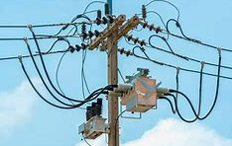
Experiences of Energy Regulation in the Pacific
Energy Regulation Only became introduced over the last 15 years
In Fiji, FCCC regulates electricity, water, including other sectors such as
telecommunication, petroleum products, food and hardware items, etc
In Tonga, Electricity Commission, established in 2008, is responsible for regulating Tonga’s electricity sector
Samoa Office of the Regulator, regulates electricity, Telecommunication, Broadcasting and Postal
Vanuatu Utilities Regulatory Authority regulates electricity and
Water Services
Notes:
Whilst energy services have been established in Pacific islands for so many years, and operated largely either by government or semi-public institutions, or the private sector for some jurisdictions, the regulation of energy services only become introduced over the last 15 years, for much of the Pacific. Examples of energy regulators in the pacific include, FCCC in Fiji, which regulates, electricity, petroleum and LPG, including other sectors such as water and telecommunications etc. In Tonga, Electricity Commission, established around 2008 is responsible for regulating Tonga’s electricity Sector. In Samoa, Samoa Office of the Regulator, regulates electricity, Telecommunication, Broadcasting and Postal. Vanuatu Utilities Regulatory Authority regulates electricity and water Services. During the first annual meeting of the Office of the Pacific Energy Regulators Alliance, held in Nadi last month, we learned that more Pacific island countries, apart from the above-mentioned regulators, are either just established or are in the process of establishing their energy regulators. May I acknowledge the support of SPC and the Asian Development Bank for the technical and financial assistance towards setting up of this regional regulatory alliance. Of course, we look forward receiving support from other development and donor agencies towards progressing the activities towards achieving of OPERA’s goals and targets.

Slide 4
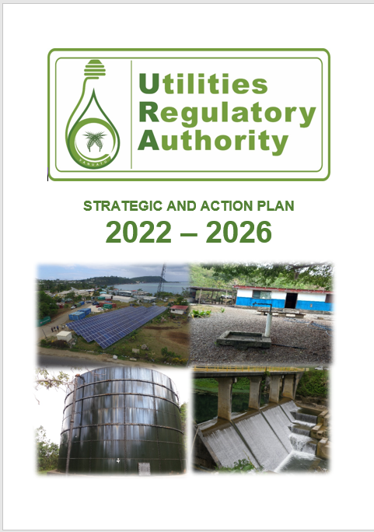
Objectives of Regulations
Regulation
Safety & Quality
Tariff Determination
Reliability of Service
Addressing Consumer issues
Notes:
As regulators, our mandate evolves around, among others, four common objectives, first, to ensure safety and quality of regulated services, particularly for the end users, second is determine reasonable utility tariffs which can be afforded by various categories of utility consumers, whilst at the same time enabling operators to financially sustain their operations. Tariff reviews normally occur between 3 to 5 years, depending on the terms and conditions of the concession contracts. As part of the tariff reviews, we make sure that operators are reasonably compensated to cover cost of operations and maintenance, management cost, investments to be undertaken during the tariff period, and returns on their investments. Investments passed through the tariff become part of the regulated asset base, and are normally amortized over their useful lives. Thirdly, Regulators also aim to ensure regulated services are reliable, and we collaborate with operators they are sufficiently technical and financial to provide reliable services. Setting the right tariff plays a critical role in enabling operators to be well resourced in administering the utility services. Hence, operators get penalized for unplanned service outages. Finally, customers of utility services confront a variety of issues concerning the service they get, which range from safety, utility service cuts to high utility cost. They get the opportunity to present their grievances with the regulator when they are unsatisfied with the feedback they get from the operators. To best address the above objectives, the regulators set operating standards whereby operators are required to follow. Some of these are articulated on the legislative framework which governs that particular utility service. And this is very important for any service or product that the authorities decide to regulate. Accordingly, regulators now move to aligning their regulatory objectives with the broader policy objectives of the governments.

Slide 5
Clear National Policies and Legal Framework are Critical for fostering use of E-Mobility in the Pacific
Strong Political will in supporting e-mobility policy-fiscal incentives, etc.
Institutional readjustments and capacity building strengthening
Strong development/donor support.
Notes:
Due to growing threats of our existence caused by impacts of climate change, our regional and national efforts are exhibited through solidified Pacific voices as well through national initiative including sustainable development strategies and Nationally Determined Contributions objectives. Achieving close to 100% renewable energy in electricity sector by 2030 is very ambitious but a common objective for many of our Pacific island nations, some of us getting close to or almost reaching there, whilst others like Vanuatu barely reaching 20% of target level. We acknowledge SPC and other development partners in the region for the technical ankd financial support contributed in this RE and Energy Efficiency spaces. At national level, experiences has proven, that new policy setting with corresponding legislative formulation only becomes successful when there is strong political will and backing. Hence, fostering use of EVs in the Pacific can be supported through clear government policies with accompanying legal framework. Accordingly, institutional readjustments and capacity building and strengthening are essential in the implementation of EV policies and enforcement of related regulatory requirements. Given such, strong external support from development partner agencies will be quite essential during the early phases of the program.

Slide 6
Possible Aspects of Regulating E-Mobility
Standards
Charging Infrastructures and pricing
Waste Disposal
Notes:
Finally, future prospects of regulatory EVs will depend largely on regulatory setting within each Pacific island country defined by the broader related legislative requirements. This may involve regulation of EV standards that are imported into the countries, including the technologies used in EV components, especially batteries. Regulation may be also applied to charging infrastructures and pricing and how these may be treated especially in electricity concession areas, where electricity operators have the sole right to produce and distribute electricity. Again this may differ from one jurisdiction to another. Finally, the regulation of wastes from EVs especially batteries, and of course other relevant aspects that requires regulation. This concludes my presentation and thank you.

