Slide 1
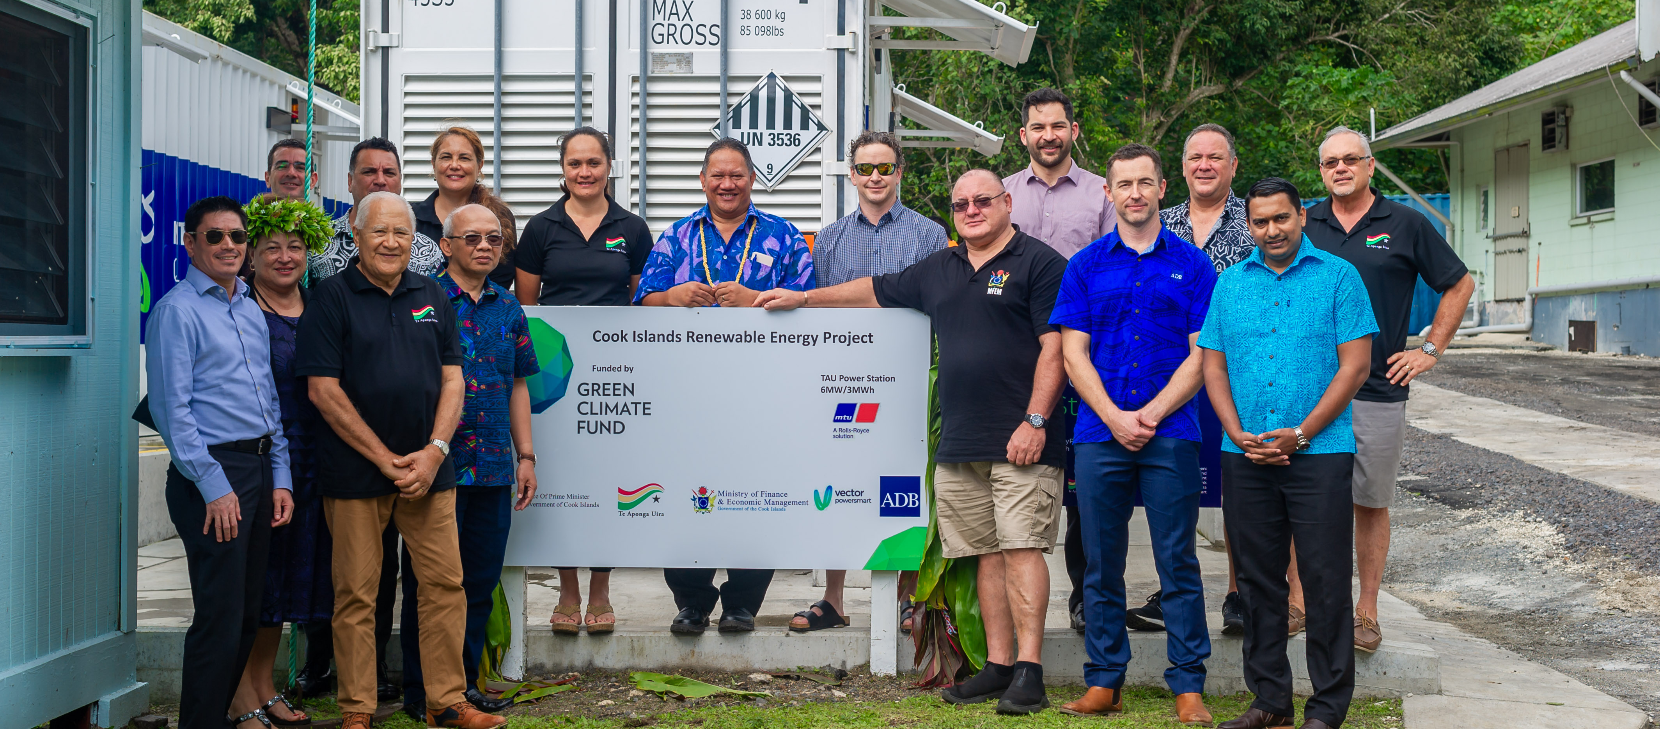
PACIFIC ISLANDS WORKSHOP ON E- MOBILITY 28 November 2022
Notes:
The Cook Islands comprise of 15 small islands scattered over 1.8 million square kilometres of the South Pacific Ocean. The population of the Cook Islands is around 17,000 permanent residents, with the majority living on the largest island, Rarotonga. Now, this number may have decreased due to seasonal workers’ migration abroad and permanent migration.
The Cook Islands Renewable Energy Chart introduced in April 2011 set a 50% renewable target by 2015 and 100% by 2020. The Cook Islands has made good progress towards the achievement of its aspirational renewable energy targets. 10 of the 12 inhabited islands have attained 100% renewable energy generation through solar PV farms and battery systems with diesel generators as a backup. The two most populated islands (Aitutaki & Rarotonga) are working towards increasing their renewable energy generation contribution moving closer to the 100% RE target.

Slide 2
Strategic Focus
1. Build stronger customer and stakeholder relationships which get people invigorated, informed and adapt customer convenience in all services
2. Grow core revenues and expand product lines
3. Achieve 100% zero diesel with customer demand provided through renewable energy for increasing amounts of time
4. Ensure reliability of core product is maintained as our competitive advantage
Notes:
Te Aponga Uira is the power utility operating on the main island (Rarotonga), and the current strategic focuses are as follows:
Build stronger customer and stakeholder relationships which get people invigorated, and informed and adapt customer convenience in all services
Grow core revenues and expand product lines
Achieve 100% zero diesel with customer demand provided through renewable energy for increasing amounts of time
Ensure reliability of core product is maintained as our competitive advantage
The ongoing changes TAU is undertaking, moving toward a transformation to renewable energy generation and supply, is a challenge. The nature of the customer base is changing and so is the need to keep up with the responsiveness to the changes. Renewable energy development, for instance, has opened services to include solar power systems and the small but potentially growing electric vehicle (EV) market.
At the moment, there are some 50 electric vehicles operating in Rarotonga, the majority being Nissan Leafs. Electric pickups/mini trucks, vans, motorcycles and tuk-tuks also operate on the island. The tiny size of the island and the limited road system on Rarotonga is very well suited to electric vehicles: roads are flat, distances driven are short and available road surface is limited.

Slide 3
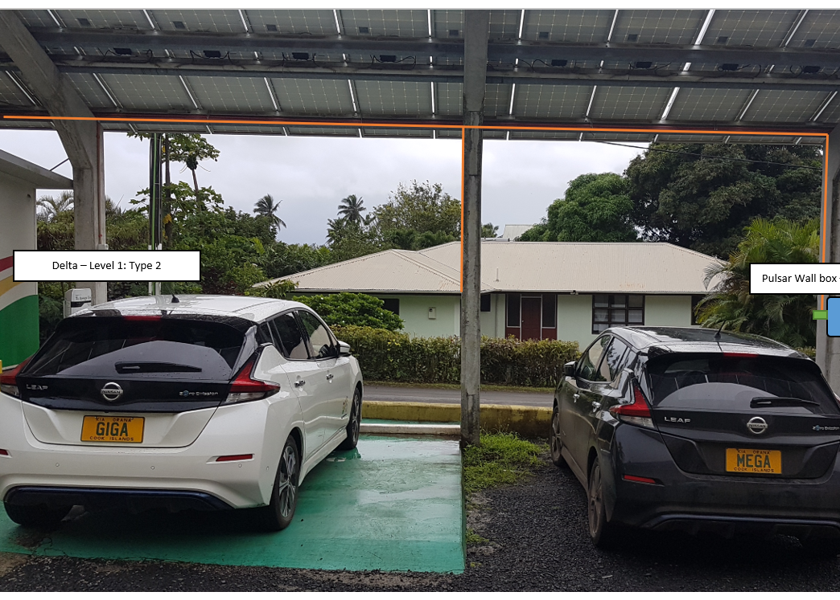
EV Charger Demonstration - TAU
2017 Opening Ceremony
10kW Solar PV System + Battery Storage
Level 1 & Level 2 Charges
Key Features of the Level 2 WALL BOX
Notes:
TAU has taken an innovative approach to this opportunity and explored EV charging technology in anticipation of EV growth in Rarotonga.
TAU has initially taken the first step with the installation of TAU’s first standard EV Level 1 charging station powered by a 10kW solar PV system with battery back in 2017 & located onsite, which has been used steadily by both private EV owners and the company vehicles over the past five years.
TAU recognises the value of being at the head of a new wave of opportunity, in this case, the market in Rarotonga for EVs. Like the installation of its first public Level 2 charging station, TAU will continue to implement initiatives that will encourage growth and assist the consumer in their decisions.
The installation of a Level 2 Type 1 charger was installed in June 2019 onsite in close vicinity of the Level 1 charger.
The charger is a Wallbox Pulsar Plus Type 2 charger able to provide a maximum single-phase charge of 7.4kW
All EVs on the island, including TAU’s 2 x 2018 Nissan Leaf’s can plug in.
Key Features of the Level 2 Type 1 Charger include.
▪ Connectivity – WIFI/Bluetooth
▪ User Identification – Wallbox app/ my Wallbox Portal
▪ User Interface - Wallbox app/ my Wallbox Portal
▪ Optional features – Power Boost

Slide 4
LESSONS LEARNT
Charging Speed
Customer Convenience
Notes:
Charging Speed – initially, when we installed the charging station, the charging turnaround was not an issue because it was mainly used by our two company vehicles. As technology improves and the cost of these technologies decreases, TAU is now looking at fast charging stations. Customer convenience with lowering charge times.
Customer Convenience – we have learnt that our charging station is not an ideal location for all our Customers, and access to the public charging station is limited, given that there is only one. Most EV owners have a standalone PV solar & battery system, residential PV system on a net metering arrangement or straight charge from the grid. Accessibility and charging speed have been the main learnings with this pilot.

Slide 5
Way Forward
Feasibility Study
Charging Station Infrastructure/ Commercial Arrangement
Notes:
Admittedly progressing EV from TAU’s point of has had to take a back seat while we focus on delivering 6MWs of solar PV generation. However, we are looking at undertaking feasibility studies on how we progress with EVs in Rarotonga and the associated assets to make this work, including the charging station infrastructure.

Slide 6
MEITAK MAATA

