Slide 1
Regional Pacific Nationally Determined Contribution Hub
Sustainable Mobility at the regional level – the NDC Hub and regional NDCs

Slide 2
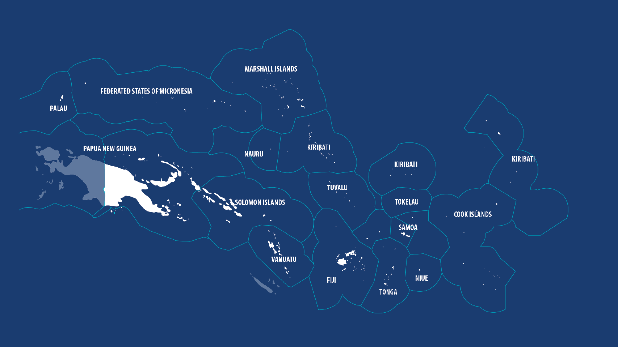
NDC Hub Member Countries
Notes:
The NDC Hub supports 14 Pacific Island Countries in enhancing and implementing their nationally determined contributions.

Slide 3
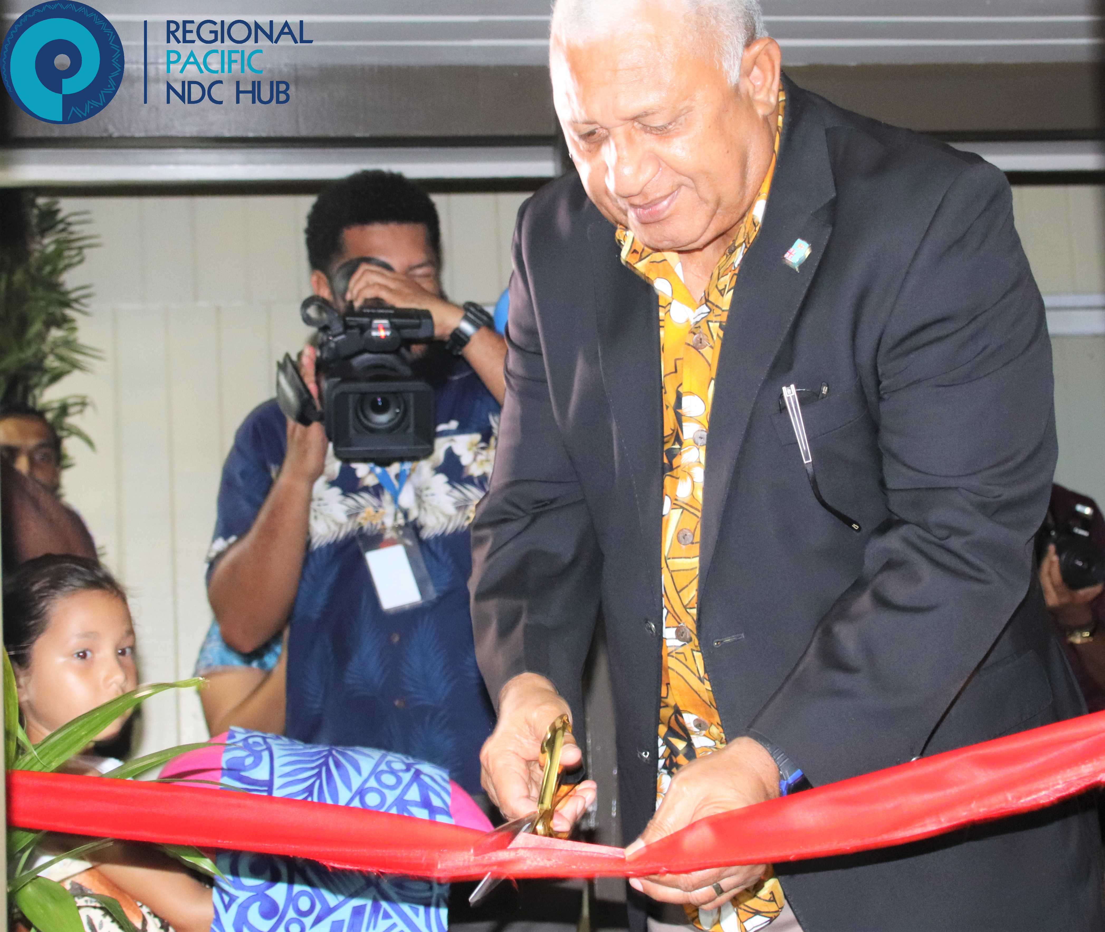
Regional Pacific NDC Hub Story
“The NDC Hub is By the Pacific, For the Pacific”
Fiji’s Prime Minister, Hon. Frank Bainimarama,
Officially launches the NDC Hub’s office, at SPC, Nabua,, in 2020.
Notes:
Background:
In 2017, leaders from the Pacific called for a platform to support them in enhancing, implementing, and financing their Nationally Determined Contributions (NDCs) under the COP 21 Paris Agreement.
Based on this, Fiji’s Prime Minister, Hon. Voreqe Bainimarama, officially launched the Regional Pacific Nationally Determined Contribution Hub (NDC Hub) at the United Nations’ Framework Convention on Climate Change (UNFCCC) COP 23 in Bonn, Germany.
The NDC Hub has continued to be actively endorsed by the Pacific. This is seen in the NDC Hub’s demand-driven structure, which ensures it continues to serve the needs of Pacific Island Countries as they work to implement their NDCs and take climate action.
As shown in this picture, Prime Minister Bainimarama officially opened the NDC Hub’s office at SPC, Nabua, in February 2020.

Slide 4
Overview of the Regional Pacific NDC Hub
Member Countries
Donors
Partners
Country requests are delivered by the Hub Implementation Unit comprising four partners:
Lead Partner
NDC Hub Implementation Unit
Steering Committee
Members of the NDC Hub Steering Committee represent the 3 Pacific sub-regions, Melanesia, Micronesia, and Polynesia, and Fiji as host-country.
The Steering Committee is currently chaired by Micronesia, represented by Palau providing strategic guidance to the Hub.
NDC Hub Country Requests Implementation
Members of the Steering Committee, representing the 3 Pacific sub-regions Melanesia, Micronesia and Polynesia, and Fiji as host country.
Notes:
The NDC Hub works with 14 Pacific Island Countries (PICs) which are the Cook Islands, Federated States of Micronesia, Fiji, Kiribati, Marshall Islands, Nauru, Niue, Palau, Papua New Guinea, Samoa, Solomon Islands, Tonga, Tuvalu, and Vanuatu.
The NDC Hub engages directly with one Focal Point in each country which is a high-level government representative from the ministry responsible for climate change.
The NDC Hub is guided by a Steering Committee consisting of one Focal Point from each Pacific Sub-region (Polynesia, Micronesia, and Melanesia), as well as Fiji as the host country. This reflects that the NDC Hub continues to be guided by the needs of the Pacific.

Slide 5
Phase 1 & 2: 36 Country Requests across 14 countries
5 NDC Investment Plans -2.3B USD investments identified
6 MRV systems
NDC Hub
Supporting plans for climate smart agriculture, water and sanitation & energy efficiency and more…
Support to enhancing 4 NDCs

Slide 6
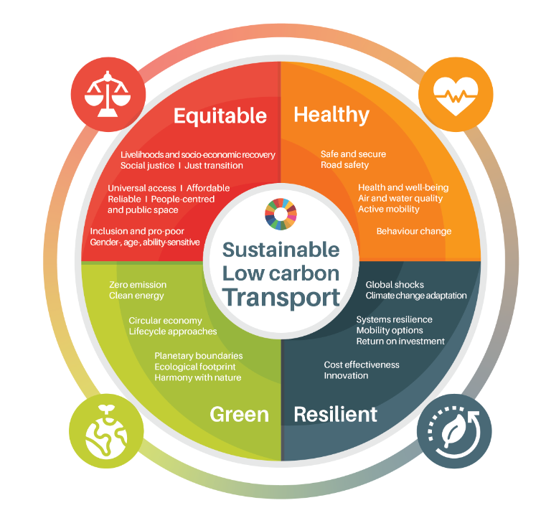
Rationale – Sustainable Transport
Sustainable, low carbon mobility is a powerful driver for positive, systemic transformation of our societies.
low carbon transport and mobility is not represented by a stand-alone Sustainable Development Goal (SDG)
Its successful implementation supports the achievement of most SDGs.

Slide 7
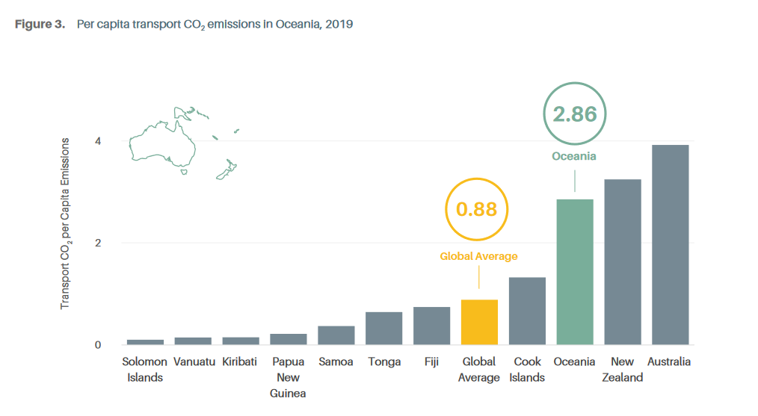
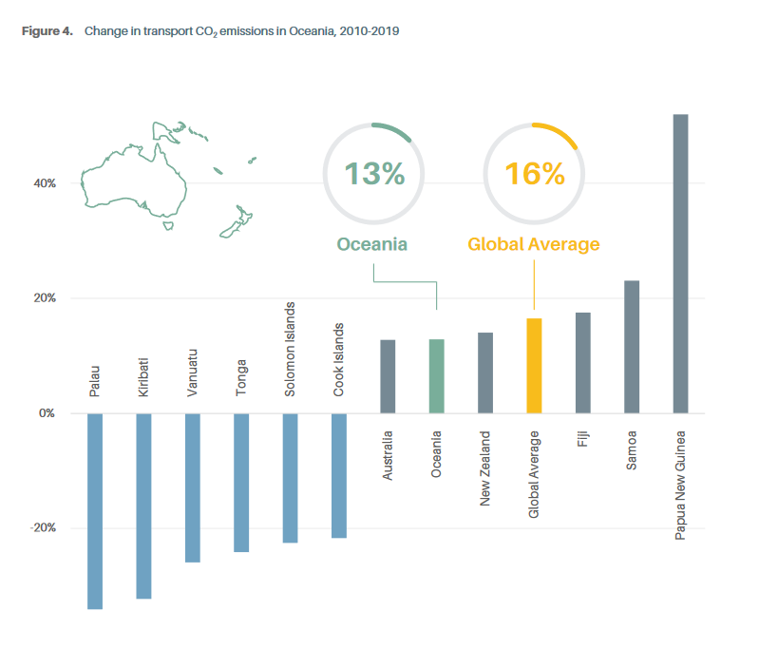
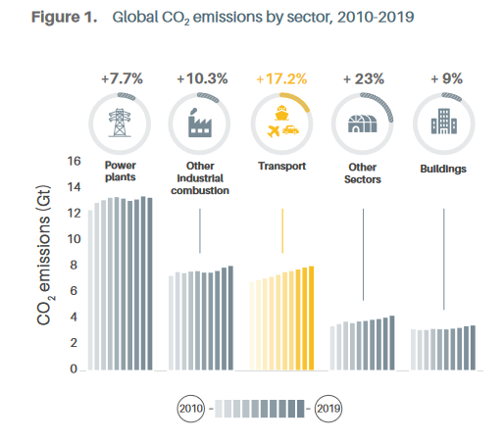
Regional Transport Emissions
2010-2019
global transport associated emissions increased by 17.2%
13% increase transport C02 in Oceania
SLOCAT Transport and Climate Change Global Status Report, 2021

Slide 8
Transport Emissions – Regional Assessment
Regional Transport emissions – 3 distinct transport emitters
Australia and NZ

Slide 9
Transport Emissions
PNG, Fiji and Palau

Slide 10
Transport Emissions
Other PICTs

Slide 11
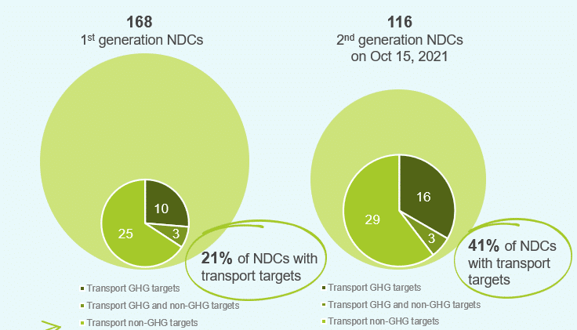
Sustainable Transport and NDCs
2nd generation NDCs
NDCs featuring a transport target almost doubled to 41% from 21%
https://changing-transport.org/key-insights-transport-in-climate-plans/

Slide 12
Sustainable Transport and NDCs
As at June, 2021
LTS (LT-LEDS) – highest number of mitigation actions identified
https://changing-transport.org/key-insights-transport-in-climate-plans/
Notes:
LT-LEDS – Long term low emissions development strategy

Slide 13
NDC Analysis - Transport Mitigation actions
Transport related emission mitigation options – LTS and NDC

Slide 14
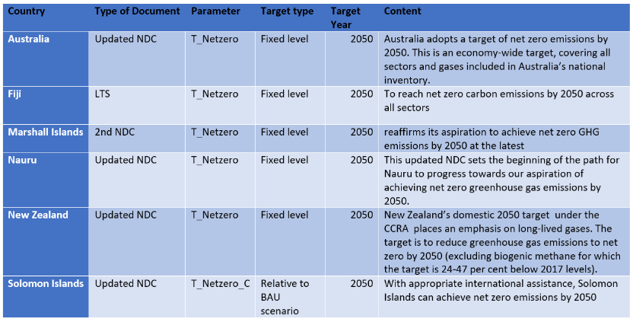
NDC Analysis – Net Zero
4 PICTs
Australia and NZ

Slide 15
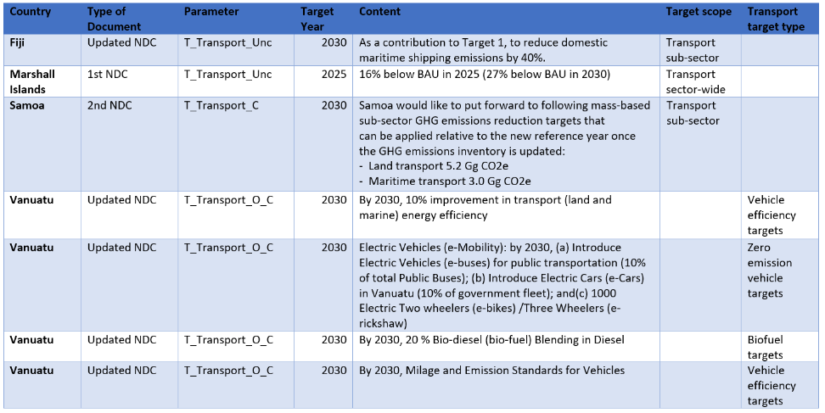
NDC Analysis – Transport Target
Fiji and Marshall Is – transport related unconditional Targets

Slide 16
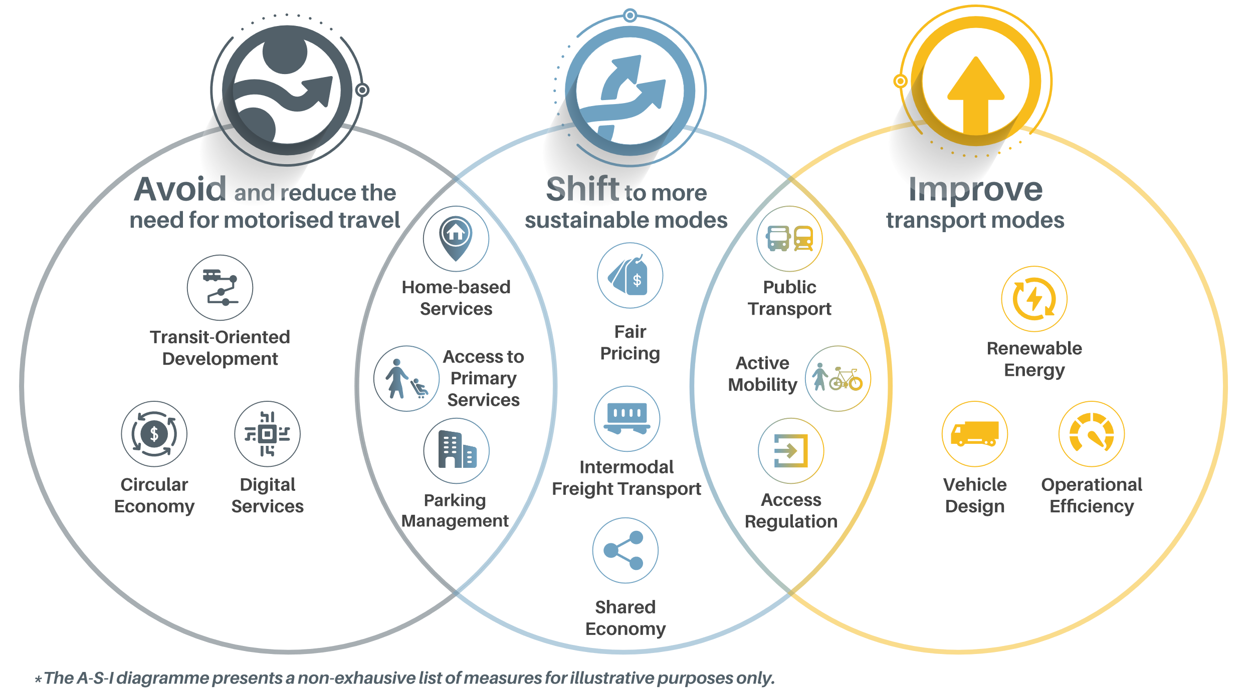
NDC Analysis – “Avoid-Shift-Improve” framework

Slide 17
NDC Analysis – Addressing Transport Emissions Mitigation

Slide 18
NDC Analysis - Transport Emissions Mitigation
Low carbon fuels and energy requirements and transport system improvement most prominent in the regional NDCs

Slide 19
NDC Analysis - Transport Emissions Mitigation Category
Fiji and Tonga have comprehensive mitigation measures
Low uptake of economic instruments and shipping improvement

Slide 20
NDC Analysis - Transport Emissions Adaptation Actions
Few PICTs have prioritised/included transport sector emissions improvement under adaptation.
Notes:
Normally infrastructure related – load restrictions, upgrade of crossing, climate resilient roads and jetties, smaller vessels, newer technologies, etc

Slide 21
Enhancing NDCs: Opportunities in Transport
Low uptake of “Avoid and Shift” mitigation approaches in their (PICTs) NDCs.
Reviewing the current NDCs through the lens of the “Avoid-Shift-Improve” framework presents meaningful, novel opportunities for countries to enhance their NDCs by better integrating transport solutions.
Addressing transport in the NDCs brings about several broad co-benefits in the sustainable development agenda.
Opportunity to raise this ambition in NDCs - through regional capacity building.

Slide 22
NDC Analysis - Challenges
How we translate our discussions these two days into actions in NDCs ?
How is that to be facilitated ?
How do we further integrate sustainable transport in NDCs ?

Slide 23
Thank you.

