Slide 1
PACIFIC ISLAND WORKSHOP ON ELECTRIC MOBILITY
Suva, Fiji 28 – 30 November 2022
“Sustainable Mobility at the National Level”
Mr. Sosefo Tofu
Pacific Island Energy Professional
PCREEE

Slide 2
Table of Contents
Sustainable Mobility at National Level
PICTs NDCs, roadmaps etc. (targets with E-mobility specific-targets)
PCREEE
Role of PCREEE,
Supported PICTs with E-mobility development
Highlight E-mobility stories in the PICTs region
Take-away messages
Notes:
Regional EV policy

Slide 3
PICTs NDCs
Country | 1st NDC Mitigation Target Sector | 2nd NDC Mitigation Target Sector
Cook Is | Electricity | No further Revision
FSM | Electricity Generation & Transport | No further Revision
Fiji | Electricity Generation & Transport | Electricity Generation & Transport, inclusive of target in Domestic Maritime shipping
Kiribati | Energy sector: power and Transport, maritime and coastal sector including mangrove, coastal vegetation and seagrass beds | No further Revision
Marshall Is | Electricity, transportation (land and sea), waste and cooking and lighting Indicative target to reduce GHG emissions by 45% below 2010 levels by 2030 | **Indicative target to reduce GHG emissions by 58% below 2010 levels by 2030
Nauru | Sectoral (energy sector) - electricity generation sector and energy efficiency through demand side management. | No further Revisions
Niue | Energy | No further Revisions
Palau | Energy sector with a focus on electricity and transport | No further revisions
PNG | To become carbon free by 2030 - 100% RE in electricity generation by 2030 | Energy: Electricity Supply and Forestry
Samoa | Energy sector with a focus on the Electricity sub-sector – 100% of its electricity generated from renewable energy sources by 2025 | Subsector focus – Electricity, Land Transport, Maritime Transport, Tourism
Solomon Is | Electricity generation, Sea transport & Land transport | Electricity generation, Sea transport & Land transport
Tonga | Energy, Waste & Land Use, Land Use Change and Forestry (LULUCF) | Energy, Waste & Land Use, Land Use Change and Forestry (LULUCF)
Tuvalu | Electricity Sector – achieve 100% of GHG reductions | Work in progress on Updating 1st NDC – launch soon!!
Vanuatu | Mainly electricity generation sub-sector but with ancillary mitigation possible in forestry, agriculture, transport and energy efficiency sector wide.
Notes:
Reduction in GHG for overall sector (not spelled out specific sector)
Marshall Island became the first country in the world to submit 2nd NDC on 22 November 2018 prior COP24
PNG -Increasing levels of renewables in the energy mix for on-grid connection – through increasing the share of installed capacity of renewable energy from 30 percent in 2015 to 78 percent in 2030. The target of 100 percent renewable energy by 2030 in the previous NDC was revised due to the influence of liquefied natural gas (LNG) into the energy mix and existing agreements with Independent Power Producers that extend beyond 2030

Slide 4
SAMOA
“Land transport Reducing GHG emissions in the land transport sector may be achieved by initially electrifying a percentage of vehicles in Samoa ……
The successful adoption of these measures will require further feasibility studies and assessments ………. ‘’

Slide 5
Republic of Fiji
Fiji Low Emission Development Strategy 2018 – 2050
Aim to reach net zero carbon emissions by 2050!!!
Very High Ambition Scenario
By 2050, 100% of all vehicle types will be EVs
Fiji Updated NDC 2020 (2021 – 2030)
Mitigation Target: To reduce 30% of BAU CO2 emissions from the energy sector by 2030
Reduce energy sector CO2 emissions by 10% through energy efficiency improvements in industry, transport sectors etc.
SDG7 roadmap for Fiji (2021 – 2030)
EE improvements need to be boosted across dif ferent sectors in order to achieve a 2.9% annual improvements by 2030 (base year 2018)
Energy Efficency improvements in Land Transport
Introduce a 25% EV market sales for private passenger vehicles + public passenger vehicles from 2025 onwards
All buses sold from 2025 onwards should be hybrid buses.

Slide 6
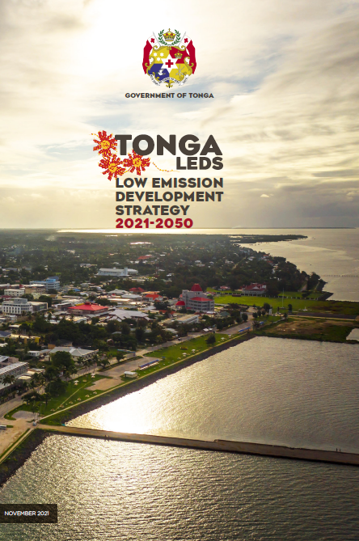
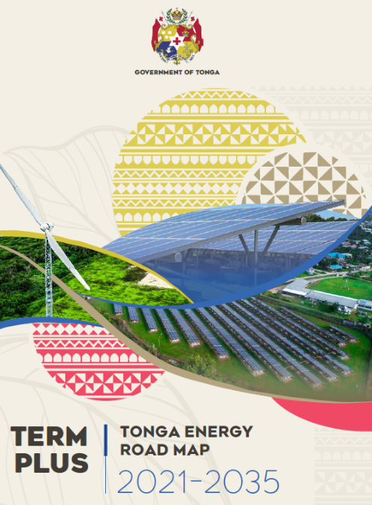
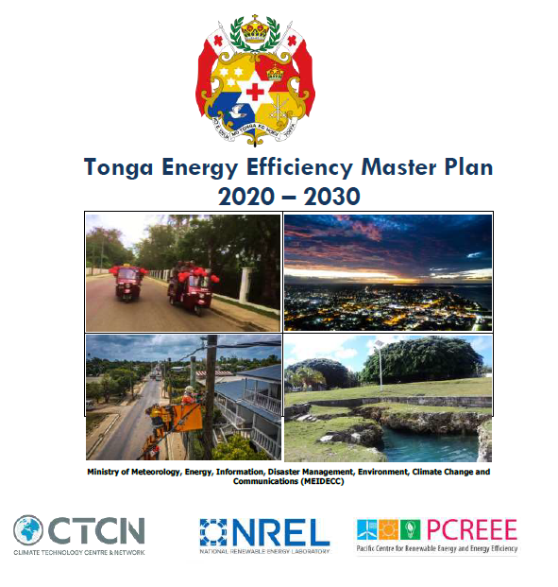
TONGA
30% of total new vehicles sales to be EV by 2035
10% of Light Duty Vehicles are electric by 2030

Slide 7
Roles of PCREEE – on Emobility
Four key areas /programs PCREEE focuses on:
RE & EE Business start-up and Entrepreneurship Support
RE and EE for Sustainable Mobility
RE Mini-grids
Energy Efficiency Investment
Output 1: Central Sustainable e-mobility policy and regulatory frameworks
Output 2: Adopted standards and guidelines
Output 3: Awareness Raising and Promotion
Output 4: Demonstration and Upscale
Notes:
PCREEE business plan – page 21

Slide 8
4th PETMM Direction
…. regional e-mobility policy document
……. regional e-mobility program to address existing barriers
…… promote SIDS-SIDS cooperation
Regional Electric Mobility Policy for PICTs (July 2020)

Slide 9
PCREEE supported PICTs in E-Mobility
Conducted webinar to support e-mobility development in:
Kiribati – 26th May 2022
Tuvalu – 30th August 2022
Aimed to support the e-mobility development and to be better prepared for the EV uptake.
Supported Leaf Capital /Switch Network in Fiji to ensure their company’s vision is put in place and commercially viable while complying with relevant legislation and regulations in Fiji
TA to conduct a legal review of the Fiji Electricity Act and training
Fund their engineer /electrician to participate in the NZ EV summit.
Partnership with Tonga Ministry of MEIDECC in EV Demonstration Project
Host the first EV-group meeting in May 2022
Tonga EV-interest group was established

Slide 10
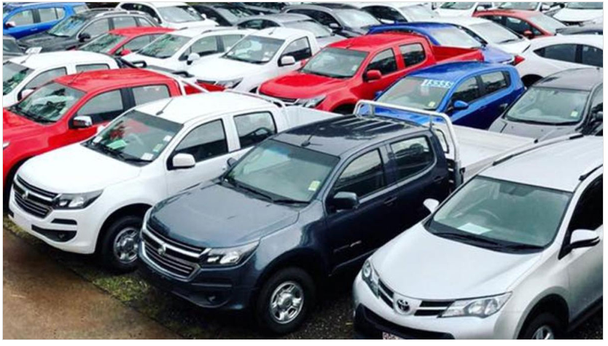
EV stories in Fiji
2022/2023 Fiji National Budget announced by Mr. Sayed-Khaiyum (Minister of Economy) that:
Government will introduce a luxury vehicle tax per vehicle for any vehicles above 3,000cc.
Subsidy for capital investments in charging stations increased from 5% (threshold above $100k to 7% (threshold above $50k)
VAT and fiscal duty on all EVs will now be zero-rated to allow accelerated depreciation of 100%.
Fiji Gov’t will also provide $5,000 subsidy per vehicle if a local business purchases 5 vehicles or more
https://www.fijivillage.com/news/Duty-on-certain-cars-increase-to-green-technologies-48xfr5/

Slide 11
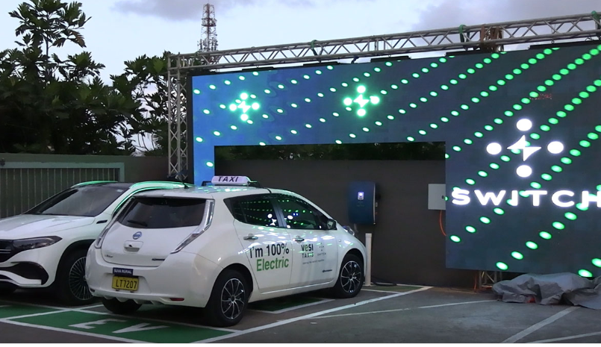
Cont….EV stories in Fiji
Fiji launches first-ever electric vehicle charging network at Kundan Singh Supermarket in late September 2022.
It is a 30kWs charger that can fully charge an EV in 20 minutes and can travel in 155kms.
Station has a solar generator in case of power outage.
https://www.fijivillage.com/news/Fiji-launches-first-ever-electric-vehicle-charging-network-at-Kundan-Singh-Supermarket-fx854r/
Notes:
Driving distance from Suva to Nadi – 190kms, from Nuku’alofa to Niutoua ~ 31kms

Slide 12
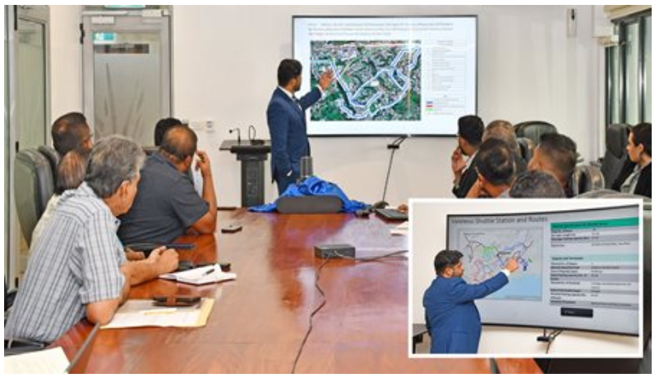
Fiji E-Shuttle Bus Pilot Program
June 2022, Fiji Minister for Economy and LTA met with bus operators to discuss the Valelelevu shuttle bus pilot program hat will serve the Greater Nasinu area – the most densely populated area of the country
Construction of Valelevu Terminal started by end of June, 2022
Electric Shuttle buses with 21-25 seats and 7 meters long will be used for the operation.
Represented the first electric public transportation fleet in Fiji.
https://www.fiji.gov.fj/Media-Centre/News/SHUTTLE-SERVICES-TO-PROMOTE-USE-OF-PUBLIC-TRANSPORT
Notes:
https://www.facebook.com/watch/?v=362663782446643
https://www.fijitimes.com/4million-for-shuttle-bus-pilot-program/

Slide 13
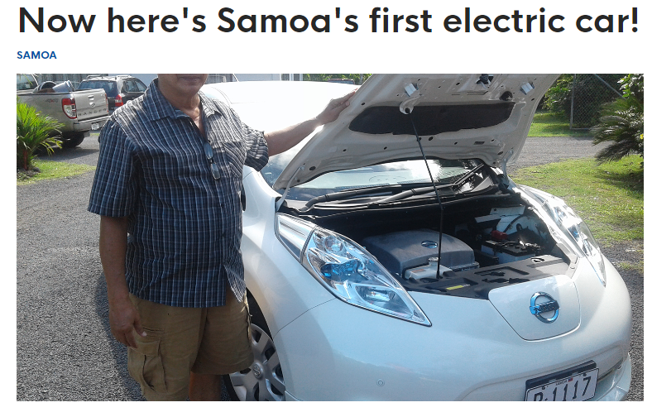
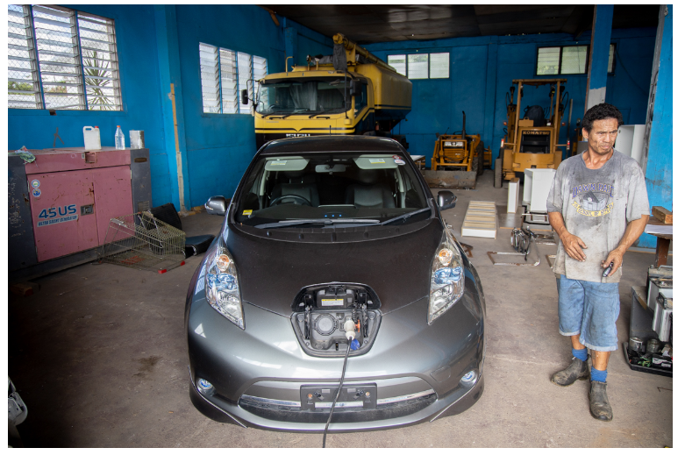
SAMOA experiences with EVs
2016
2021
Lotopa Commercial Vehicles imported 4 Nissan Leaf Electric Cars in April 2021
Vehicle can cover 106km when fully charged
https://www.samoaobserver.ws/category/samoa/25944
https://www.samoaobserver.ws/category/samoa/84420
2020 New legislation was to be introduced in October to remove excise taxes on electric vehicles.

Slide 14
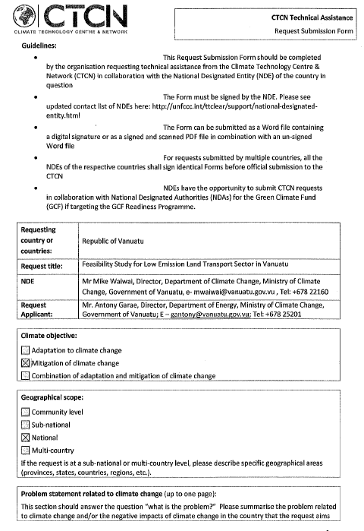
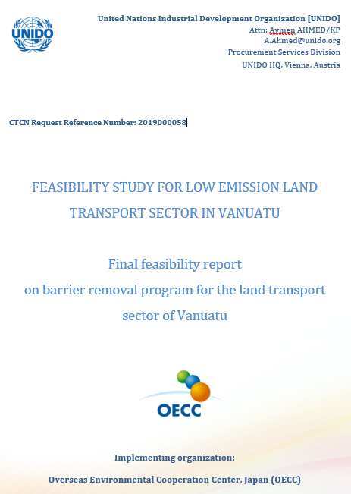
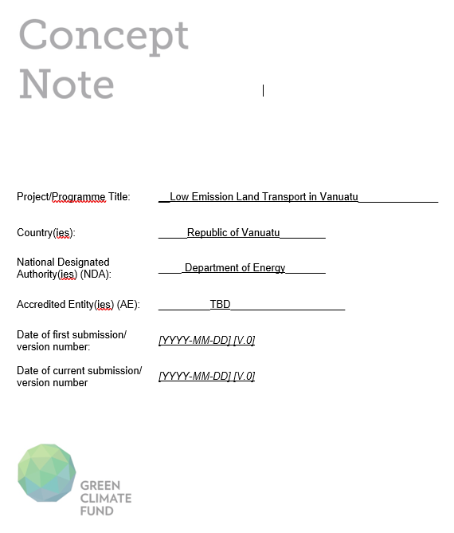
Feasibility Study for Low Emisision Land Transport Sector in Vanuatu
10th October 2019, Gov’t of Vanuatu has requested CTCN to provide support in the form of a feasibility study for Low Emission Land Transport Sector in Vanuatu.
2. OECC submitted the final Feasibility study report to Vanuatu on 25 March 2022
3. Formally submitted to GCF on Wednesday, April 20, 2022
Notes:
After formal submission of GCF concept note to GCF, then a financial analysis for developing funding proposal will be started.

Slide 15
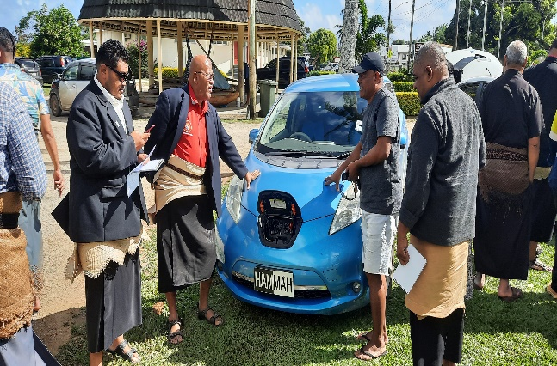
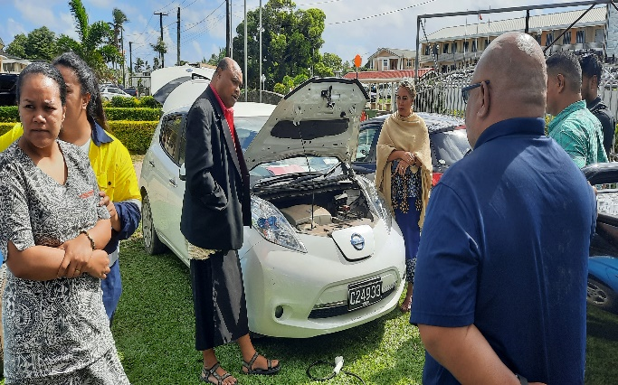
E-Mobility interventions in Tonga…..
Tonga Department of Energy under Ministry of MEIDECC has requested NREL to draft an EV policy framework to accelerate the adoption of Electric Vehicles
Status:
Literature Review has been finalized and publish soon.
NREL still working on Task 3.
Rep from NREL will elaborate more on the project tomorrow.
EV policy → EV roadmap → Feasibility study → GCF concept note / proposal

Slide 16
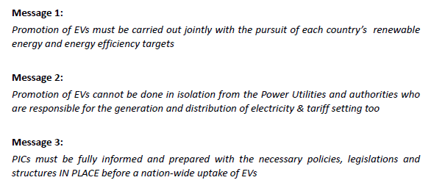
Take-Away Messages

Slide 17
THANK YOU!!

