Slide 1
Related Outcomes from Pacific Regional Transport Officials’ Meeting: 15-16 & 18 November 2022 (virtual)
PACREE Workshop of the Potential Role of E-Mobility on the Pacific Island Energy Security and 1.5C Ambition 28-30 November 2022
Mr. Yolisaguyau TOM'TAVALA
Policy & Legal Adviser
Oceans and Maritime Programme (OMP)
Geoscience, Energy and Maritime (GEM) Division
Pacific Community (SPC)

Slide 2
Scope
1) OVERVIEW of Pacific Regional Maritime Transport Officials’ Meeting 2022
2) FRAMEWORK for Action on Transport Services 2011 – 2020
3) RELATED OUTCOMES-
- Pacific Ports Vision 2030 – 2050 Recognition Framework,
- MTCC Pacific

Slide 3
1) OVERVIEW of Pacific Regional Maritime Transport Officials Meeting 2022
Progress Updates
Progress on the implementation of priorities in the maritime transport sector from 4th PRETMM 2019,
Networking
Re-establish/strengthen networking across the region,
FATS 2011 - 2020
Review and begin discussion on replacing the Framework for Actions on Transport Services 2011-2020 (FATS),
Pacific Ports Vision 2030 - 2050
Adopt the Pacific Ports Vision 2030 – 2050 Recognition Framework,
Issues/Challenges
Discuss current issues and challenges, and identify strategies for mitigation,
5th PRETMM 2023
Decide and agree on strategic, high level maritime transport matters to be tabled in the forthcoming 5th PRETMM 2023.

Slide 4
Setting the Agenda for 5th PRETMM 2023
Papers, presentations and deliberations at the meeting
Papers and presentations may be updated and used as part of the agenda of the 5th PRETMM 2023.
5 – 6 papers will form the agenda for discussion at 5th PRETMM
Aligned with the theme of the Meeting and to the topical issues in the region and globally.
5th PRETMM 2023
Host Country – VANUATU
May 2023

Slide 5
2) FRAMEWORK for Action on Transport Services 2011 - 2020
FATS Guiding Principles
Leadership, governance, coordination and partnerships.
Capacity development, policy, planning and regulatory frameworks.
Transport safety and security.
Improved access.
Environmental impact, technology and energy.
Transport data, information and knowledge.
Sustainability, monitoring and evaluation.
https://tinyurl.com/4p4zas2y

Slide 6
3) RELATED OUTCOME # 1 Pacific Ports Vision 2030 – 2050 Recognition Framework
PACIFIC PORTS VISION 2030–2050 RECOGNITION FRAMEWORK
Pacific Ports Vision Recognition Framework.

Slide 7
Framework Overview
Objectives, Measures and Targets
Resilient Climate change adaptation Disasters & emergency response cybersecurity Support for economic development & operational efficiency Compliance with international standards Security Safety Data Exchange | Green Climate change Carbon neutrality Leadership Measurement & monitoring Execution Energy Efficiency Awareness Execution Incentivizing green shipping Engagement Implementation | Clean Water quality Marine spills Waste management Community and neighbourhood relations Dredging & coastal hydrology Environmental engagement and compliance
Level of Indicators
Unengaged yet to develop any plan or undertake any action relevant to long-term objectives
Engaged making preliminary steps towards identifying areas for improvement and developing plans relevant to long-term objectives
Highly engaged making significant contributions to long-term objectives
Leading high achieving models of resilient, efficient, and sustainable ports
Administration
SPC, SPREP, PMTA, PIMC, OG
Securing funding to support the deployment and use of the framework.
Raising awareness of the framework amongst Pacific ports.
Facilitating training and provision of tools, templates and a technical help desk for ports to work with.
Verification and Certification

Slide 8
Pacific Ports Vision 2030 – 2050
Resilient
Green
Clean
Resilient: The port is profitable and has the capacity to absorb, adapt to, and recover from disruptions.
Green: The port has net zero carbon emissions.
Clean: The port minimises its impact on surrounding natural environments & local communities.

Slide 9
Improving availability of maritime transport costs data in the Pacific region
Accelerating “Transfer of Environmentally Sound Technologies” (TEST Biofouling) through demonstration pilots to reduce biofouling and related emissions
Project Sponsor – International Maritime Organization (IMO)
Project Timeline – project extension TBC
Target Countries –
Project Sponsor – International Maritime Organization (IMO)
Project Timeline – 2023 - 2025
Target Countries –
(LPC)
(PC)
Pilot project on the retrofitting of a Fijian government ship with energy efficient technology
Building capacity of Pacific Islands Countries for climate mitigation in shipping and advocate measures for the reduction of GHG emissions from ships
Project Sponsor – International Maritime Organization (IMO)
Project Timeline – project extension TBC
Target Country –
Project Sponsor – International Maritime Organization (IMO)
Project Timeline – 2023 (6 months)
Target Countries –
Notes:
MTCC Pacific completed Phase I of the IMO’s Global MTCC Network (GMN) project on the 31st of December, 2021. While awaiting the formal confirmation of Phase II of the GMN project, MTCC-Pacific is currently implementing four specialised projects ranging in a variety of disciplines.
Improving availability of maritime transport costs data in the Pacific region
The Initial IMO GHG Strategy on reduction of GHG emissions from ships (the Initial Strategy) acknowledges that impacts on countries of candidate GHG reduction measures should be assessed and considered as appropriate before their adoption, paying particular attention to the needs of developing countries, especially SIDS and LDCs. The Comprehensive Impact Assessment of the IMO short-term GHG reduction measure, adopted at MEPC 76 identified several data gaps on maritime transport costs and the economics of shipping, especially in the Pacific region. To this, the IMO has engaged the services of MTCC Pacific to carry out the “Development of an IMO project on improving availability of maritime transport costs data in the Pacific region”, funded through the IMO GHG TC Trust Fund. Further to improving the availability of relevant maritime transport costs data in the Pacific region, facilitating future assessments of impacts of candidate IMO mid- and long-term greenhouse gas (GHG) reduction measures in the Pacific region are also being viewed.
The study focuses on seven Pacific IMO member countries, namely, Cook Islands, Fiji, Marshall Islands, Solomon Islands, Tuvalu, Tonga, and Vanuatu. We’ve had three in-country missions to collect data on freight costs, cargo throughput, typical shipping routes in Solomon Islands, Vanuatu and Tonga. We’ve engaged Fiji and most recently Cook Islands in dialogue. Due to the current national emergency in Tuvalu, we have yet to reach out to our focal points however, they have been notified of the project. One of the lessons learned in implementing this project has been the challenge of obtaining the above data sets from countries as well as mapping where the data is housed in-country noting that this project is economic-heavy, in some cases the data is not sitting traditionally with the maritime administrations.
We are currently negotiating a project extension with IMO as well as re-defining the scope of the project which includes the opportunity to develop a data collection guideline as a reference tool for data collecting and data mapping for these types of projects in the region.
(2) Accelerating “Transfer of Environmentally Sound Technologies” (TEST Biofouling) through demonstration pilots to reduce biofouling and related emissions
The “Accelerating Transfer of Environmentally Sound Technologies through demonstration pilots to reduce biofouling and related emissions” (TEST Biofouling) Project is assisting developing countries to build their knowledge on control and management of biofouling and showcase effective approaches to biofouling management and the mitigation of environmental risks associated with the transfer of Invasive Aquatic Species (IAS) through biofouling by means of demonstration projects at both regional and country level. The TEST Biofouling project will closely cooperate with and build on achievements, networks and knowlegede built by the GloFouling Partnerships project.
The core of the TEST Biofouling project is to test novel technologies and new sustainable methods of biofouling management through demonstration projects, which can be effective ways to showcase to developing countries the availability and possibilities of new technologies and the environmental and energy efficiency benefits of their use. The TEST Biofouling project aims at achieving this through 12 national demonstration projects, which can benefit GloFouling LPCs, as well as to undertake 3 regional demonstration pilots in Africa, Caribbean and Pacific regions on the most cutting edge technologies and on their use with the support of knowledge partners.
Following the GloFouling set up, our LPCs in the Pacific, Fiji and Tonga as well as our PC, Tuvalu, have been selected. We are in the process of developing and revising tailor-made capacity building tools through a Capacity review questionnaire which will help feed into the development of pilot tests. This questionnaire will be circulated in February 2023 and feedback to be received by first week of April, 2023.
(3) Pilot project on the retrofitting of a Fijian government ship with energy efficient technology
In support of the implementation of the IMO Initial Strategy and following the outcome of the Technology Needs Assessment National Stakeholder Consultation organized by Fiji Climate Change & International Cooperation Division of the Ministry of Economy in 2019, the Government of Fiji has agreed that MTCC-Pacific will install on a Fijian government ship, the MV Vei Vueti, a propulsion improvement device known as Propeller Boss Cap Fins (PBCF) that can enhance propeller efficiency and thus reduce fuel consumption and associated GHG emissions.
The Propeller Boss Cap Fins (PBCF) is a device that improves propulsive efficiency by recovering energy from the hub vortex generated behind a propeller. As a result, PBCF reduces fuel oil consumption by 5% as well as GHG emissions. The PBCF resolves the propeller torque rich condition, reduces underwater noise and stern vibration, and prevents rudder erosion. The PBCF being procured is a fixed device that will be attached to the hub of a ship’s existing propeller. Vessel and propeller modifications are not required and no specific maintenance is required after installation.
This project’s extension will also be discussed with IMO as the intended slipping date of the vessel now extends beyond the current project timeline. Further to this, procuring the PBCF of this size for smaller sized vessels has resulted in extended discussions with a wide range of industry experts.
(4) Building capacity of Pacific Islands Countries for climate mitigation in shipping and advocate measures for the reduction of GHG emissions from ships
In 2017, Transport Ministers noted Pacific and European cooperation and leadership at the IMO to reduce GHG emissions and ensure that IMO provides its contribution towards the Paris Agreement goal of guarding temperatures to well below 2 degrees Celsius and aiming for 1.5 degrees Celsius. Since 2015, the cooperation between Fiji, Kiribati, Marshall Islands, Solomon Islands, Tonga and Tuvalu together with European Member States and support from the European Commission under the Shipping High Ambition Coalition (SHAC) have demonstrated the capacity of PICs to collaboratively influence policies and measures that are adopted at IMO for climate mitigation in shipping. While impact of these cooperative arrangements has been demonstrated, it is essential to now establish a more structured cooperation framework within which PICs could build their own capacity to prepare and coordinate their policy views within the region, with the countries active in the SHAC, and at IMO during working groups and Committee meetings.
Through the partnership of GIZ and RMI, this project aims at establishing a robust cooperation framework to build the capacity of Pacific Islands Countries and strengthen these cooperative arrangements for climate mitigation in shipping and advocate measures for the reduction of GHG emissions from ships. The project will commence in 2023 for 6 months targeting government officials in the SHAC countries.

Slide 10
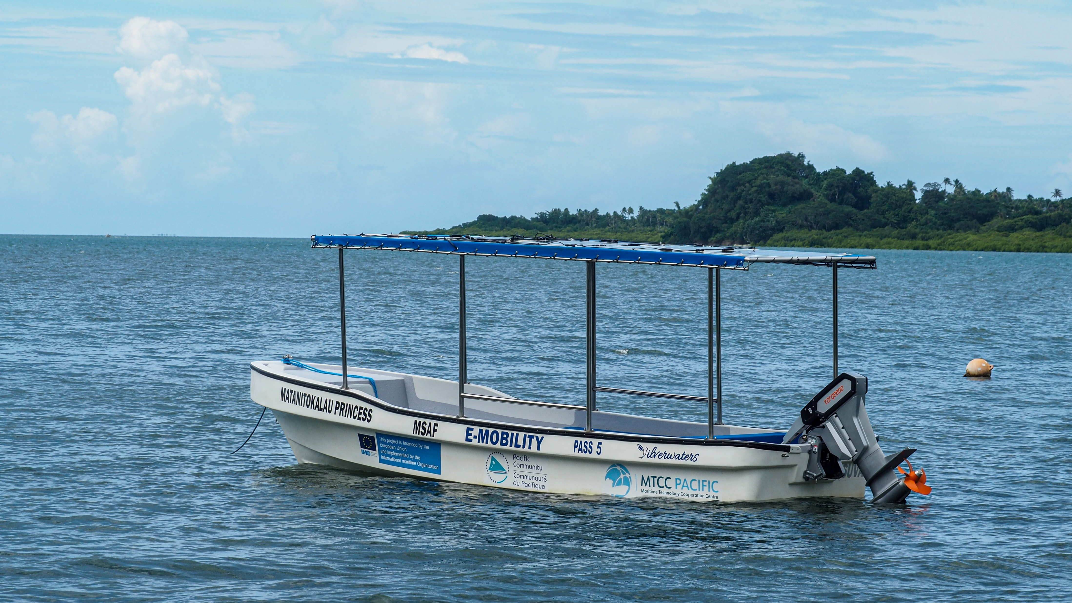
Solar-Powered Boat
Vessel Details:
19 ft fibreglass boat fabricated by Silverwater Fibreglass Boats
Torqeedo 20hp hybrid outboard electric motor
24-3500 battery power bank
8 x 200 W module solar panels(total charge capacity of 1.6kW) built on stainless steel canopy
Shore fast charger
Solar PV charge controllers
6 life jackets
Additional compartments built onboard to store life jackets and other safety equipment
Max speed - 15knots
MV Matanitokalau Princess
Notes:
For Nakalawaca village, the women’s group used to hire a boat for fishing activities and also pay for the fuel from the earnings. The increasing fuel cost and difficulty in accessing fuel meant low income for the families and hindered the progress and function of the school and community in executing their duties. MTCC-Pacific conducted various consultations with the villagers on the baseline information on fuel cost, the benefit for the community and importantly the environment and marine ecosystem.
Through fair and competitive process, GREENCO Fiji, a solar company that serves to provide Energy & Water independence throughout Fiji and the Pacific based in Nadi was awarded the contract of works which included the supply of a fibreglass open skiff, a 20HP equivalent outboard motor, battery power bank and supporting marine accessories. As part of the contract, proper maintenance and continuous training must be provided to the local community.

Slide 11
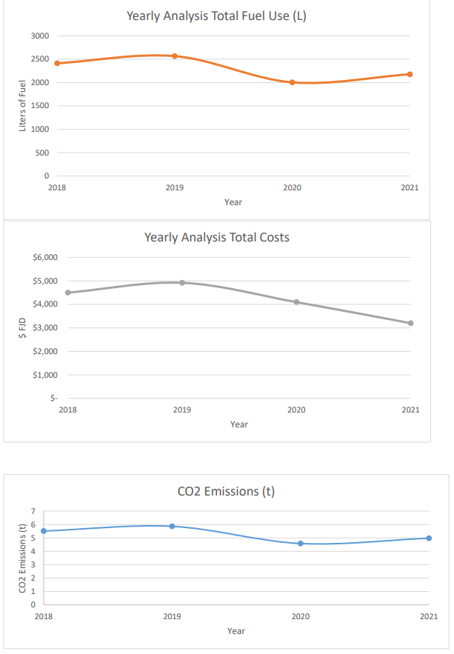
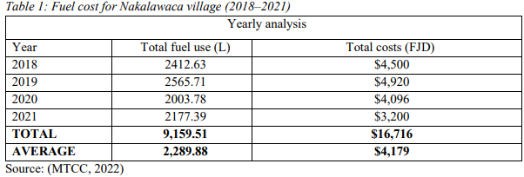
Savings (projected)
Notes:
Historically the villages solely depended on the diesel power outboard motor. The table shows fuel cost for a single outboard engine boat of Nakalawaca village highlighting fuel usage and fuel prices from 2018–2021 when a 2–stroke engine boat was being used for fishing and travelling.
On an average yearly, it is estimated that Nakalawaca villagers will be saving FJ$4,179 in fuel costs and 5t of GHGe for fishing expeditions and short distance travelling. They always had to ensure that sufficient income was generated to cover the fuel cost and as the same time generate sufficient income to buy fuel for the next trip.

Slide 12
Request: Paper for 5th PRETMM on Energy Savings Tenkyu tumas

