Slide 1

PACIFIC ISLANDS WORKSHOP ON ELECTRIC MOBILITY
28 – 30 November 2022
Suva
'Ofa Ma'asi-Kaisamy
Manager, Pacific Climate Change Centre

Slide 2

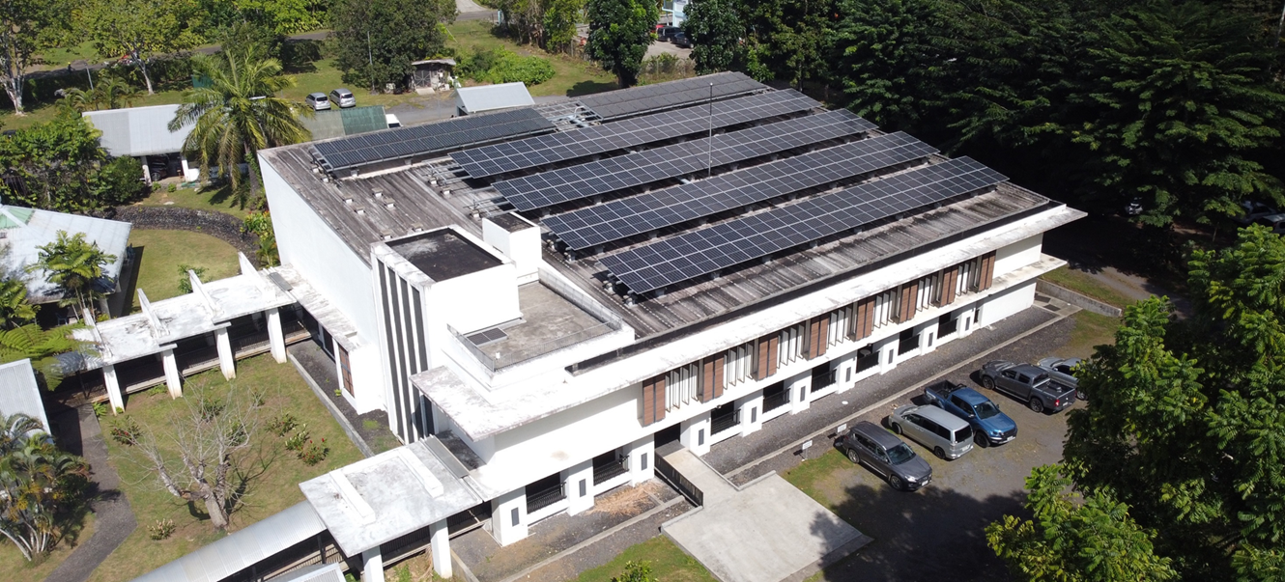
The Pacific Climate Change Center hosted at SPREP
100 Percent Solar Powered Building

Slide 3
Presentation Outline;
The Pacific Climate Change Centre
Innovative Exhibition 4-6 Oct. 2022 – Key outcomes
Innovation Strategic Partnership Framework
JICA PCCC PROJECT: Supporting the Pacific to Access Climate Innovative Solutions
Next Steps – partnership and collaboration on innovative solutions to CC in region and PICTs

Slide 4
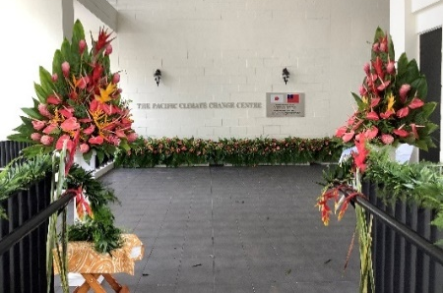
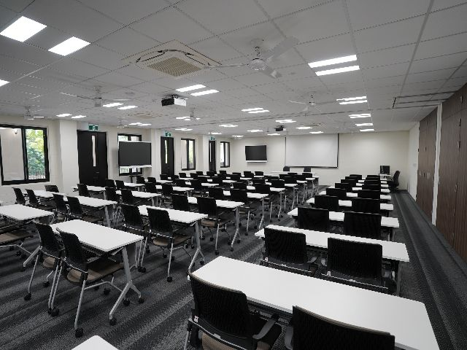
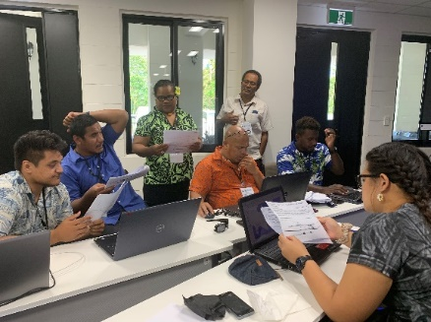
The Pacific Climate Chance Centre
A Centre of Excellence
VISION
Highly valued by Pacific Island Countries and Territories (PICTs) as it provides practical support, knowledge and training.
Underpinned by strong partnerships with Pacific Governments, applied research institutions, donors and the private sector.
Trusted source of user-friendly, scientifically robust information.
Leads to better decision-making and innovative products which are increasing resilience in the Pacific.
FUNCTIONS
Lead to better decision-making and innovative products for resilience building in the Pacific.
Knowledge brokerage, Applied research, Capacity building through training and learning, and Innovation.

Slide 5
Key Pillars of the PCCC Function
Knowledge Brokerage
Capacity Building
Applied Research
Innovation

Slide 6
Innovative Exhibition 4-6 Oct. 2022 – Key outcomes
Attendance: 400 participants per session, reaching 1600 for the innovation presentations.
A key topic per day: Disaster Response and preparedness, Energy efficiency and green energy production, Biodiversity, Water Protection and Agriculture (from surveys)
Multi-stakeholders event: private sector companies, research universities, public institutions, CSOs.
Examples of solutions presented during the exhibition:
resilient housing with local constructing material to increase cyclone resistance;
GIS mapping for improved biodiversity, forestry and health management in remote communities;
Micronesia Conservation Trust;
new solar panel printing technology;
new partnerships platform dedicated to islands network;
Solutions for Coastal Erosion and High Tides
smart crop production systems for food security,
advance policy initiatives to advance electric public transportation transition.(Decarbonizations of the Public Bus Sector in Fiji)
Niue Ocean Conservation Credit

Slide 7
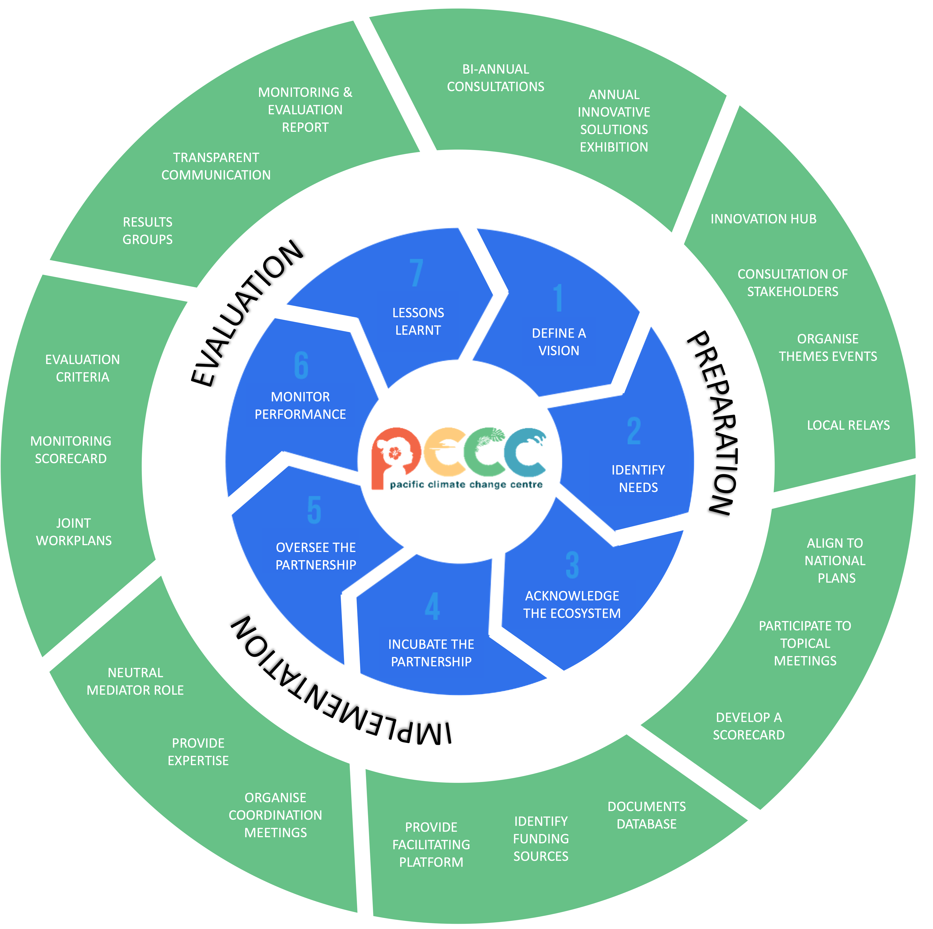
Innovation Strategic Partnership Framework
A virtuous circle of 7 step approach
Socialise and define an innovative idea/vision/goal/objectives
Identify needs, gaps and opportunities
Initiate and catalyse through the PCCC innovation lounge
Incubate and formalise the partnerships
Implementiaton of partnerships
Overseer and Monitor the partnerships
Build on lessons learnt

Slide 8

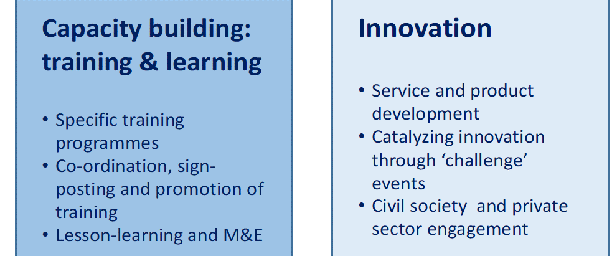
JICA PCCC PROJECT: Supporting the Pacific to Access Climate Innovative Solutions
The innovation strategic partnership framework to be delivered and implemented through the JICA PCCC PROJECT: Supporting the Pacific to Access Climate Innovative Solutions
Lead Partnership - The Government of Samoa and JICA

Slide 9
GOAL
  Capacities for climate resilience in the Pacific are enhanced through the strengthened innovation and capacity-building functions of the PCCC.
PURPOSE
  The Innovation and Capacity Building functions of the PCCC are enhanced by establishing partnerships and strengthening its capacity to support both public and private sector initiatives to facilitate and institutionalize innovative solutions.

Slide 10
KEY OUTPUTs
  Training programs are established for Micro, Small and Medium-sized Enterprises (MSMEs) and government entities for innovative solutions.
  The innovation function of the PCCC is strengthened to support both the public and private sectors in making innovative solutions available.
  Partnerships of public and private sector entities and modalities of engagement by the PCCC are established to demonstrate innovative climate resilience solutions in at least 3 PICs.

Slide 11
Next Steps
JICA Project for Innovative Solutions for Pacific Climate Change Resilience – Begins June/July 2023
Finalize the Innovation Strategic Partnership Framework - 2023
PCCC CC Innovation Lounge to be launched 2023
Engagement with national and regional stakeholders on innovative CC solutions for collaboration through the Innovation Strategic Partnership Framework
Working with countries to catalyze innovative CC solutions implementation in countries at sectoral and sub-national levels
Strengthen capacity and support PICTs improve climate finance access for innovative CC solutions
Facilitate South – South collaboration and partnerships for innovative CC solutions ( facilitated by PCCC innovation lounge)

Slide 12

Thank You

