Slide 1
PACIFIC ISLANDS WORKSHOP ON ELECTRIC MOBILITY
Donor’s Perspective
Roxane Castelein
Focal Point for Climate Change mitigation
(Energy and Transport decarbonization)
Roxane.castelein@eeas.europa.eu
DELEGATION OF THE EUROPEAN UNION FOR THE PACIFIC

Slide 2
EU’s e-mobility Projects in the Pacific
Electric Scooters for police officers in the Marshall Islands
Implemented by RECO;
10 e-scooters provided to the police in 2021 for demonstration of the technology;
A charging station;
Policy support for the Local Government to develop regulations to support the adoption of e-scooters.

Slide 3
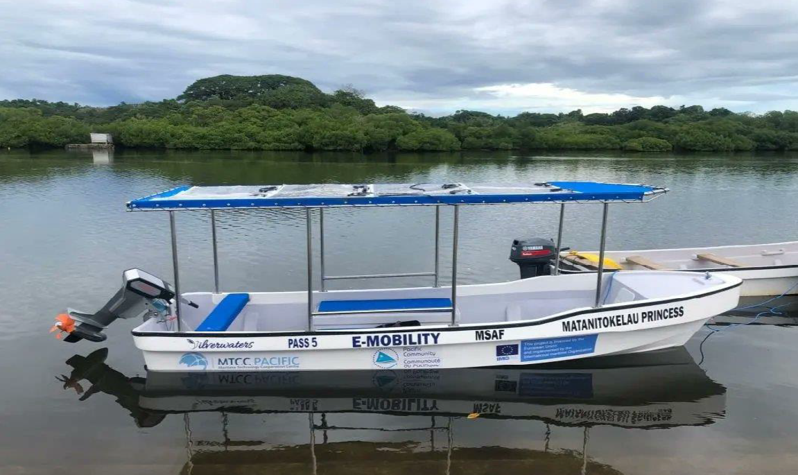
EU’s e-mobility Projects in the Pacific
Solar powered electric outboard boat
Implemented by the Pacific Maritime Technology Cooperation Center (MTCC). Global project implemented by the IMO and SPC and SPREP in the Pacific;
Objective: Decarbonizing maritime transport;
Regional technical support and implementation of SEEMP and ports energy audits and pilots in targeted countries: Fiji, Kiribati, RMI, Samoa, solomon Islands, Tuvalu and Vanuatu
One of the pilots in Fiji was the design and built of a solar powered electric outboard engine of a fishing boat that was given to the Fishing Women Club in NakalawacaTailevu. Launched earlier this year.
Notes:
Engine installed:
Torqeedo; 20 HP
The overall objective of the MTCC-Pacific is to support targeted PICTs in their efforts to reduce their GHG emissions and reliance on fossil fuel by the implementation of standards, best practices and innovative solutions by maritime transport operators.
a)Provide all Pacific Island Countries and Territories (PICTs) with technical support through templates, guidelines, generic law for energy efficient operations of ships and ports; and
b) Provide targeted countries (Fiji, Kiribati, Marshall Islands, Samoa, Solomon Islands, Tuvalu and Vanuatu) with in-country technical assistance through the implementation of adapted Ship Energy Efficiency Management Plan (SEEMP) on board domestic ships, energy audits in ports. Some pilot projects relate to low-carbon technologies and operations in maritime transport, and others relates to Data Collection and Reporting (DCR) systems on fuel consumption of ships.
First phase was concluded a couple of months ago and next phase will start early 2023.

Slide 4
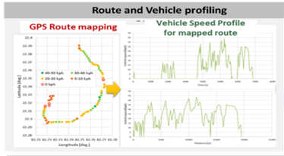
EU’s e-mobility Projects in the Pacific
TA for Decarbonizing the Government Fleet in Fiji
Technical Specifications based on:
Data collection
Route and Vehicle Profiling
Battery Sizing and Design
Charging Strategy
Costs (CAPEX and OPEX)
Notes:
There is also a data collection component being undertaken with the government fleet drivers through a GPS application to understand better the vehicle specifications; the routes taken, km driven, etc
The potential impact on the grid will also be modeled and simulated

Slide 5
EU Green Deal and Fit for 55
Our Goal is to Make Europe the first climate neutral continent
To get there, the 27 EU Member States pledged to reduce emissions by at least 55% by 2030, compared to 1990 levels;
The European Green Deal set the blueprint for this transformational change;
Proposals to reduce GHG emissions in all sectors of the Economy:
Sustainable Transport
Cleaning the energy system
Renovating buildings
Nature-based Solutions
Circular Economy
…
Notes:
The European Green Deal was announced in December 2019. Our Goal is to Make Europe the first climate neutral continent. This means for the transport sector a 90% cut in emissions by 2050.
In December 2020 the Eurpean Council endorsed a new binding climate target of a net domestic reduction of GHG emissions by at least 55% by 2030.
In July 2021, the European Commission put forward the 'fit for 55' package of legislative proposals to meet this target. port and clean energy, preserving biodiversity, oceans and forests, promoting sustainable agriculture, developing green cities and the circular economy.

Slide 6
EU Priorities to decarbonize the transport sector
Transport represents 27% of total EU’s emissions
Fit for 55 package includes measures for all transport means: aviation; maritime and land transport;
CO2 emission performance standards for cars and vans (they represent 15% of EU’s total emissions);

Slide 7
E-mobility plays an important role
Some instruments to promote e-mobility:
Ensure interoperability among Member States;
Putting adequate infrastructure in place and building the charging network;
Battery Recycling;
Fiscal Incentives;
Investment in technology development;
Establishing policies and regulations.
Notes:
By 2030 the EU has the target to install 3M public charging points.

Slide 8
But it is not only about e-mobility
Importance of developing Transport Decarbonization Strategy and Action Plan;
Other Instruments:
Pricing Carbon and providing better incentives for users,
Fuel Efficiency Standards,
Green fuel, a big push for green Hydrogen,
Promotion of public transport,
Boosting the use of data and AI for smarter mobility,
…
Notes:
The European Commission developed a ‘Sustainable and Smart Mobility Strategy’ together with an Action Plan that was presented in December 2020.
Some targets from that Action Plan include:
- By 2030 scheduled collective travel for journeys under 500 km should be carbon neutral
- By 2030 zero-emission marine vessels will be market-ready
- By 2035 zero-emission large aircraft will be market-ready
To reach those targets different instruments are being deployed:
1. Pricing Carbon and providing better incentives for users.
from 2026 road transport will be covered by emissions trading, putting a price on pollution, stimulating cleaner fuel use, and re-investing in clean technologies. Carbon Pricing for the aviation sector and the maritime transport sector will also be deployed.

Slide 9
Importance to look at the entire value chain
Down the VC:
Batteries are mineral intensive
Up the VC:
Efficient way to recycle batteries and in the Pacific ?
Notes:
And the mining industry is not the cleanest one.
Tesla just signed an exclusivity with a Nickel mining in New Caledonia.

Slide 10
THANK YOU!
VINAKA !
Roxane Castelein
Roxane.castelein@eeas.europa.eu

