Slide 1
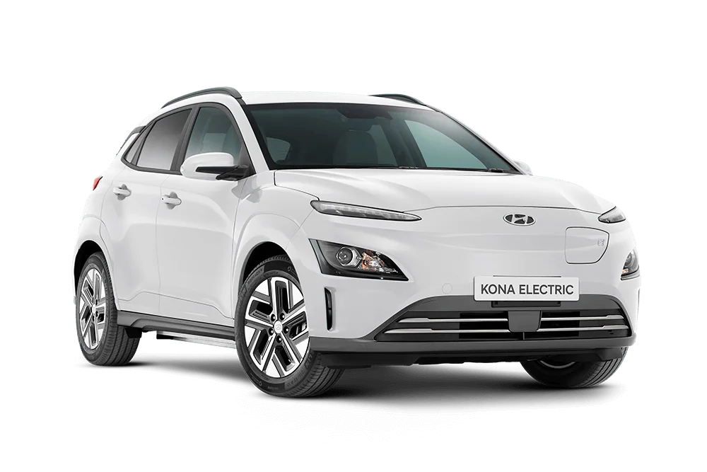
E-MOBILITY IN SAMOA
Electric Power Corporation

Slide 2
OUTLINE
General Information – Highlights of Samoa.
Energy Situation - Review of the Present
E-Mobility Pilot Project – Charging towards the Future.
Challenges for Samoa – Opportunities to Rise.
Conclusion

Slide 3
General Information
Highlights of Samoa
Total population of 198,410 (as of 2021 census).
Situated in the South Pacific.
Native Language: Samoan.
Religion: Predominantly Christian.
Major Industries: The services sector account for 66% of GDP, followed by industry and agriculture at 23.6% and 10.4% respectively.
Exports: Agriculture employs two-thirds of the labour force and furnishes 90% of exports, featuring coconut cream, coconut oil, noni (juice of the nonu fruit, as it is known in Samoan), and copra.

Slide 4
General Information
Highlights of Samoa
Imports: Refined Petroleum ($34.6M), Coated Flat-Rolled Iron ($21.6M), Non-fillet Frozen Fish ($18.7M), Metal Stoppers ($14.4M), and Poultry Meat ($12.8M), importing mostly from China ($87.3M), New Zealand ($70.6M), South Korea ($46.5M), Singapore ($29.5M), and United States ($24.8M).
Electricity Act 2010, EPC Grid Code, and Energy Sector Policy.
National Energy Coordination Committee (NECC).

Slide 5
Energy Situation
Review of Present
Installed Capacity
50.3MW Total Generation Capacity.
Diesel 45.8%
Hydropower 25.9%
Solar 27.1%
Other 1.2%
Primary Energy
Maximum demand of 26MW.
60% from renewable sources (15.7% Hydro, 49.8% Solar, and 1% Wind).
33.5% generation contribution by Diesel stations (average MD).
Electricity Tariff
WST$0.52/kWh
Domestic Prepaid.
WST$0.63/kWh
Non-Domestic Prepaid.
WST$0.63/kWh
Domestic Postpaid.
WST$0.67/kWh
Non-Domestic Postpaid.
Fixed rates for Top 100 consumers.
Fuel Unit Price
Diesel = WST$4.69/L.
Petrol = WST$4.36/L.
Kerosene = WST$4.24/L

Slide 6
E-Mobility Pilot Project
Charging towards the Future
Objective: Synthesize existing research on projections for electric vehicle supply, and price for the period 2020 – 2030. Quantifying the:
Expected level of electric vehicle production in key supply markets.
Potential supply of new electric vehicles into Samoa.
Expected change in the price of new electric vehicles (including electric vehicle batteries) available to Samoa.
Information collation limited to neighborhood and conventional passenger vehicles (2020 to 2023). Light and heavy commercial (2024).

Slide 7
E-Mobility Pilot Project
Charging towards the Future
Samoa Context
Samoa is an extremely small market on the global scale. Limited policies and incentives are available to encourage the uptake of electric vehicles.
Supply of electric vehicles to Samoa is extremely limited.
Up to 60MW of new renewable energy projects forecasted up to 2031.
Key Findings
Electric vehicle market is evolving quickly globally but faces significant uncertainty. Policies to promote or encourage uptake of electric vehicles.

Slide 8
E-Mobility Pilot Project
Charging towards the Future
Consumer Concerns
Reliability, safety, battery degradation, price and resale values, and access to charging infrastructure.
Key Outputs (Phase 1, 2020-2022)
NECC/LTA EV Policy Drafted.
Hyundai new EVs supply market opening.
Township charging infrastructure Pilot.

Slide 9
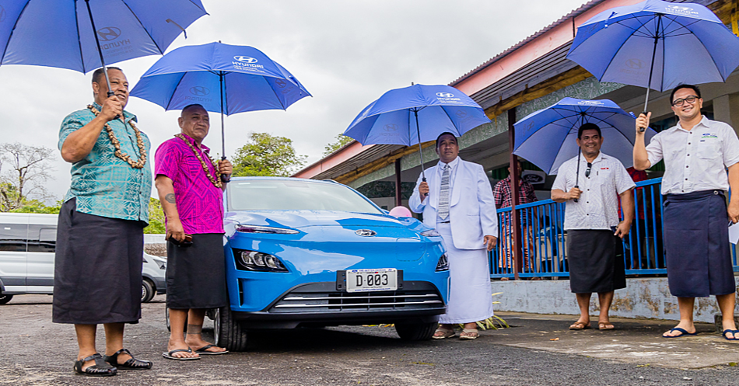
E-Mobility Pilot Project
Charging towards the Future
E-Mobility Pilot Project Launch, Savaii, Samoa (2022).
Government Officials and Hyundai Samoa Representatives

Slide 10
SUMMARY
There is consensus in international literature and amongst key stakeholders in Samoa that, over time, the cost of electric vehicles will become competitive with the cost of conventional vehicles, and that they will become widely available across more models.
Key findings and concerns in Samoa revolve around access to the infrastructure and public awareness.
Policies to promote or encourage uptake of electric vehicles will need to be flexible and adaptive to change.
FAAFETAI / THANK YOU

