Slide 1
Perspectives and Experiences on E-mobility
Kakau Foliaki
Tonga

Slide 2
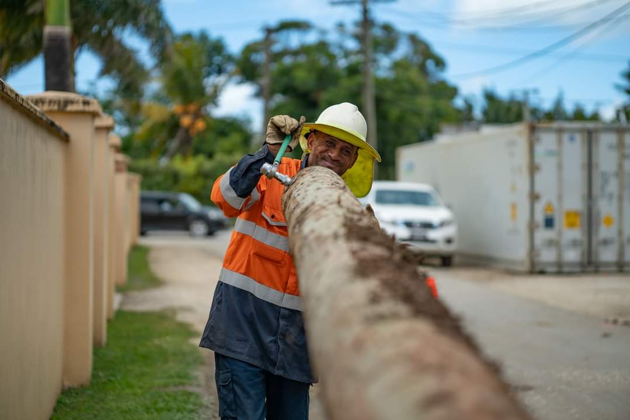
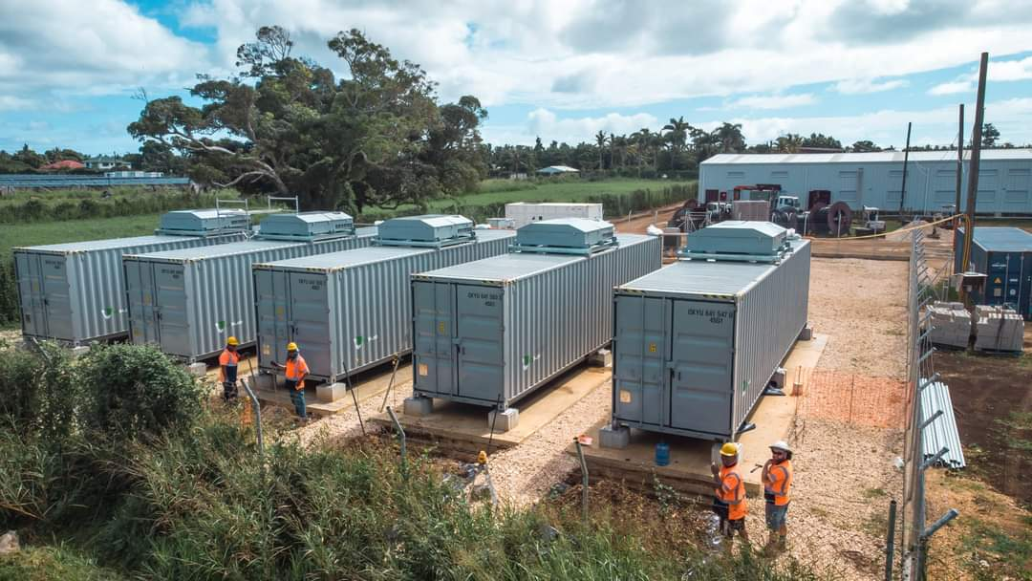
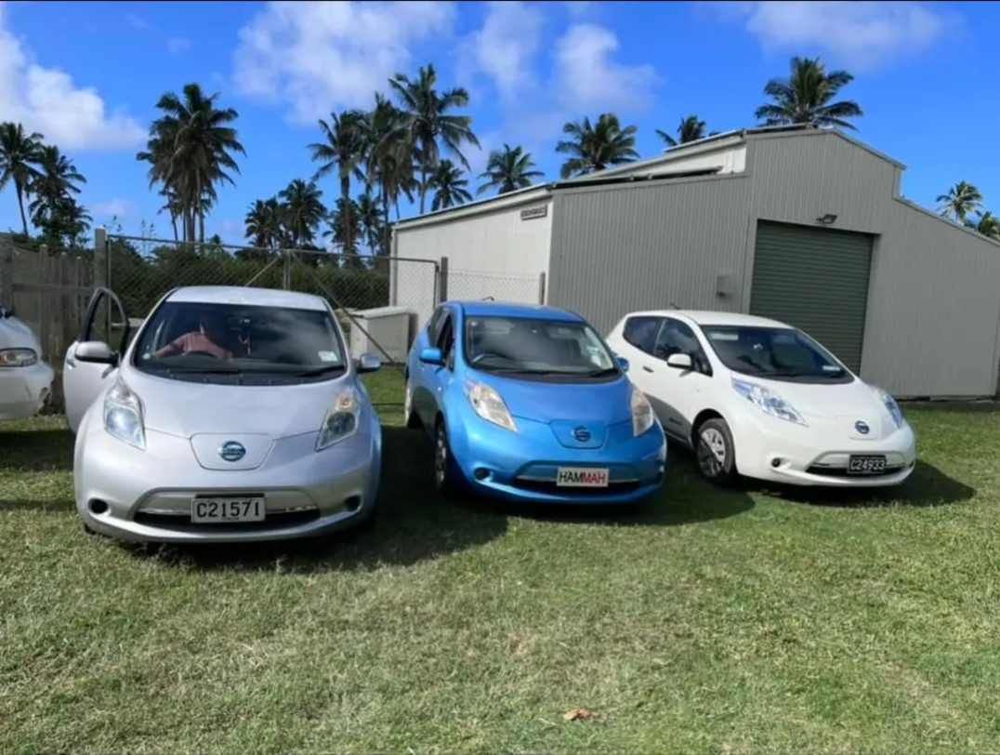
Content
Electricity and Transport Sector of Tonga
Tonga’s Perspective
Experiences in e-mobility
Way forward with e-mobility

Slide 3
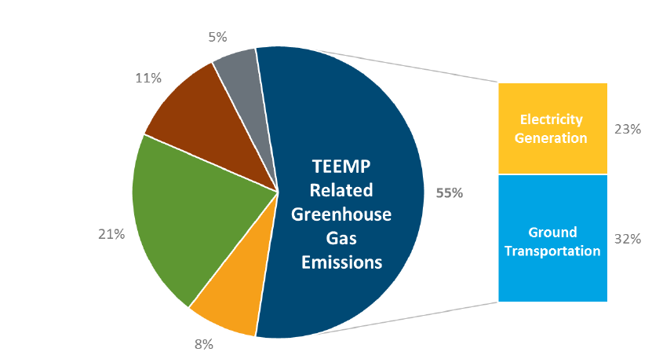
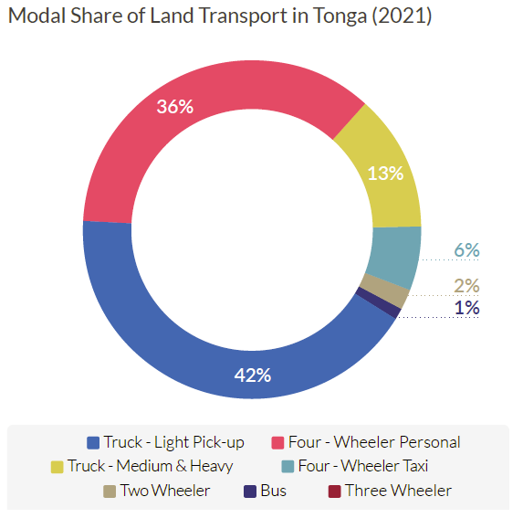
Transport Sector
The transport sector is the main user of imported petroleum products.
32% of GHG emissions account for ground transportation, 23% for electricity generations.
Land transport is the dominant mode of transport, while maritime and aviation (domestic shipping for transportation of people and goods and fishing) are also also important.
4 wheeler and light pick up accounts for 36% and 42% respectively.
Ministry of Infrastructure regulates the transport sector.

Slide 4
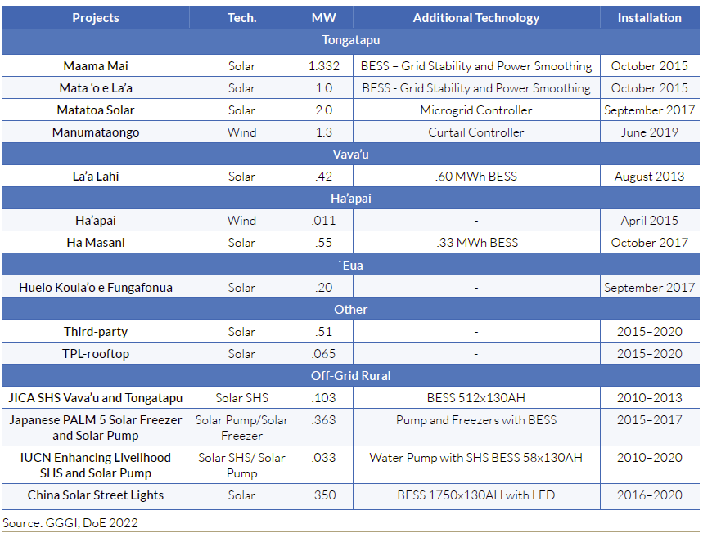
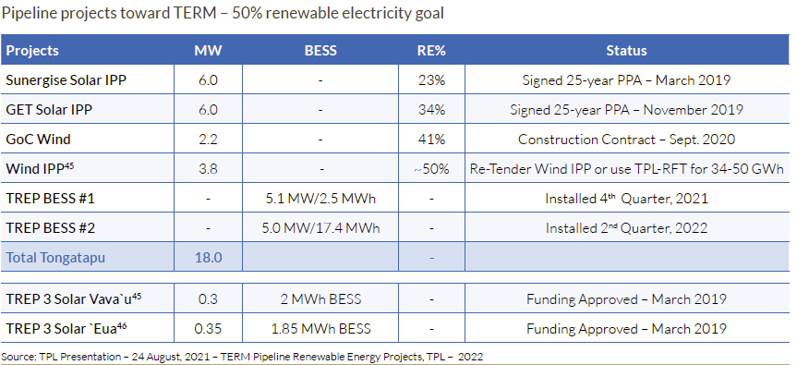
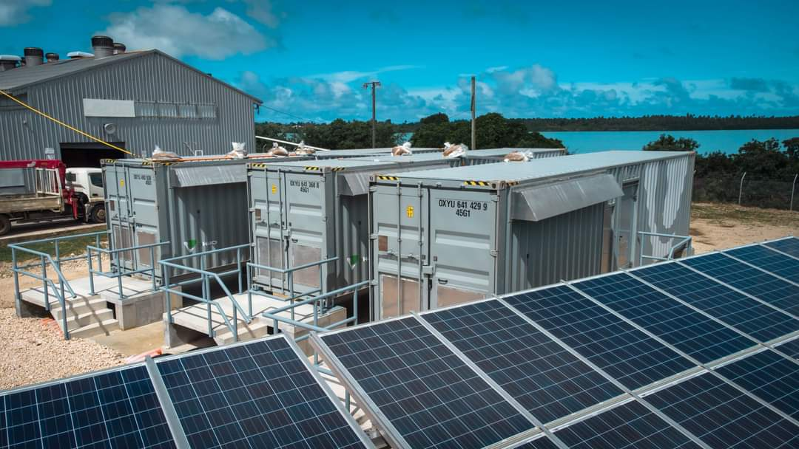
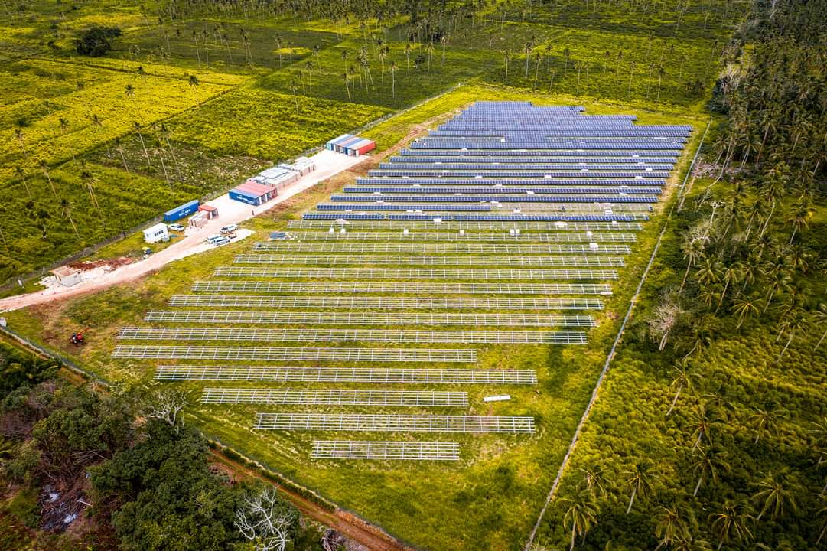
Electricity sector
Tonga Power Limited is the only Power Utility in Tonga (SOE).
Installed On-grid Diesel Capacity - 17.7 MW + 7.3 MW RE (Solar and Wind)
Electricity tariff - T$.1.16/kWh (US$0.60/kWh)
Electricity access in about 98%

Slide 5
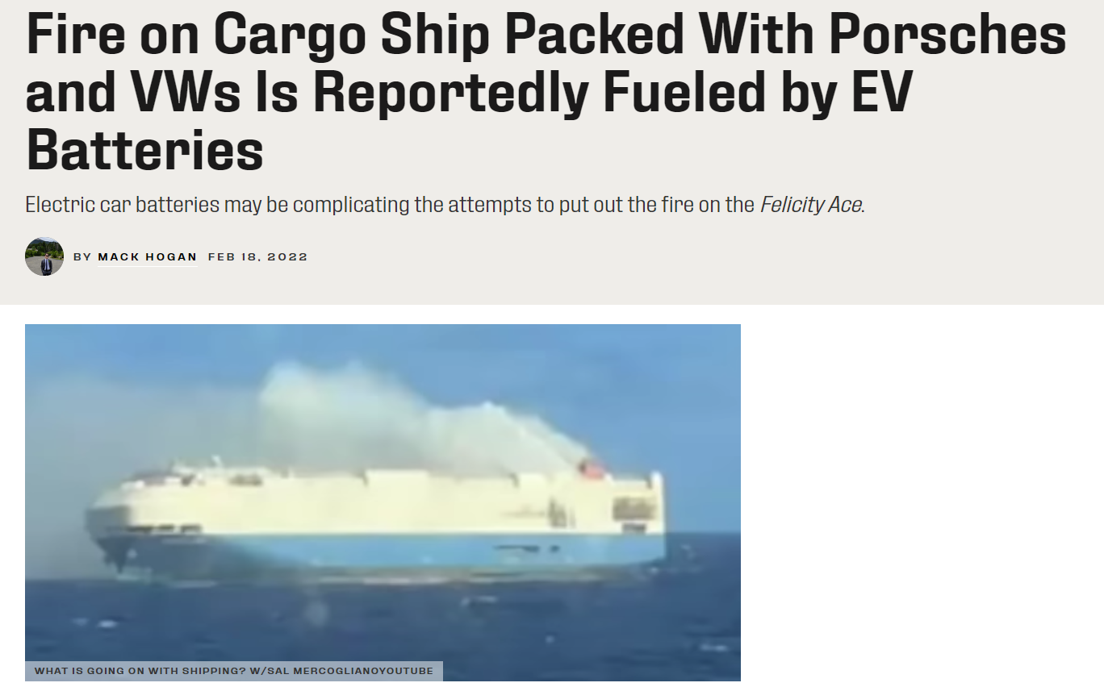
E-mobility status in Tonga
Only 4 EVs (Nissan leaf) in Tonga
Pros – cheaper to run (additional $200/month (electricity) vs $600/month (fuel))
Cons – battery deteriorate quickly and no capacity for maintenance
1 Plug-in hybrid (Mitsubishi Outlander)
Lack of system to calculate the import tax for EV - Tax is based on the size of the engine (cc) of ICE.
Local car dealership – not convinced to import EV due to lack of interests from the public or maintenance capacity.
Difficult to import EV - some shipping line restrict shipping vehicle with battery due to fire hazard – some EVs are shipped via NZ

Slide 6
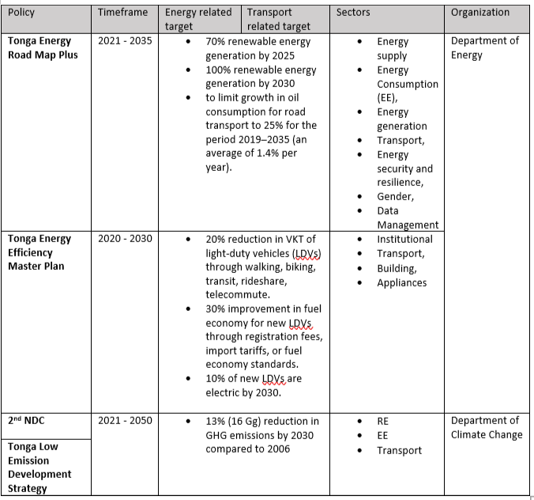
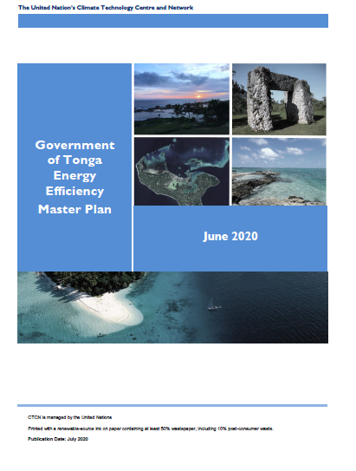
E-mobility perspective

Slide 7
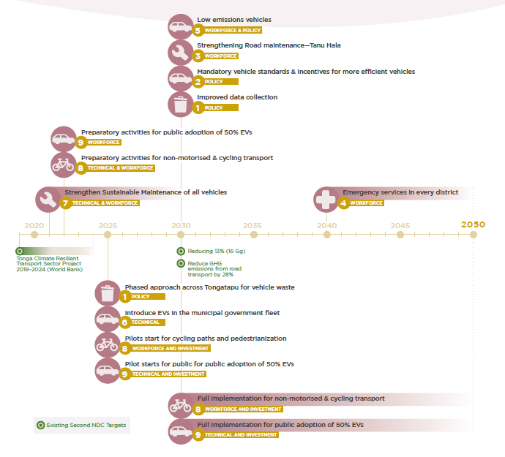
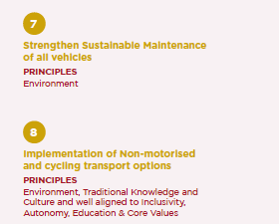
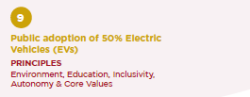
Low emission development strategy (LEDS) 2021 - 2050

Slide 8
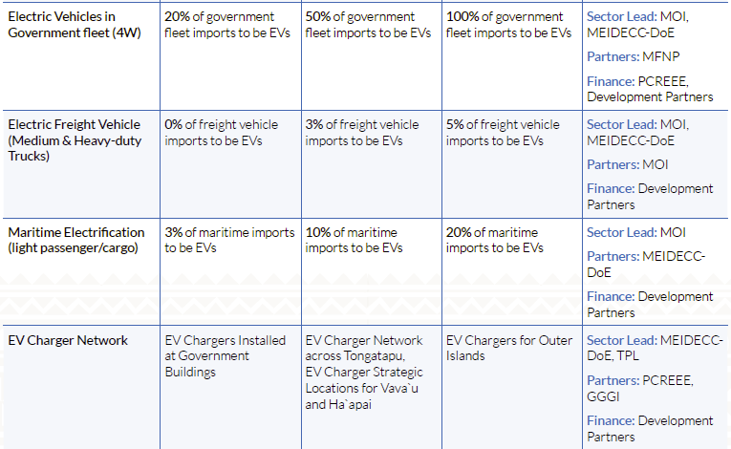
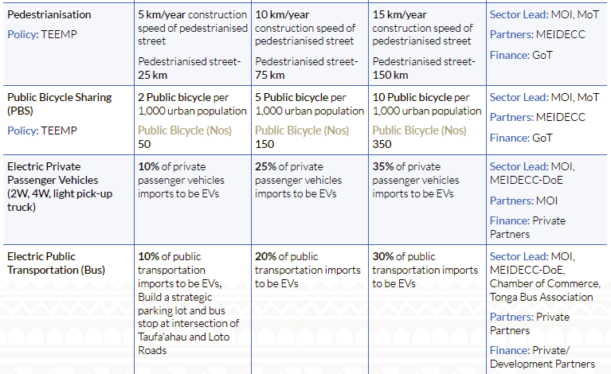
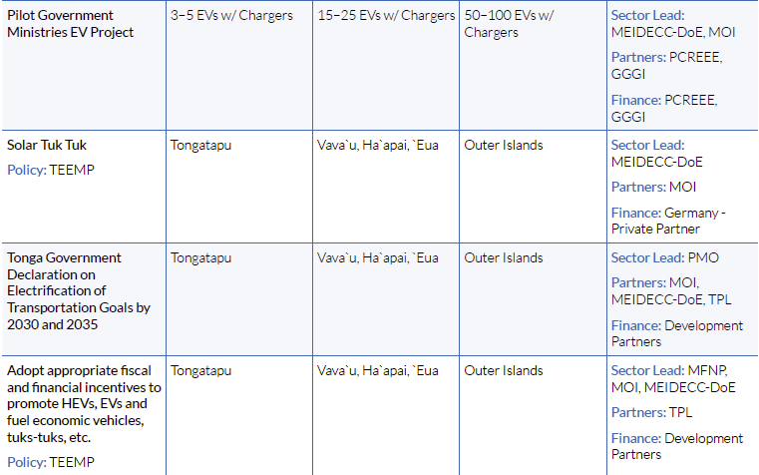
TERM PLUS – 2021 - 2035

Slide 9
Tonga Energy Efficiency Master Plan – 2020 - 2030

Slide 10
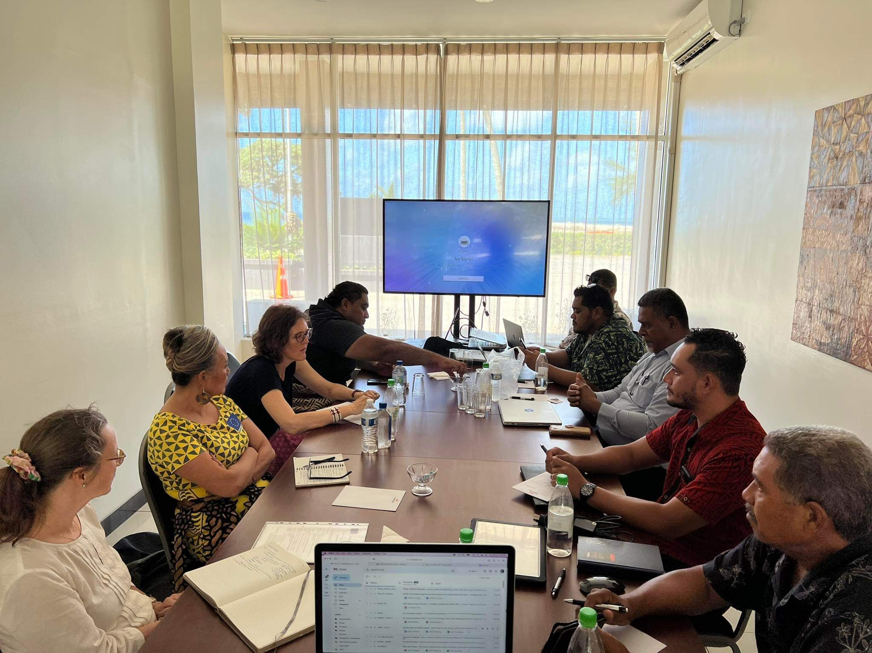
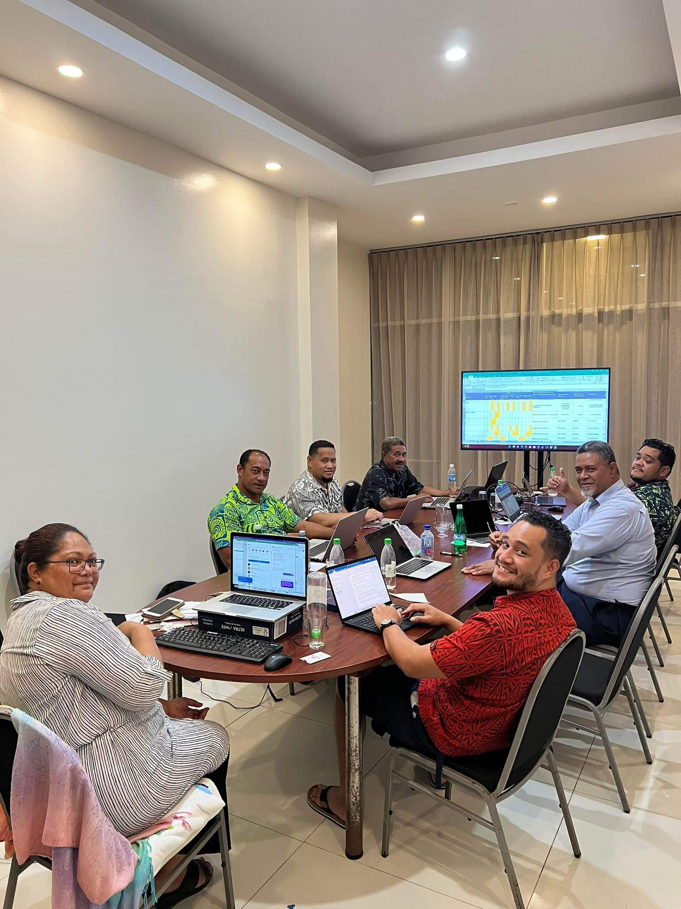
What have we done?
Energy Planning
Monitoring and Evaluation Framework
TERM Plus investment Plan
Donor roundtable discussions
EV road map by NREL
Technical Assistance
Development of E-mobility Road Map (NREL)
Public Transport feasibility studies (GGGI)
Cost benefit analysis of policy options for an increased EV uptake
Study on tariff and power sector infrastructure requirements on electric vehicles
Development of recommendations incentivizing Tonga’s EV transition.
EV Demonstration Project
Nissan Leaf demonstration project
E-mobility Task Force
EV Awareness
Climate Change National Awareness Week
E-mobility proposal (e.g. GEF8)

Slide 11
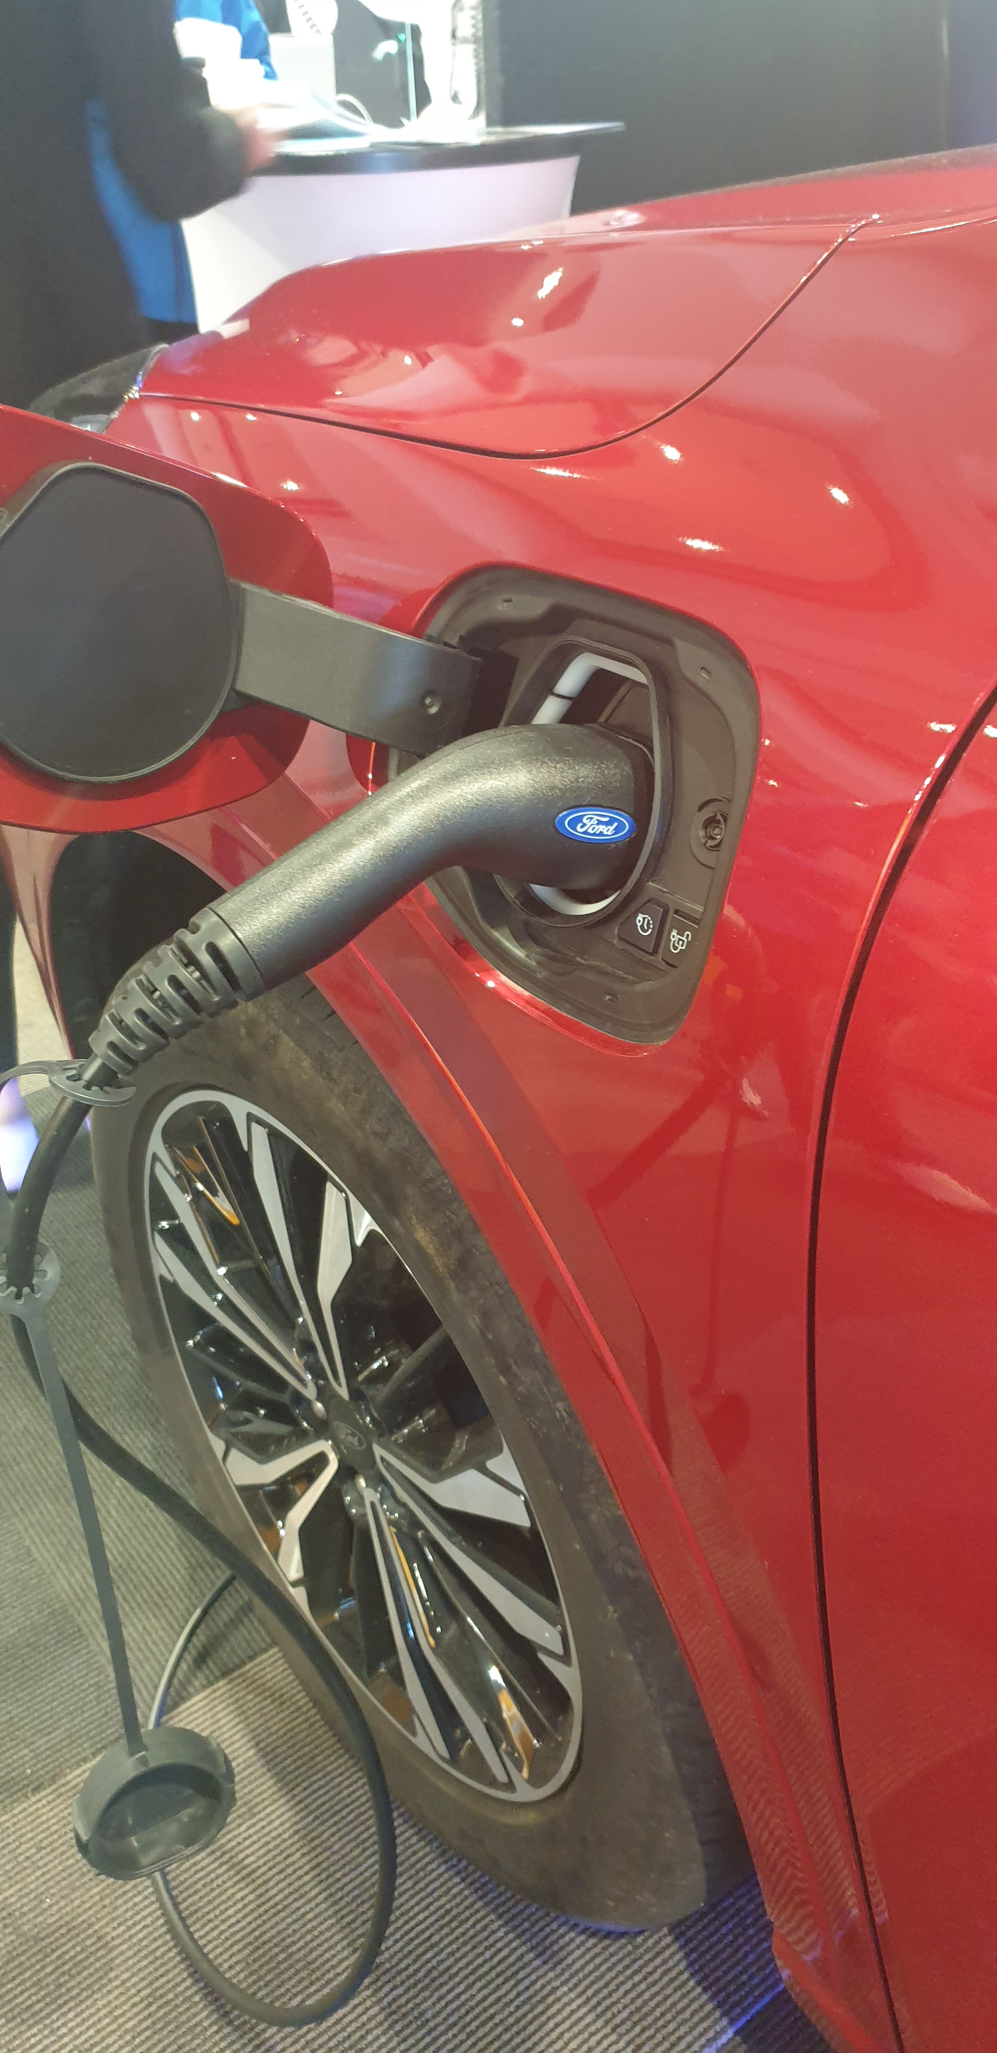
What are the barriers?
Affordability
T$30k-$50k for a second-hand EV from Japan
Maintenance especially the battery
EVs and charging stations
Challenge the status quo – convince the import of EV over ICE
Fear of more EV than charging stations will be an issue
Fear of grid readiness/stability for EV charging
Lack of studies for policy decision-makers:
Understand the impact of EVs on the grid
EV vs ICE (pros and cons)
Incentives and policy options
Standards etc.
Existing Transportation Culture
ICE vs EVs
Public transport vs Private cars (convenience)
Influence changes to existing legislation that restricts EVs charging business
Duration of charging vs fueling your car
EV awareness
Driving range anxiety
Maintenance and spare part anxiety
Driving behavioural change

Slide 12
Way forward
4. E-mobility infrastructure
Charging stations mapping + business model
Charging infrastructure-grid connected vs solar?
Home charging and public charging stations demo
Climate Proof
5. Capacity building
Accredited training programme with Tonga National University/ Tonga Institute of Science and Technology
Overseas Short – long term accredited trainings
6. Data Management
Updated and integrated smart real time data system
7. Gender
Mainstream energy and gender into national policies
8. Awareness
Sustainable Energy Investment Forum/Expo
Sustainable Energy Week
9. Electricity
Collaborate with Power Utility to understand the impacts of EVs on the grid with considerations of upcoming RE projects and RE penetrations.
Impacts on tariff
Management/Coordination
Department of Energy and Ministry of Infrastructure
E-mobility Task Force (DOE, MOI, PCREEE, Tonga Chamber of Commerce, Custom and Revenue) – update the Energy Steering Committee on e-mobility interventions
E-mobility and fuel efficient procurement incorporated into government procurement policy
Investments/Financing/Market Innovation
Incentives pragramme for income levels (affordability)
Private Sector Investments programme (accessibility)
Bankable projects (TERM+ investment plan)
Policy/Regulation/Standards
Fuel efficiency standards
EV and charging station standards
EV Road Map

Slide 13
MALO

