Slide 1







ENERGY INVESTMENT FORUM
27th – 29th April 2026
Port Moresby, PNG | APEC Haus
Practical Experience in De-risking Renewable Energy Investments in Small Islands
Experiences from the ground in other SIDS / regions
Presenter : Mr. Wycliffe Ngwabe
Designation : Country Lead, UNCDF
Mr. Eddie Megao | Deputy Managing Director, NEA | Energy Investment Forum 2026

Slide 2

The Investment Challenge in Small Island Countries
High Upfront
Costs
Currency Risks
Increases financial
uncertainty
Limits investment
opportunities
Limited
Demand
Weak Financial
Ecosystems
Reduces potential
returns
Hinders access to
capital

Slide 3
Why De-risking Matters
Blended Finance
Combines public and
private funding for
projects.
Technical
Assistance
Enhances project
implementation
through expert
support.
Sustainable
Financial
Solutions
Policy Support
Long-term financial
stability for
development
challenges.
Creates enabling
environment for
investment and
growth.
Market
Development
Stimulates economic
growth through
market expansion.
Risk—not capital—is the barrier

Slide 4
UNCDF De-risking Toolbox
First-Loss
Capital
Guarantees
Digital Finance
Financial Risks
Mitigated
Financial Risks
Concessional
Loans
Capacity
Building
Goal: Crowd in private investment

Slide 5
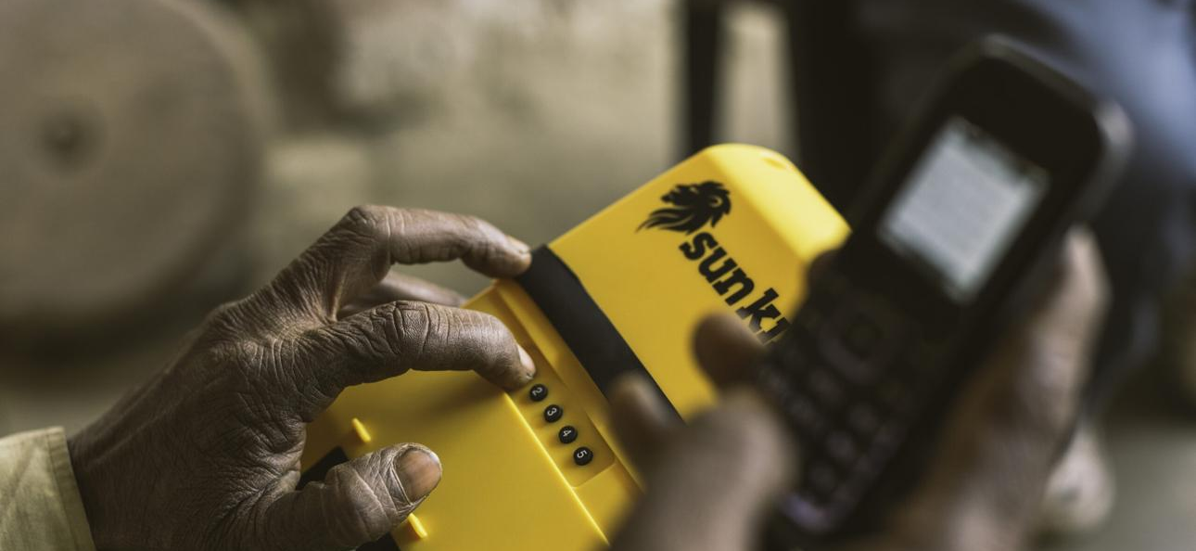
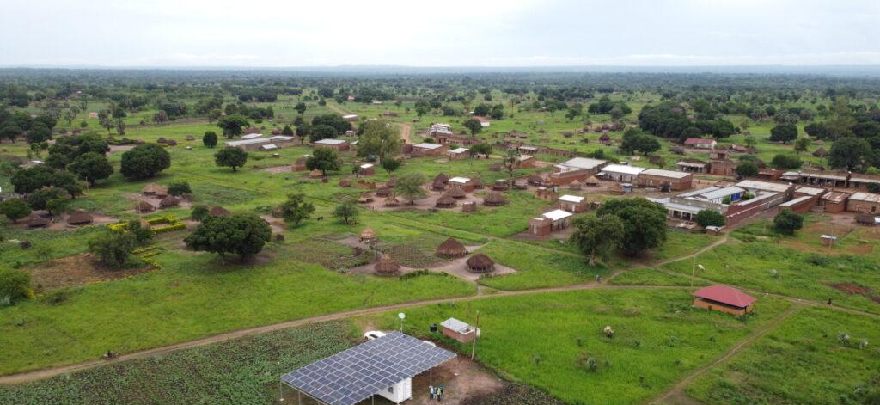
Case Study: PAYGo Solar
Countries: Africa & Asia
Mobile payments + solar
Catalytic capital
Impact: Millions reached

Slide 6
Case Study: 1
PAYGo De-risking Mechanism in Uganda
PAYGo De-risking
Mechanism
Flexible Repayment
Options
Framework enhancing
financial transactions
through digital payment
tracking.
Caters to diverse customer
needs with adaptable
repayment plans.
Improved Credit Risk
Assessments
Enhances accuracy in
evaluating customer
creditworthiness.
Investor Attraction
Attracts investors by reducing
financial risks.
Secure and Efficient
Financial Environment
Creates a safer and more
streamlined financial
ecosystem.
Goal: Attracted investors

Slide 7
Lessons Learnt for Mini-Grid Success
Feasibility and
Subsidies
Crucial for mini-grid
implementation in Pacific &
Africa.
Regulatory Support
Mini-Grid
Success
Creates enabling environment
for mini-grid investment.
Improved Bankability
Attracts financial resources
for sustainable mini-grid
development.

Slide 8
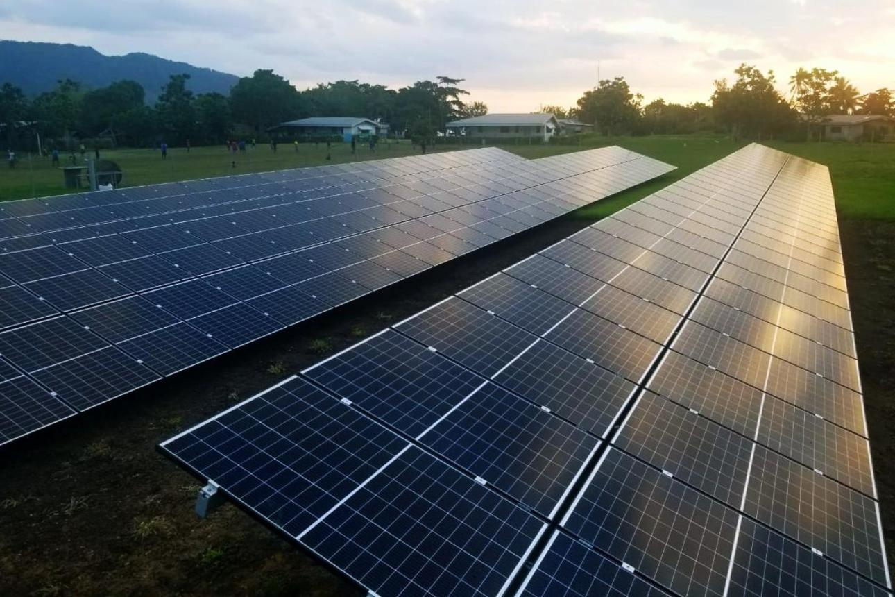
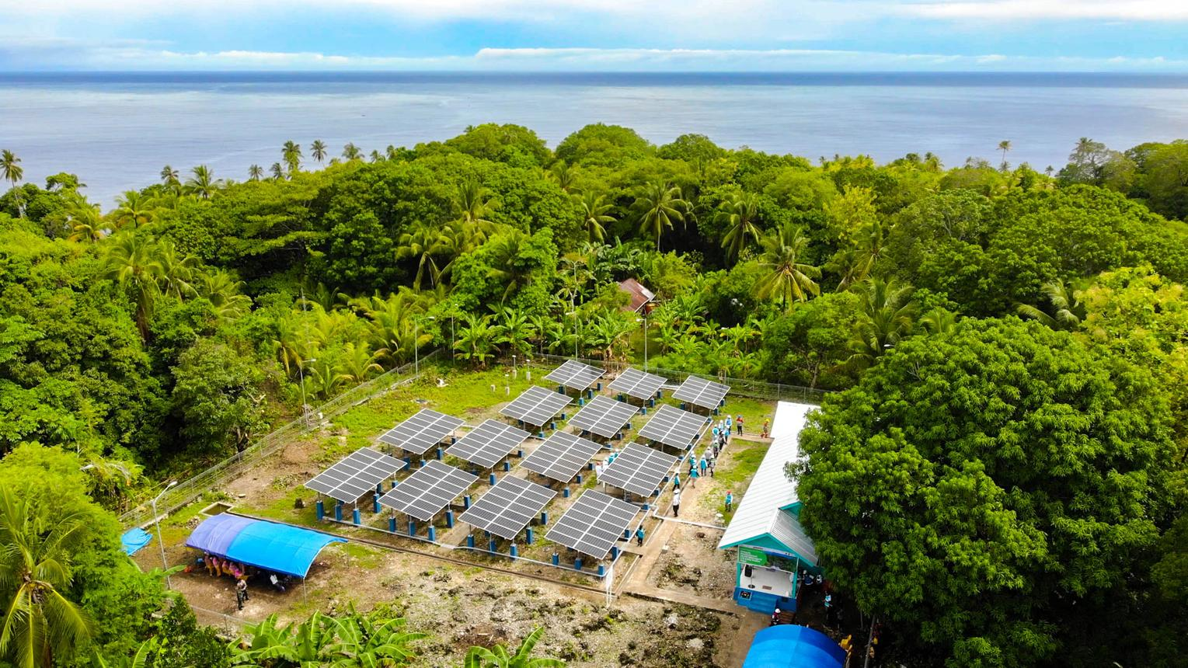
Case Study: 2
CleanStart Programme in Africa and Asia
Energy Access
Financing
Provides financial support for
clean energy solutions.
Microfinance
Integration
Incorporates microfinance to
improve energy accessibility.
Risk-Sharing
Mechanisms
CleanStart
Programme
Implements risk-sharing to
encourage new market
development.
Market Development
Fosters growth of new
markets for clean energy.
Sustainable Energy
Solutions
Promotes sustainable energy
solutions for underserved
communities.
Impact: New markets created

Slide 9
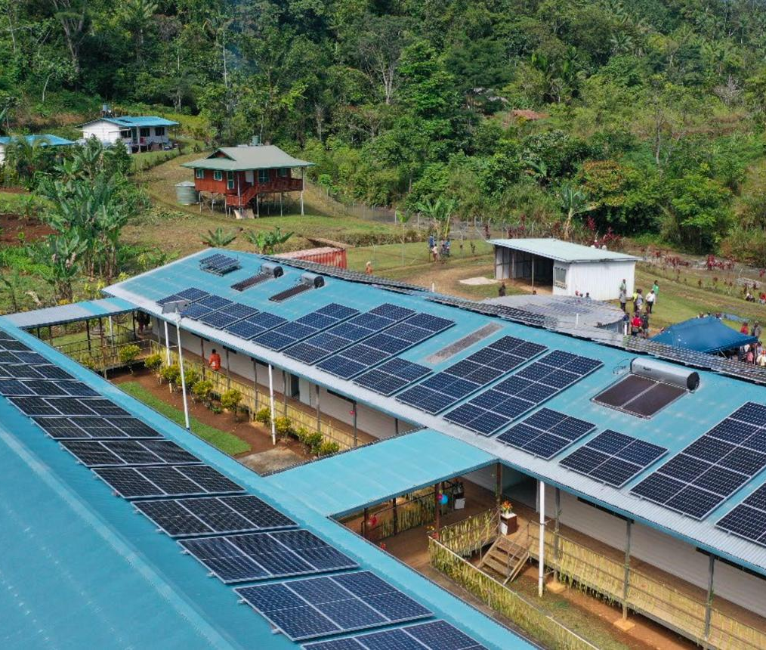
PNG Context

Slide 10
PNG's Persistent Challenges
High Service
Costs
Limited Finance
Access
Burdens consumers and
providers
Restricts investment
opportunities
Geographic
Fragmentation
Major Energy
Gaps
Complicates service
delivery
Hinders economic
progress

Slide 11
UNCDF in PNG
Blended
Finance
Sustainable
Financial
Solutions
Combining different
funding sources
Digital Finance
Expansion
Long-term and
effective financial
tools
3
Broadening access
to digital financial
services
2
4
Financial
Inclusion
1
The ultimate goal of
UNCDF's efforts
Applicable to energy sector

Slide 12
UNCDF Value add in the Energy sector
Bank
Partnerships
Guarantees
Securing financing and
supporting energy
initiatives
Providing assurance to
investors and
stakeholders
MSME
Aggregation
PAYGo Models
Consolidating demand
and resources among
small enterprises
Facilitating flexible
payment options for
accessibility

Slide 13
Proposed Pathway to Scale
Pilot Phase
Initial testing to validate
concepts and gather insights.
Data Collection and
Analysis
Gathering and analyzing data
to inform decision-making.
Guarantees
Pathway to
Scale
Providing assurances to
attract private investment.
Private Capital
Securing funding from private
investors for expansion.
Sustainable
Ecosystem
Creating an environment that
supports continuous
innovation.

Slide 14
Achieving Secure and Sustainable Investments
2
3
1
Blended
Finance
Digital Finance
4
Facilitate access and
efficiency
De-risking
Combine public and
private resources
Transition to
Scale
Ensure investments
are secure
Realize full potential
of strategies
Implement Key
Strategies
Insecure Investments
Secure Investments
Investments lack security and
sustainability
Investments are secure and
sustainable
From pilots to scale

Slide 15
Thank You
Wycliffe Ngwabe
Country Lead
United Nations Capital Development Fund
Wycliffe.Ngwabe@uncdf.org

