Slide 1
JOINT INFRATEC – PCREEE Workshop
Business Skills & Productive Use of Energy Training for Community Members in Kotu & ‘O’ua
Thursday 29 Feb – Friday 1 March 2024
Mr. Sosefo Tofu
PCREEE

Slide 2
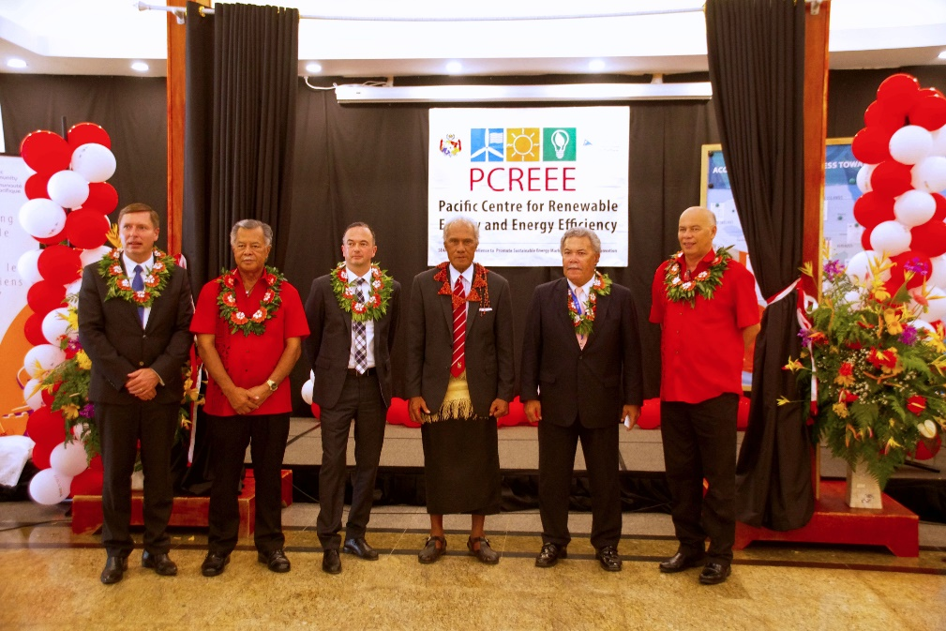
PCREEE Background
Fokotu’u ‘I he 2017, ‘Epeleli
Malumalu ‘I he Pacific Community (SPC) pea ‘oku ‘ofisi ‘I Nuku’alofa, Tonga.
Tokoni’I fakapa’anga ‘e he United Nations Industrial Development Organisation (UNIDO) pea mo e Austrian Development Agency (ADA).
Mission:
To create, educate, and facilitate the increased awareness and development of the RE&EE Agenda in the Pacific region, with special emphasis on the private sector and local industries.
Objectives:
To improve access to modern, affordable and reliable energy services, energy security and mitigation of negative externalities of the energy system (e.g. local pollution and GHG emissions)
To promote renewable energy and energy efficiency investments, markets, and industries in Pacific Island Countries and Territories (PICTs).

Slide 3
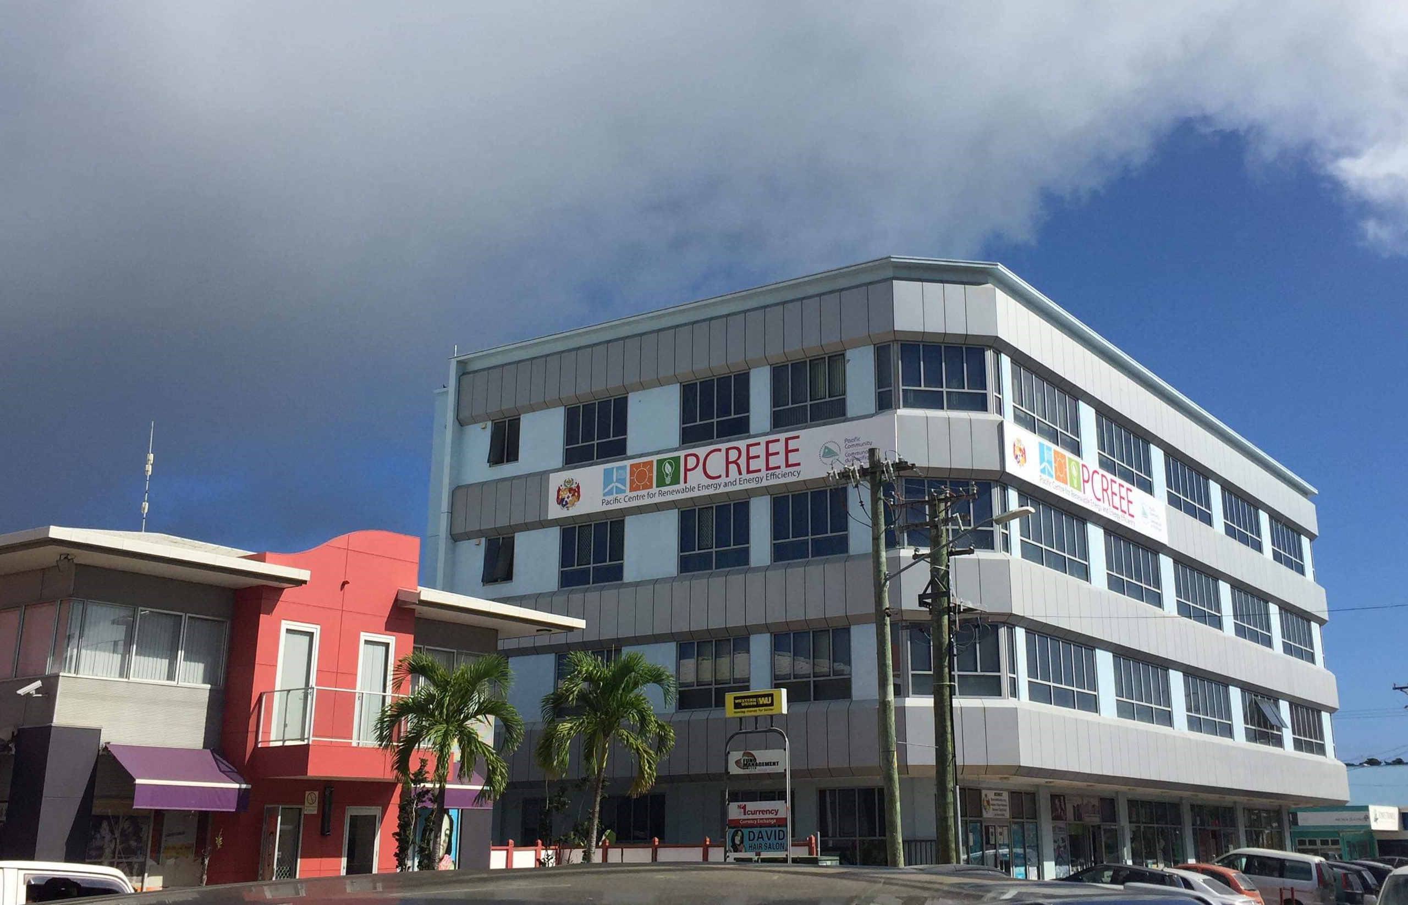
PCREEE office
Level 4,
MEIDECC Building

Slide 4
Palani fakata’u 10 ‘o e PCREEE
Ng. ‘Elia lalahi ‘e 4
Programme 1. RE&EE Business Start-Up and Entrepreneurship Support
Programme 2. RE&EE for Sustainable Mobility
Programme 3. RE Mini-grids
Programme 4. Energy Efficiency Investment
https://www.pcreee.org/sites/default/files/documents/files/PCREEE_BP_Completo.pdf
Notes:
Palani fakata’u 10 e PCREEE

Slide 5
Koeha e fa’ahinga tokoni ‘o e PCREEE ki he ‘uu Fonua e Pasifiki, kau ai ‘a Tonga.
Capacity Buildings Program – Fakahoko ha ng. ako (pe training)
Energy Policy Development – (incl. guidelines /standards) – tokoni ki hono fa’u ha ng. policy pe palani ‘I he ma’u’anga ivi ke ngaue’aki ha Fonua.
Energy Forum, Awareness
Funding subsidy [incentives] – fakaivi fakapa’anga
Programme 1. RE&EE Business Start-Up and Entrepreneurship Support
Programme 2. RE&EE for Sustainable Mobility
Programme 3. RE Mini-grids
Programme 4. Energy Efficiency Investment

Slide 6
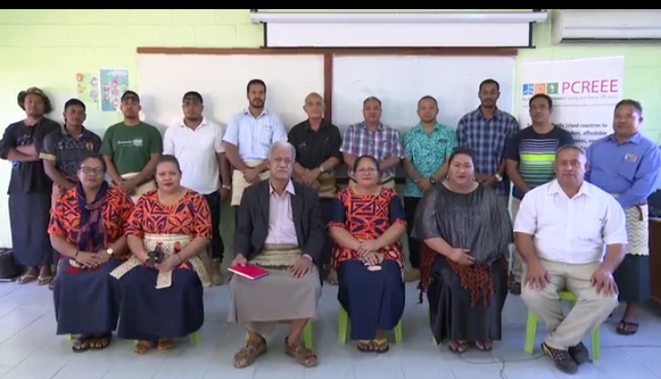
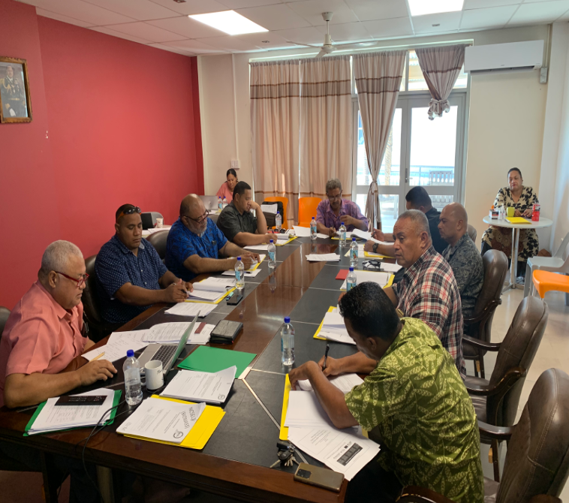
PCREEE Sustainable Energy Business Start-up and Entrepreneurship and Tsunami recovery subsidy
Tokoni ki hono fa’u e ng. faka’ilonga ako fakafonua ‘I he Ma’u’anga Ivi
Level 1 mo e 2 na’e kamata hono fakalele ‘I he ‘apiako Tu’uloa ka e pehee ki he Fokololo he 12 September 2022:
Toko 20 ‘I he Level 1 pea toko 30 ki he Level 2
Toki lesisita e Level 3 he 2023, pea fakaangaanaga ke kamata fakalele ‘I he ‘aho 4 Ma’asi ‘a ia ko e uike kaha’u.
Kei fa’u Level 4 he lolotonga ni.
Notes:
NSCE Level 1 & 2 successfully started on the 12 September 2022 with 20 students (71% female, 29% male) registered under Level 1 and 30 students for Level 2 (21% female, 79% male).
Subsidy scheme to increase RE&EE business opportunities
Promoting RE Business Start-ups and Entrepreneurship in the Rural Areas of Vanuatu

Slide 7
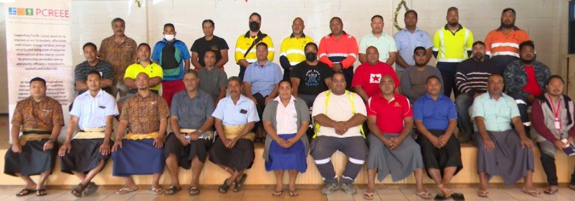
Tokoni ki hono fokotu’u ‘o e Electrical Contractors Association – e.g. kau laiseni fakauaea ‘uhila.

Slide 8
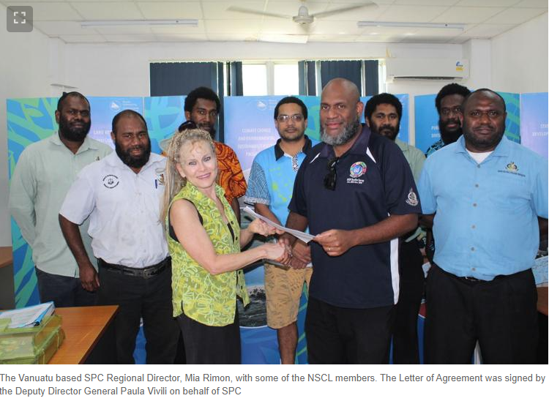
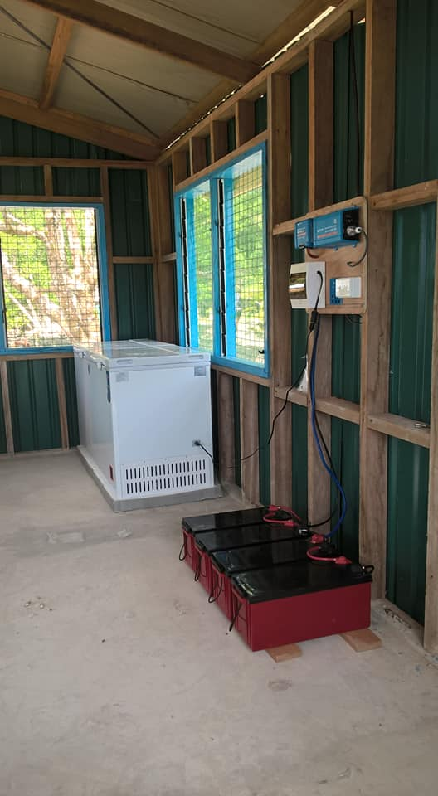
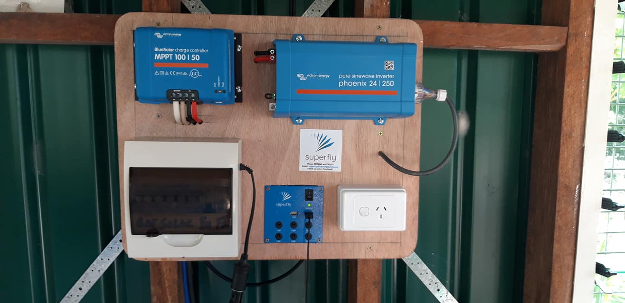
Fakaivia fakapa’anga ki he pisinisi taautaha ki hono fakalele ha ki’I pisinisi ‘oku fakafelave’I mo e ma’uanga Ivi tu’uloa (or RE & EE)
VANUATU - Navara Saving and Loan Society COMPLETED | SOLOMON IS – Tookina Tribal Land Conservation Association (TTLCA)- IN PROCESS

Slide 9
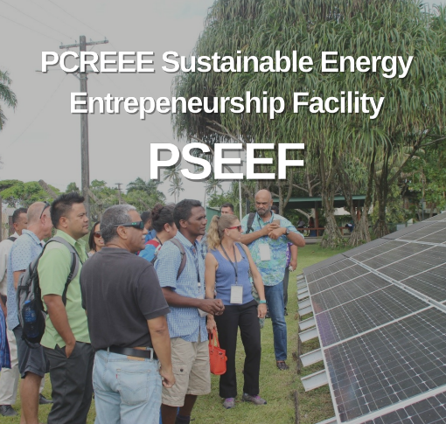
Founga ‘o e ki’I polokalama Fakaivia (PCREEE Sustainable Energy Entrepreneurship Support – PSEEF)
Malava ke tokonia fakapa’anga ‘aki e 30% ‘o e ng. totongi fakamole [total cost] ‘o e poloseki.
Fakataumu’a pe ki he ng. pisinisi iiki pe ko e kulupu ‘I ha komiunitii.
Ko e totongi ‘o e 30% kuo pau ke fakahoko ‘o fakatatau ki he founga mo e tu’utu’uni ngaue ‘a SPC.
Ko hono fokotu’u mo fakahoko ‘o e poloseki kuo pau ke ‘oua toe loloanga he ta’u ‘e 1.

Slide 10
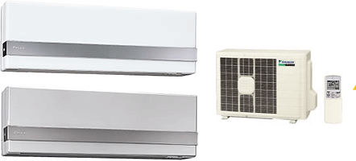
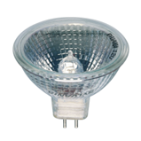
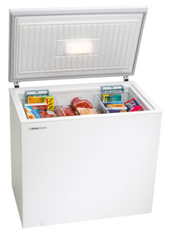
Minimum Energy Performance Standards & Labelling [MEPSL] program
Notes:
Polokalama ki hono faka’ai’ai e ngaue’aki e ngaahi naunau ‘uhila ‘oku

Slide 12
THE ENERGY RATING LABEL
Calculating Cost to Run [Compare the labels on two similar sized fridges]:
Annual Cost to Run = Energy Consumption (kWh) x Electricity Tariff (TOP/kWh)
Example – Kapau fie fakatau ha’o ‘aisi fo’ou ‘I Tonga, pea ko e totongi ‘o e ‘uhila ki he ‘iuniti (kwH) ko e TOP$1.10
 | ‘Aisi 1 | ‘Aisi 2
Lahi e fetu’u he Leipolo | Fetu’u e 3 | Fetu’u e 6
Lahi ‘o e fakamole ki he ‘aisi takitaha | 542 kWh x $1.10 = $596 .20 ki he ta’u | 318 kWh X $1.10 = $349. 80 ki he ta’u

Slide 13
MALO ‘AUPITO

